Slide 1

APNIC Update
Paul Wilson

Slide 2
APNIC news

Slide 3
Resource Certification
Digital certificates verifying resource holdings
  For security, routing, authorisation
  As per RFC
MyAPNIC certificate services
  Generation and management of certificates for all members and all resources
  In production from this week
Other services under development
  Provision of “hosted” service by EOY

Slide 4
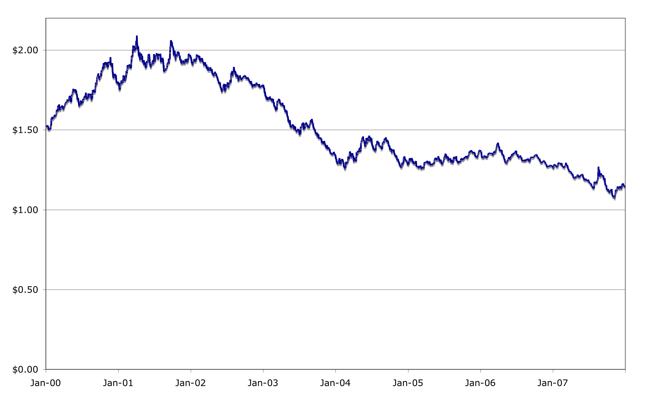
APNIC fees - USD exchange rate
AUD $1.27 *
Youch!
* Official AUD-USD exchange rate forecast for 2007, on which APNIC”s budget was based.

Slide 5
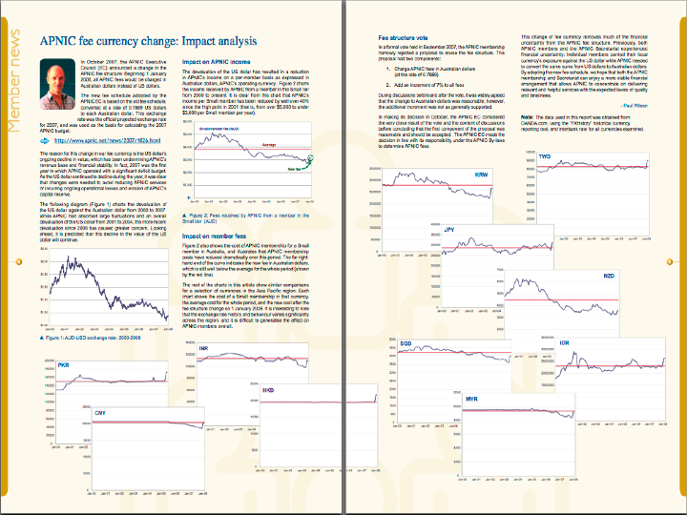
http://www.apnic.net/apster
http://www.apnic.net/apster

Slide 6
APNIC Survey 2009
Members and Stakeholder survey
  Bi-annual input to APNIC planning
  Independent – Dr John Earls, KPMG
  Anonymous response guaranteed
IP addressing survey
  IPv4 consumption and contingencies
  IPv6 transition planning
Schedule
  Preparations begin this week
  Survey release early December
  Report for APNIC 27, Manila, 2009

Slide 7

ISIF
Information Society Innovation Fund
  Competitive grants programme for innovation Internet technologies and applications
    Successor to PAN R&D Grants Programme
  IDRC, APNIC, ISOC and Dot Asia
  APNIC funded to provide secretariat and administrative support
  http://www.isif.asia

Slide 8
IP address status – IPv4 and IPv6

Slide 9
IPv6 status
Transition is slow
  Lack of user demand
  Lack of ISP deployment
  Slow vendor/software implementation
Why?
  Transition cost is significant
  No immediate or short-term ROI
  Business case is non-existent
  ISPs could deploy but choose not to

Slide 10
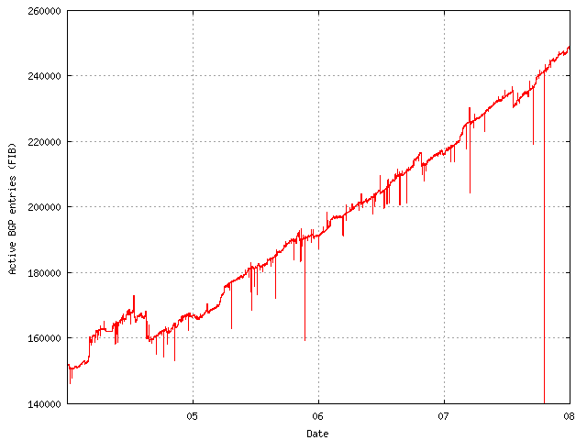
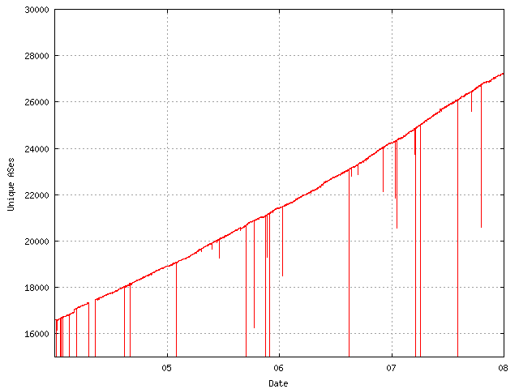
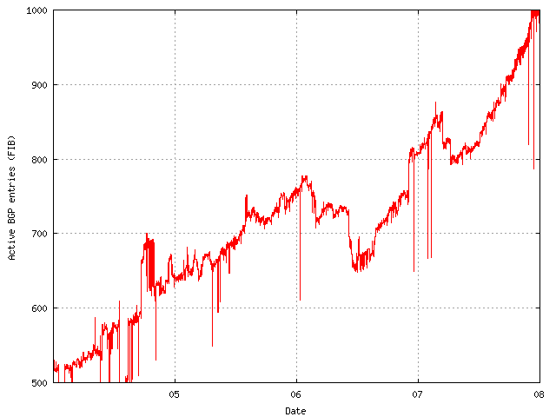
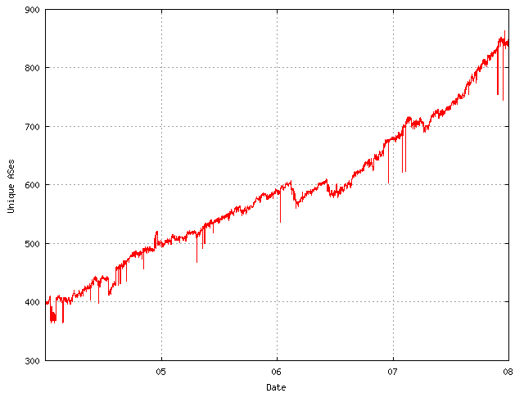
IPv6 status
250,000
27,000
67%
60%
IPv4
IPv4
ASN
1,000
850
100%
110%
IPv6
IPv6
ASN

Slide 11
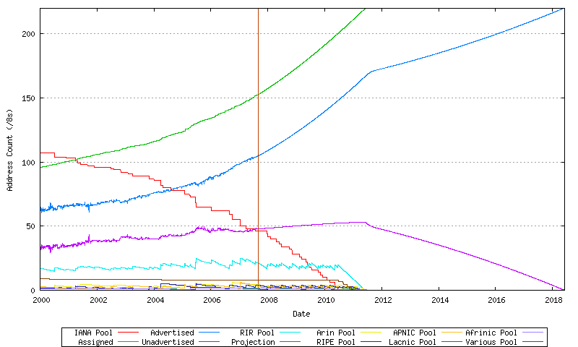
IPv4 status – Consumption
RIR allocations
Routing table
???
Historical Data
Projection
http://bgp.potaroo.net/ipv4

Slide 12
IPv4 status – Policies
Soft landing proposals
  IANA distribution of final /8s
  RIR use of last /8
  Review of legacy space utilisation
  Allocation timeframe (12 months to 6 months)
Transfer proposals
  Different RIR approaches
    APNIC and RIPE are most “liberal”
  Potential to allow a “market” for addresses
    Familiar mechanism for resource efficiency
    Complex and controversial issue

Slide 13
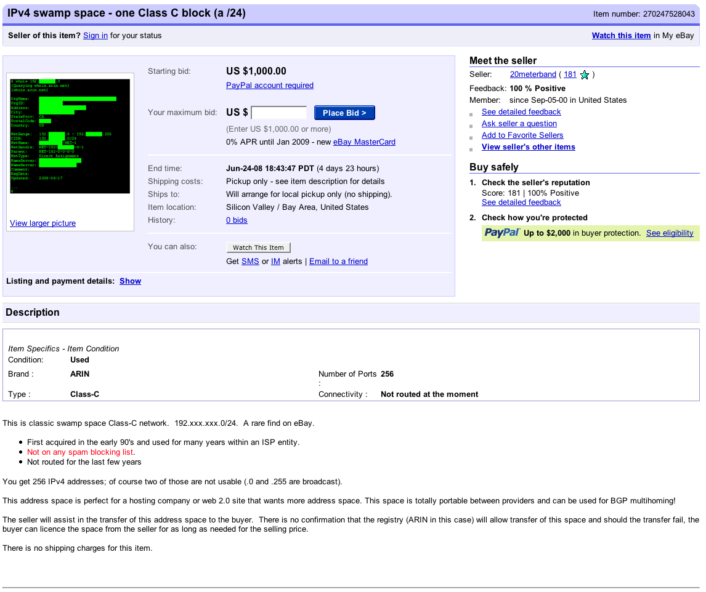

Slide 14
Where are we?
IPv4 free pools will be exhausted well before IPv6 transition is complete
  5 to 10 years
ISPs will continue to need IPv4 after 2011
  Where will they get it?
Options for RIRs
  Reclamation/redistribution of legacy space
  Facilitation and encouragement of transfer
  Do nothing?

Slide 15
Thanks
pwilson@apnic.net

