Slide 1

Asia Pacific Regional Internet Governance Forum (APrIGF)
Secretariat Updates
By DotAsia Organisation
AP* Retreat Colombo
2016-10-1

Slide 2
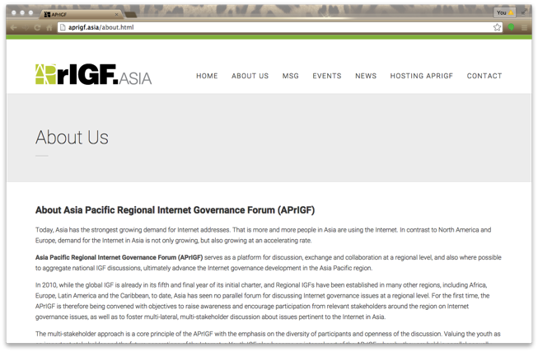
Asia Pacific Regional Internet Governance Forum (APrIGF) is one of the key regional initiatives on Internet governance which provides an open platform for multi-stakeholders to discuss and identify issues and priorities, and ultimately advances the development of Internet governance in the Asia Pacific region as well as bring forward and contribute to the wider global Internet community.
http://aprigf.asia
Notes:
An open platform for the multi-stakeholders to come together
Discuss and identify the issues that are relevant and important to our region
Advance the IG discussions within Asia Pacific and contribute to the global discussions
Community & Consensus driven Initiatlive on a voluntary basis
For collaboration

Slide 3


Notes:
Since the start of APrIGF,
Run in parallel the Youth IGF
Important element to engage youth and our next generation
Facilitated by NMA

Slide 4
Past APrIGFs & YIGFs
Hong Kong 2010 (Jun 15-16)
Singapore 2011 (Jun 16-17)
Tokyo 2012 (Jul 18-20)
Seoul 2013 (Sep 4-6)
Delhi 2014 (Aug 3-6)
Macau 2015 (Jun 29 – Jul 3)
Taipei 2016 (Jul 26 - 29)
Notes:
- 1st year started in 2010 after IGF Egypt
Participation from Asia Pacific region still low back then
Since then we grow in scale and becoming more formalize

Slide 5
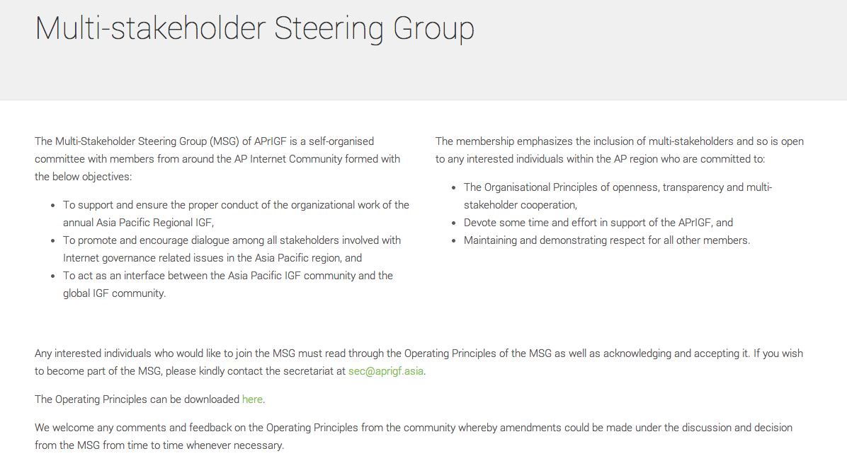
Multi-Stakeholder Steering Group (MSG)
To support and coordinate the organizational work under the Operating Principles with an emphasis on openness, transparency and multi-stakeholder cooperation
Promote and encourage the dialogue of Internet Governance related issues in the Asia Pacific Region and act as the interface between global IGF community
Chair (2015 – 2017)
  Mr. Paul Wilson, Director General of APNIC (Technical)
Vice Chairs:
  Mr. Chester Soong, ISOC Hong Kong (2016-2018) (Civil Society)
  Mr. Arun Sukumar, Observer Research Foundation, India (2015-2017) (Civil Society)
Notes:
Self-organized committee formalized in 2013 with the Operating Principles
To support and coordinate the organizational work
Promote and encourage the dialogue of IG related issues in AP
Interface between global IGF community
Openness, transparency and multi-stakeholder cooperation
Open to any interested individuals from the AP region who are willing to commit
e.g.

Slide 6
Multi-Stakeholder Steering Group (MSG)
msg@aprigf.asia
  Current members: 85
  (Active Members: ~35 as of Aug)
  Committees:
  Program Committee
  Fellowship Committee
  Drafting Committee
  Election Committee
Monthly/Bi-weekly teleconference meetings
Annual F2F meeting at AP* retreat & IGF meeting
Meeting archives available online
Notes:
5 Government - 2 from Oceania (Vanuatu & Nauru)
5 Private Sector –
1 Youth recently joined

Slide 7
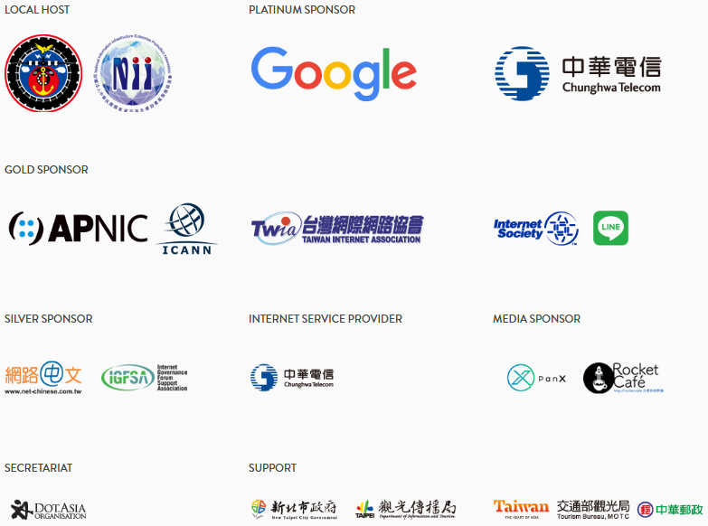
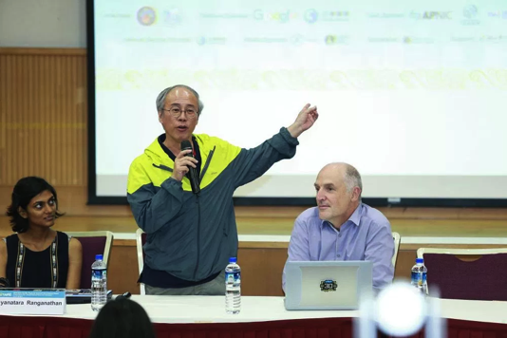
APrIGF 2016 (https://2016.aprigf.asia)
Date: July 26 (Pre-event), July 27 – 29 (Main Conference)
Venue: NTUH International Convention Center, Taipei
Theme: A New Internet Era – Merging Physical Space with Cyberspace
Local Hosts:
  NIIEPA
  MOTC of
  Taipei Government
Notes:
MOTC – Ministry of Transportation & Communications
100 participants from local
Fellowship Program – received 127 applications supporting speakers, enhancing diversity

Slide 8
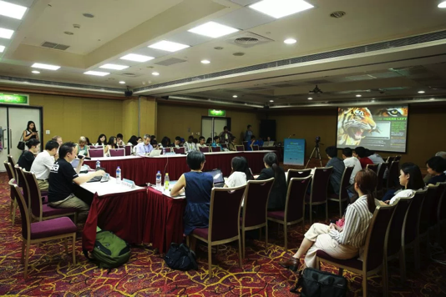
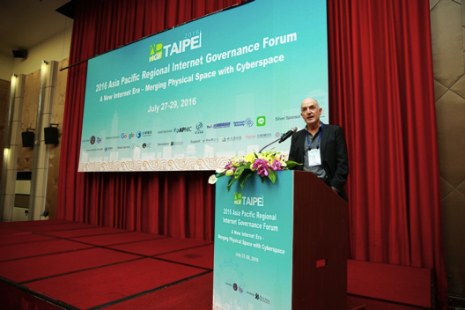

APrIGF 2016 Statistics
Total Participants:
  317 ( Overseas 200; Local 117) (including yIGF)
  from 26 countries/districts
  including 42 government representatives from 11 countries/districts
Number of Sessions: 30 parallel sessions & 4 plenaries
Number of Speakers: 110
Number of Fellows: 19 (Out of 127 applications)
Total Expenses: USD$221,530
Notes:
Approx - Fellows: US$34,608

Slide 9
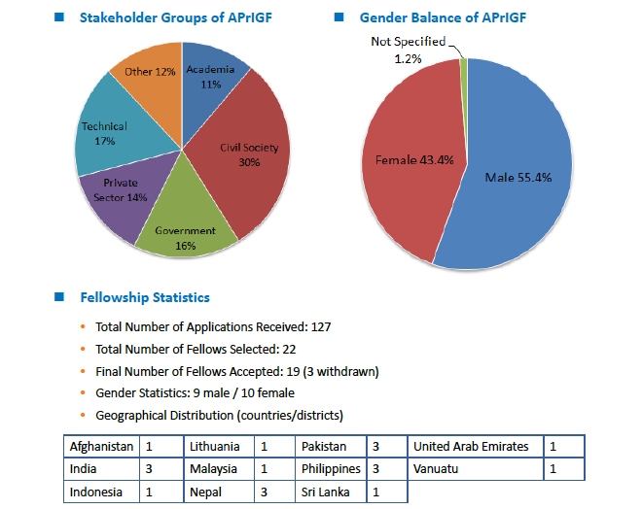
APrIGF 2016 Statistics

Slide 10
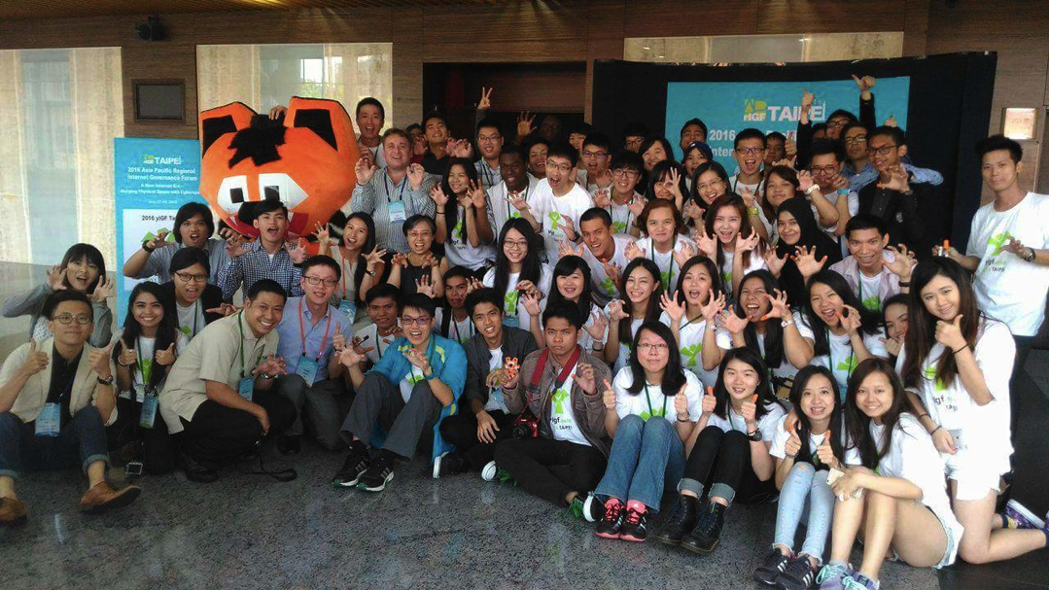
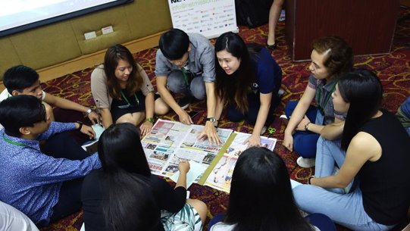
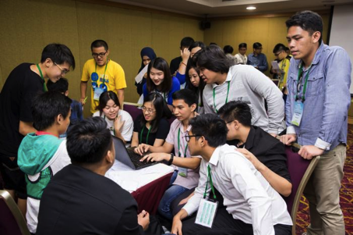
YIGF 2016
Total number of Youth Participants: 50
  21 Philippines, 4 Thailand, 1 Malaysia, 24 Taiwan
  7 facilitators from Hong Kong (NetMission)
Report available at: https://2016.aprigf.asia/archive/
Notes:
YIGF: 50 (21 Philippines, 4 Thai, 1 Malaysia, 24 Taiwan)
Discussions on SDGs
How Internet Governance is enabling that
Role Play on
Privacy, Security, Cyber Bullying, Filtering, Internet Access, Rights and Regulations
The discussion topics are as follows,
1) What are the roles and responsibilities of Search Engine/Commerce in the Internet? Under the multi-stakeholder model, how can each stakeholder govern the Internet architecture? How can people prevent being trapped in the Information bubble?
2) Is cyber bullying inevitable? How to draw the line between joking, trolling and cyber bullying? How can each stakeholder help prevent or stop cyber bullying? What are the rights and responsibility of Internet users when it comes to online speech or actions?

Slide 11
Organize your local YIGF!
Core Elements:
  Idea Wall
  Multi-Stakeholder Role-Play Discussions
  Internet Governance Games
  Attend APrIGF Workshops
Toolkits Now Available:
http://www.netmission.asia/training-materials/
**Good News! NIIEPA announced their commitment to organize the 2017 YIGF Taipei
Notes:
Vietnam and Malaysia

Slide 12
APrIGF Program Agenda
- 94 Workshop Proposals Received!
- 44 proposals accepted
- 30 parallel sessions (including mergers)
- 4 plenaries (Opening, Closing, Townhall Sessions)
Sub-Themes:
The Future of Impact of IANA Transition - 1
Security - 4
Human Rights - 10
Impacts of International Agreements and Policies - 1
Universality - 4
Cyber Connectivity – 4
Multi-Stakeholder Model - 4
Others - 2
Notes:
A New Internet Era – Merging Physical Space with Cyberspace
1. The Future Impact of IANA Transition The IANA transition proposal is expected to be submitted to USG sometime in the early 2016. There are many new designs arising from the proposals, from those related to institution to those of mechanism, some of which are very different from what we are used to. How does it work? What is changed? What may be the impact?
2. Security Cyber Security, the protection of information systems from damage and disruption, is critical not just to the stability of cyberspace, but also increasingly important to the physical world. At the same time, Privacy and Data Protection are also hot issues that nations are grappling with in this new era. Where is the balance between security and privacy/data protection?
3. Human Rights Human rights are central to a “New Internet Era.” Human rights standard should apply to the internet environment in the areas of access and development, freedom of expression, right to assembly and privacy as well as on the right to education, health, culture and to a broad range of other rights. The impacts of new laws and policies on cyber-security, data protection, surveillance, anonymity, intermediary liability on human rights have been subject to intense scrutiny and debate by all stakeholders.How should human rights online be enforced, and by whom? What are the main instruments to engage all sectors and make them accountable for human rights protection? How are new laws pertaining to cybersecurity affecting freedom of expression, assembly, and privacy online? What protections exist in different countries, and what best practices are being developed? What standards for human rights protection should ICT companies, service providers and infrastructure providers follow?
4. Impacts of International Agreements and Policies Trans-Pacific Partnership (TPP)’s and a couple of other multilateral free trade agreements’ impact to Cyberspace. Concluded recently, TPP’s implication extends to intellectual property (such as copyright and domain name dispute resolution) and cross-border data flow issues, while US congress did not approve SOPA. What will be the impact on ccTLDs, etc? What are the impacts of such agreements on Internet community?
5. Universality The next era will involve global changes to the Internet, such as the deployment of IPv6, and internationalized domain names and email addresses. What progress is being made, and how can we do more towards these important global developments?
6. Cyber Connectivity Increased connectivity is driving digital transformation at unprecedented rates and has the potential to bridge the digital divide and even wealth gap. It is also changing traditional business models – one of the more recent developments has been the growth of IoT (Internet of Things) and ubiquitous use of technology, from the global industrial economy right down to our personal lives. What developments can we expect in the new era, what potential do they hold?

Slide 13
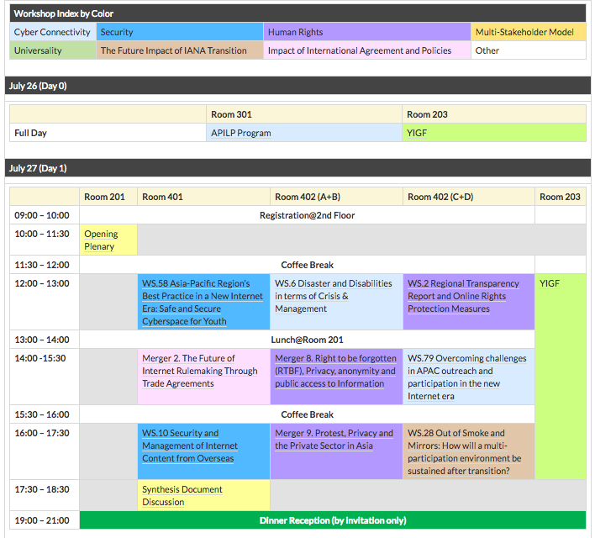

Slide 14
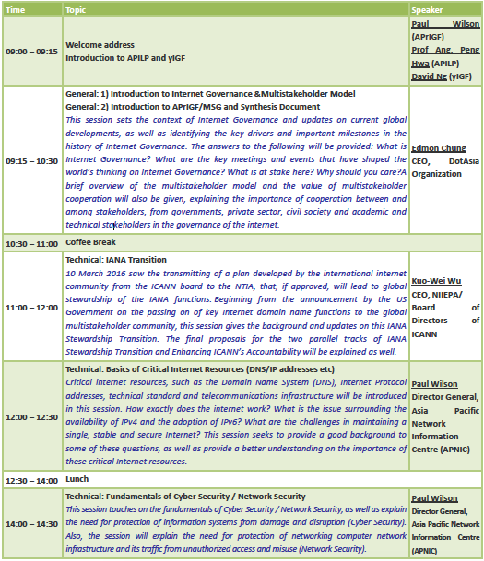
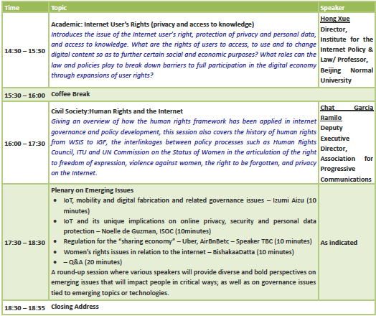

Asia Pacific Leadership Internet Program (APILP)

Slide 15
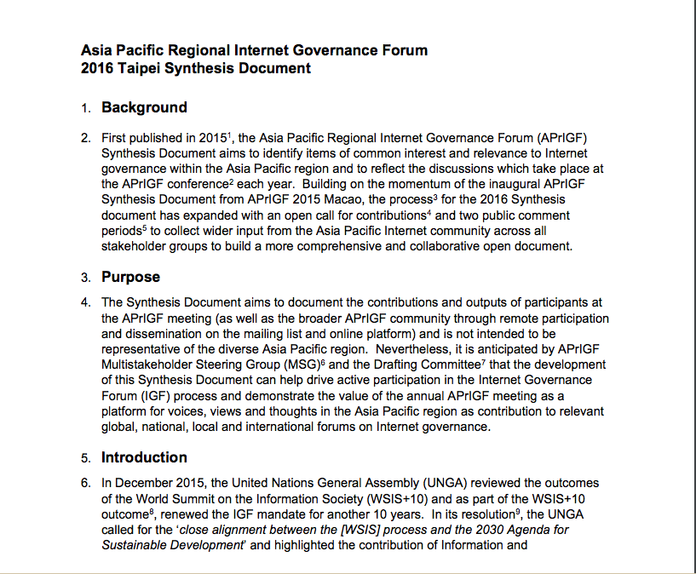
Synthesis Document 2016
Notes:
Background
First time experiemented in Macau 2015 hoping to engage a wider AP community on the discussion
it is the hope of the APrIGF MSG that the development of the Outcomes Document can help drive active participation in the movement, as well as to allow for a platform to project voices, views and thoughts in the Asia Pacific region as contributions to relevant global, national, local and international forums on Internet Governance.
- With the success, we continue this year with a longer process for public input to include a wider community
- With special highlights on the Intersessional work on Connecting the Next Billion,
- And also considering the SDGs set forth by UN for the 2030 agenda

Slide 16
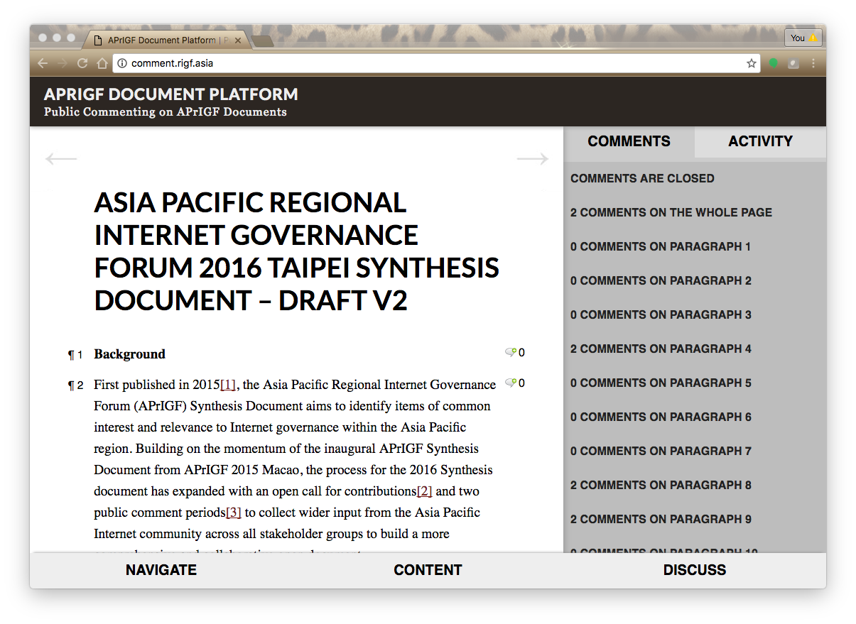
Synthesis Document 2016

Slide 17
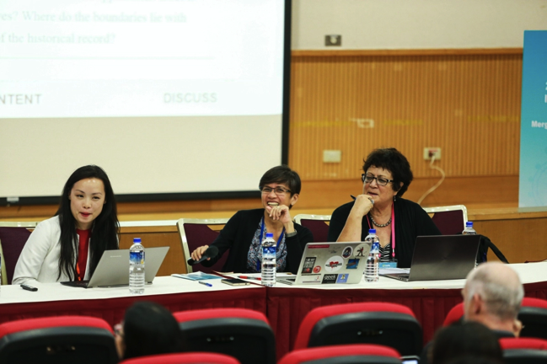
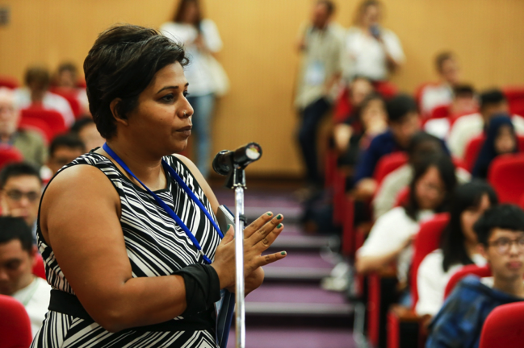
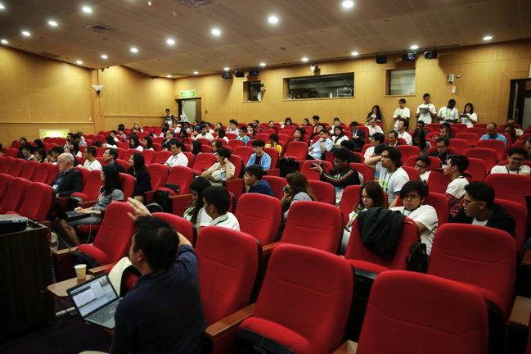
Way of Contribution
Drafting Committee to synthesize the document based on the community contributions.
Total number of comments received: 156 online
Pre-Conference
Thematic Comments Submission (17 May – 30 May)
Public Comment on Draft 0 (9 Jun – 9 Jul)
On-Site
Townhall Sessions (27 – 29 Jul)
Public Comment on Draft 1 (21 Jul – 5 Aug)
Post Conference
Public Comment on Draft 2 (15 Aug – 26 Aug)

Slide 18
Synthesis Document 2016
Continuing Efforts in Bringing the Next Billion Online
Security
Human Rights & Internet
The Multi-Stakeholder Model
Digital Economy & Trade
Future Impacts
Final Version Published on 9 Sep –
https://2016.aprigf.asia/synthesis/
Notes:
- With special highlights on the Intersessional work on Connecting the Next Billion,
- And also considering the SDGs set forth by UN for the 2030 agenda

Slide 19

Host: AuDA
Date: Oct 2017 (TBC)
Stay tuned to submit your workshop or apply for fellowship!
Remote Participation is also available.
APrIGF Melbourne 2017

Slide 20
Join the APrIGF Processes
Subscribe to announce@aprigf.asia to receive news and announcements from APrIGF
Join discuss@aprigf.asia to share any updates and discuss with other stakeholders in the AP region on Internet governance related issues.
Join the decision making process by joining the Multi-Stakeholder Steering Group (MSG)
Any enquiries, please send to sec@aprigf.asia
If you would like to list any Local IGFs initiatives at our events page, please kindly contact the Secretariat.
Notes:
National IGFs
Self-organized committee
To support and coordinate the organizational work
Promote and encourage the dialogue of IG related issues in AP
Interface between global IGF community
Openness, transparency and multi-stakeholder cooperation
Open to any interested individuals

Slide 21

Internet Governance is Fun! Join us =)

