Slide 1
China’s Internet and
Internet Society of China (ISC)
Kaili Kan, Ph.D. ALAC, ICANN
Oct. 1, 2016 APNIC 42
Colombo, Sri Lanka

Slide 2
China’s Internet
Largest coverage:
  ~800 million end-users
Deep penetration:
  Into remote rural areas
  Into about every industry
Huge Internet corporations
  Tencent, Alibaba, Baidu, …
  Significant economic and social impact

Slide 3
Internet Society of China (ISC)
Established in 2001
Current membership
  821 corporate members
  56 academic members
Works closely with the government (MIIT)
Multi-stakeholder model
  Scholars representing consumer interests

Slide 4
ISC’s Mission
Serve the needs of members:
  Protect consumers’ interests and rights
  Corporate members’ interest
Promote the development of Internet in China
Assist the Government in policy-making

Slide 5
ISC Working Groups (1)
Network and Information Security Committee
Internet Self-discipline Committee
Anti-spam Committee
Internet Copyright Committee
Academic Committee
Application Innovation Committee
Rural Services Committee

Slide 6
ISC Working Groups (2)
Cross-strait Internet Exchange Committee
IOT Committee
Finance Committee
Shared-economy Committee
Vehicle Internet Committee
Legal Affair Committee
Medical Application Committee
On-line Culture and Media Committee

Slide 7
ISC Initiatives
Industry Self-discipline
Anti-spam
Internet Copyright protection
Network Security
E-Charity
Information Accessibility
Internet Corporate Credibility
Honors / Awards

Slide 8
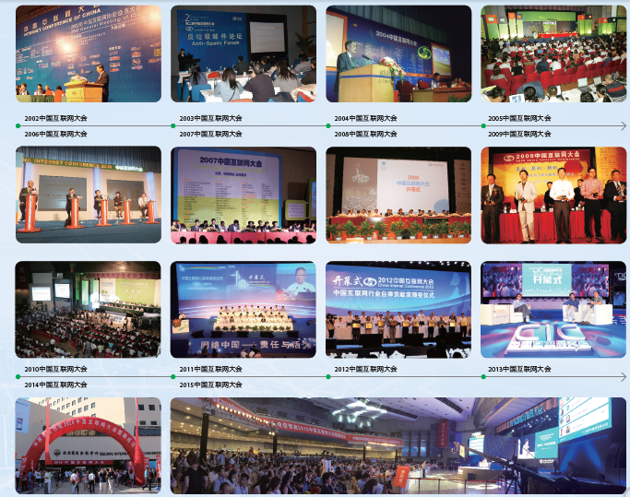
China Internet Conference (CIC)

Slide 9

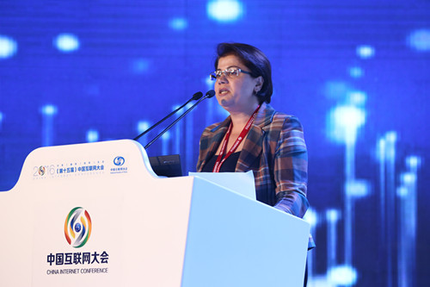

APRALO at CIC 2016

Slide 10
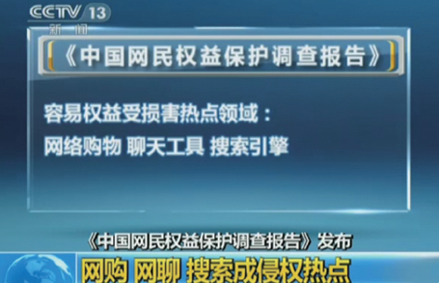
Protecting Consumer Rights
ISC’s Survey on Consumer Internet-Rights Protection
(CCTV aired nation-wide)

Slide 11
Internet Industry Self-discipline
Pledge of Self-regulation and Ethics
Code of Conduct in E-mail Services
Code of Conduct in relation to pornography
Self-discipline on Internet Search
Self-discipline on terminal Security
Self-discipline on Internet copyrights
…… (total 30 self-discipline / code of conducts by April 2016)

Slide 12
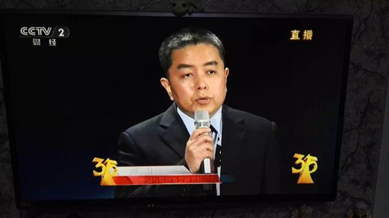
ISC calling to protect consumer data at 2016 CCTV’s “3.15” Gala

Slide 13
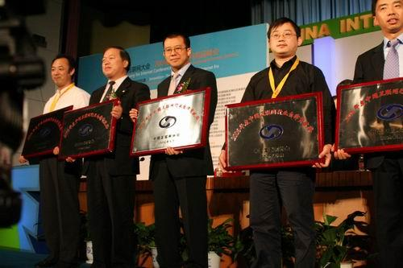
Self-Discipline Award
Starting 2005, ISC presents annual “Internet Self-discipline Award”

Slide 14
Protecting Internet Environment
ISC created (2007.5) and leads “Green Network Alliance” to create healthy network culture for teenagers
Recommend websites to consumers
Regular self-discipline and mutual-checking among ISC members

Slide 15
ISC on Anti-spam
Works together with top ESPs
“White List” covers 85% of domestic ESPs
Released 9 reports, covered 203,197 IP addresses sending spam
From 2003 to 2011, spam decreased from 65.72% to 40.10%
Global ranking of China-sent spam dropped out of top-12 (source: Sophos 2012)

Slide 16
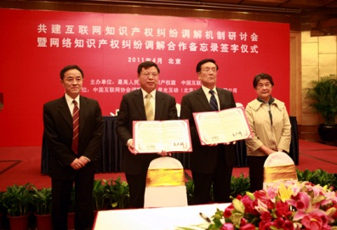
ISC on Copyright Protection
2005.9: Published convention on Internet copyrights
Training programs, workshops, case studies
2008: Mediation Center to solve disputes

Slide 17
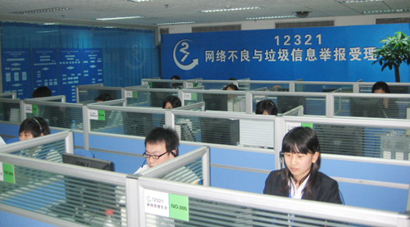
12321 Report Center
Feb. 2006: Spam reporting center
Apr. 2008: 12321 E-message Complaint & Reporting Center (hotline, website, email, SMS, WAP, APP, etc.)

Slide 18







Reporting Info received in 2015
607,000
Total: 1.852 million
420,000
316,000
256,000
133,000
2,000
Spam
Email
Spam Text Messages
Mal-APP
Telephone
Fraud
Spam
MMS
Phishing/
Cyberporn

Slide 19
ISC on Network Security
2006.10: published definition of mal-ware and channel for consumer complaints
Assigned institution to evaluate software and recommend removal tools
Reported mal-ware decreased by 80%

Slide 20
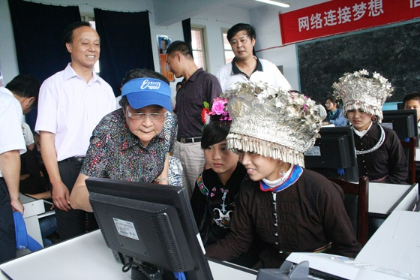
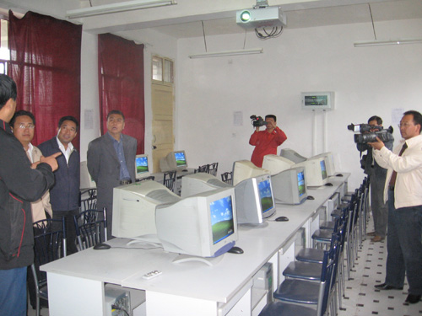
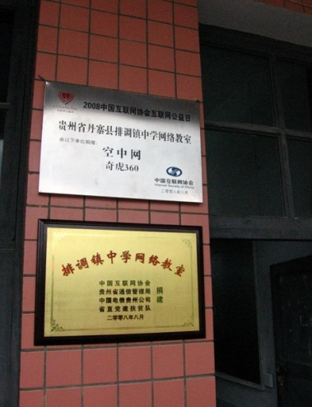
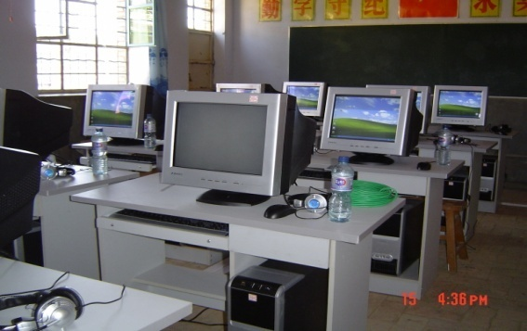
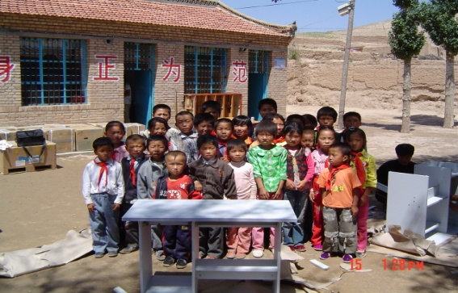
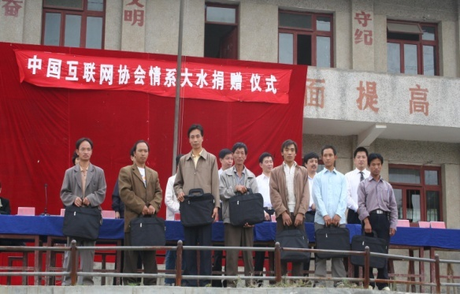
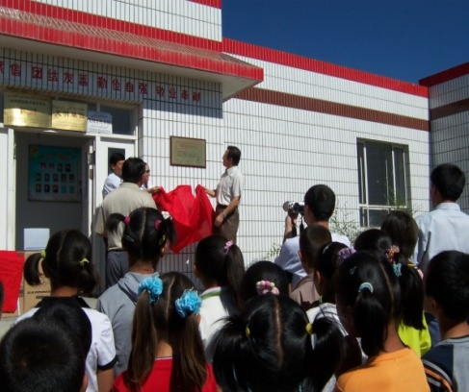
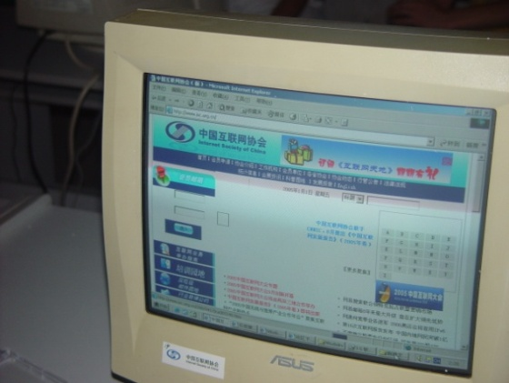
ISC on E-Charity
Since 2005, May 25 became “e-Charity Day” in order to shrink the digital divide

Slide 21
Thank you!
Q&A
kankaili@gmail.com

