Slide 1
APNIC Foundation Update for AP*
Duncan Macintosh
CEO
APNIC 44 Taiwan

Slide 2
Grants

Slide 3
DFAT grant 2017-18
Funding source: DFAT’s Cyber cooperation program to build capacity in the Indo-Pacific - raising cybersecurity capability and awareness
Proposal: A secure and resilient internet infrastructure for development in the Pacific.
Amount: AUD 200,000 over two years (July to July)
Economies: Cook Islands, Fiji, Kiribati, Marshall Islands, Papua New Guinea, Samoa, Solomon Islands, Tonga, Tuvalu and Vanuatu

Slide 4
DFAT grant cont.
CERTs established* or proposed: Fiji, Papua New Guinea, Samoa, Vanuatu and Tonga*
Next in line: Cook Islands, Kiribati, Marshall Islands, Solomon Islands, and Tuvalu
Activities: Surveys, training workshops, cybersecurity drills, technical assistance, community events, fellowships, monitoring and evaluation, seed funding

Slide 5
ISIF Asia 2017
Funding source: APNIC
Amount: AUD160,000
Proposal: Three grant categories and one award
Activities:
Internet Operations Research (AUD85,000)
Cybersecurity (AUD30,000)
Internet for Development (AUD30,000)
ISIF award (AUD15,000 includes AUD 5,000 for logistics)

Slide 6
Internet Society 2016-17
Funding source: ISOC
Amount: AUD 56,000
Proposal: Cybersecurity - Developing Tonga National CERT
Activities:
Training
Technical assistance and mentoring
Participation at the Internet Governance Forum 2016 workshop “Cybersecurity – Initiatives in and by the Global South“.

Slide 7
Proposals in Process

Slide 8
DFAT second proposal 2017-18
Funding source: DFAT’s cyber cooperation program to build capacity in the Indo-Pacific - raising cybersecurity capability and awareness
Proposal title: A secure and resilient internet infrastructure for development in the Pacific - Samoa.
Amount: AUD 50,000 approx.
Economies: Samoa

Slide 9
IDRC 2018
Funding source: IDRC’s Networked Economies program
Proposal title: Seed Alliance - an alliance to scale digital innovation
Amount: CAD 300,000 (CAD 100,000 for ISIF Asia)
Timeframe: Nov 2017 - Oct 2019
Activities:
  Scaling-up digital innovation across the three regions in projects focusing on gender inclusion; and
  To foster women’s leadership in the Internet for development sector

Slide 10
IDRC – ISIF Asia
Amount: CAD 100,000
Activities:
One scale-up grant of CAD 40,000
One small grant of CAD 30,000 (CAD 20,000 from IDRC grant and AUD 10,000 from an APNIC contribution);
One award of CAD 5,000 on gender equality (with a travel grant for IGF awards ceremony)
One fellowship for the scale-up grantee to attend 2018 AVPN conference.
ISIF Asia 10th anniversary activities support CAD 10,000

Slide 11
Internet Society 2018
Funding source: ISOC Community Networks Grants and Awards 2018
Proposal title: Seed Alliance: Connecting the Last Mile
Amount: USD 100,000
Activities: Four grants and two awards to support the development of community networks across the global south
ISIF Asia: One USD 20,000 grant and one USD 10,000 award (includes IGF Fellowship)

Slide 12
The fund raising cycle
7. INVOLVE
1. IDENTIFY
6. NEGOTIATE / CLOSE
2. RESEARCH / EVALUATE
Needs
5. ASK
3. PLAN CULTIVATION
4. INVOLVE / CULTIVATE

Slide 13






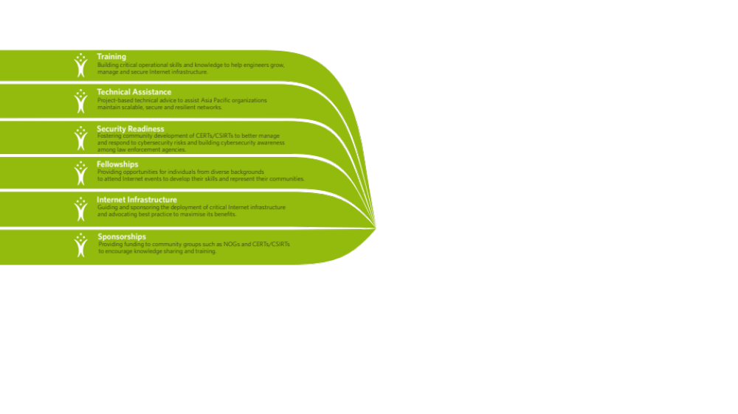
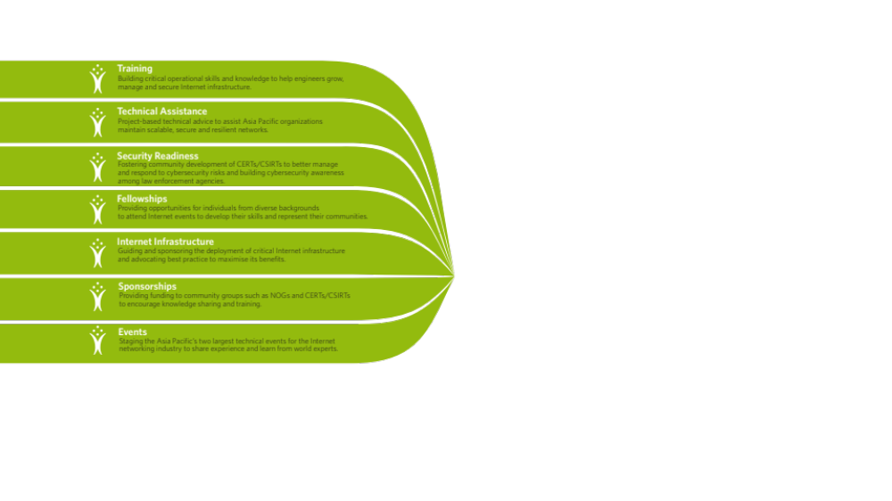
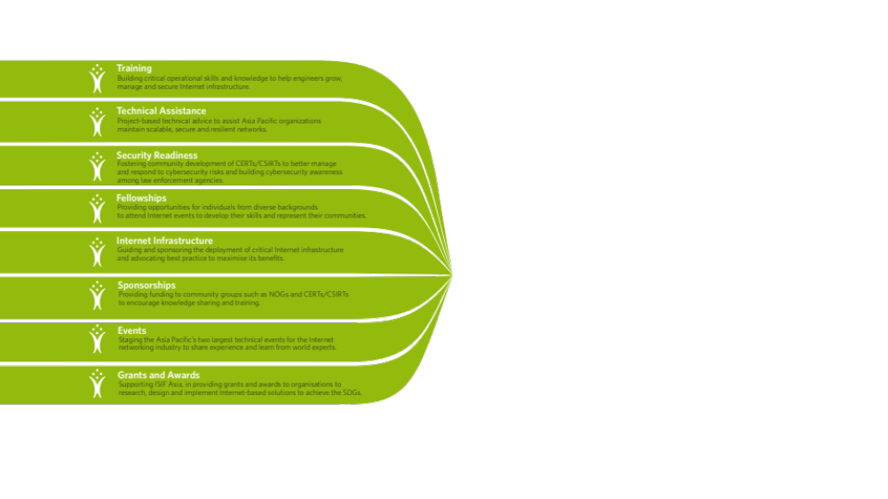
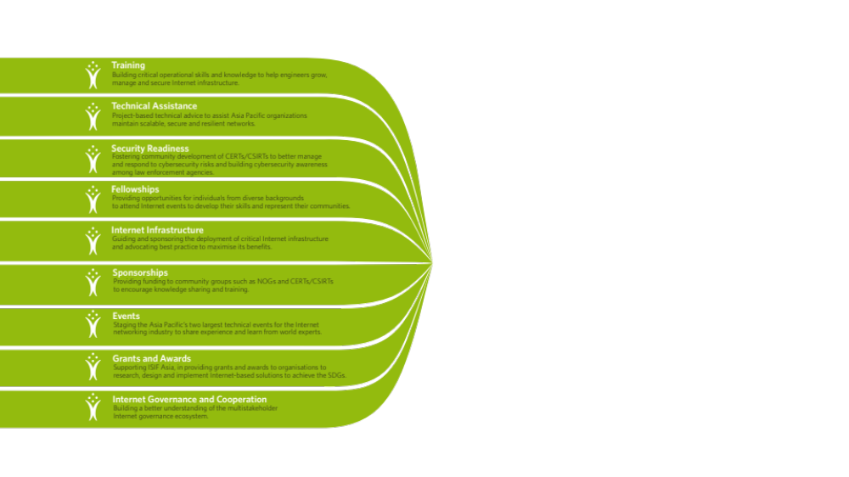
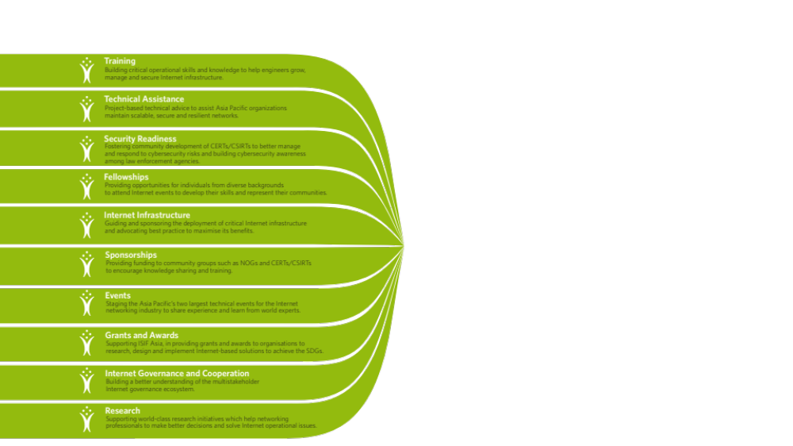
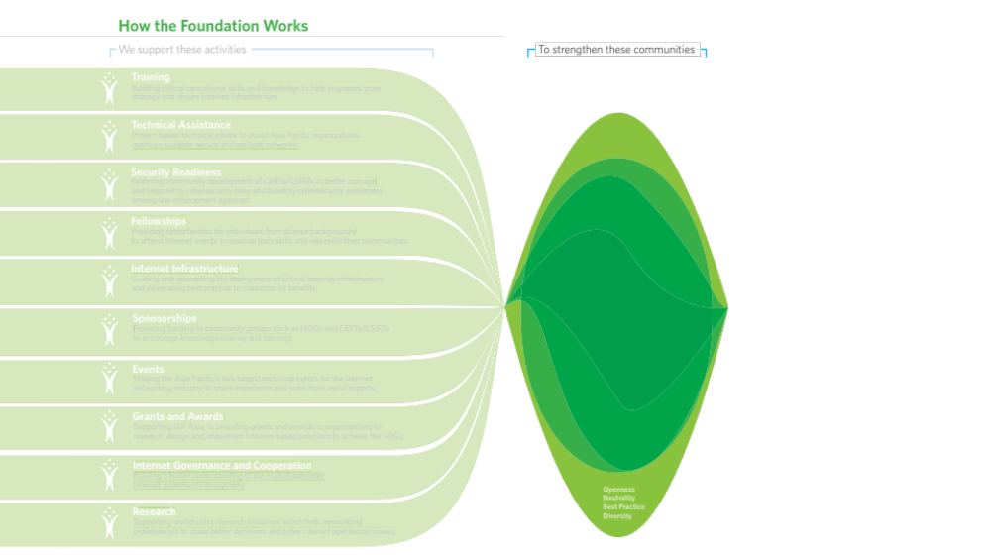



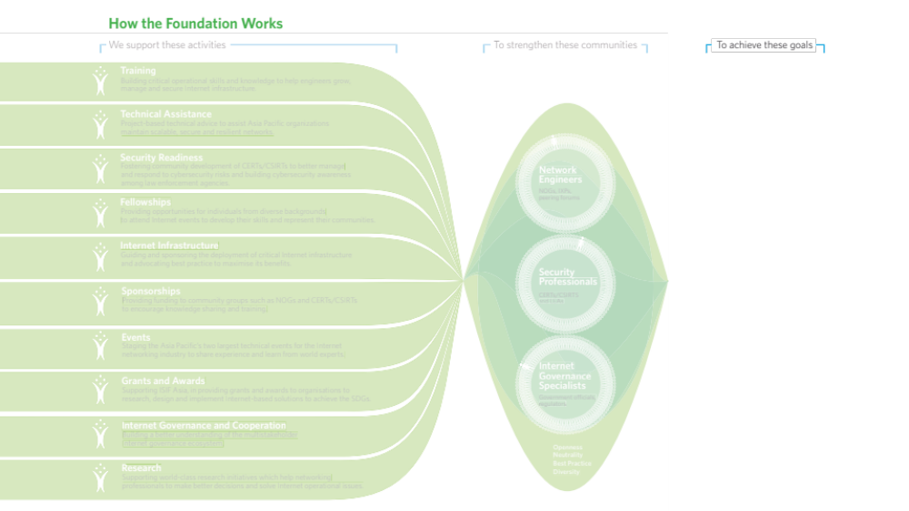




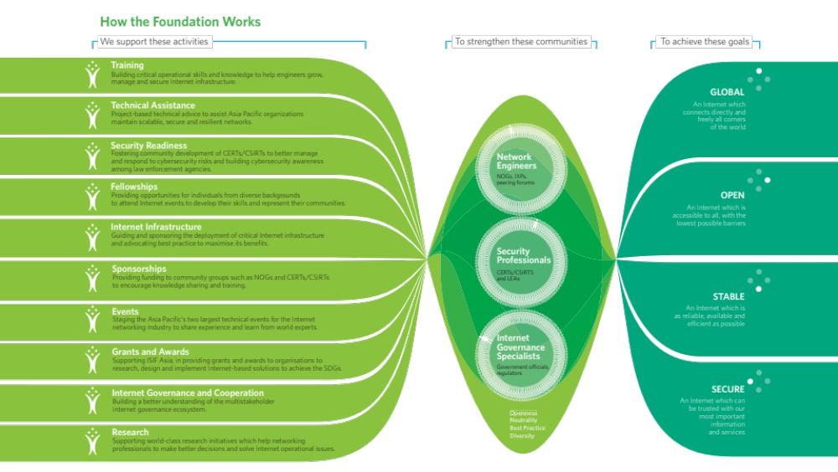

Slide 14
2018 activity plan
Develop board-led strategic plan (with supporting operational and fund-raising plans)
Support and implement Board-initiated fund-raising opportunities
Establish Advisory Council
Identify, document and engage at least 2 new (potential) donors a month
At least five project proposals (from 2018 APNIC priorities) developed for funding, including matching fund (dollar-for-dollar) strategy
Project/grant management and implementation

Slide 15
Thank you

