Slide 1
APCERT Activities
Asia Pacific Computer Emergency Response Team
February 2017
Notes:
As I am in charge of APCERT Secretariat business, I would like to talk about APCERT activities for global collaboration.
1

Slide 2
About APCERT
Asia Pacific Computer Emergency Response Team
  Forum of CSIRTs in the Asia Pacific region
  Established in February 2003
  Annual Events
    1. APCERT AGM & Conference
    2. APCERT Drill (Simulation exercise of cyber attacks)
  APCERT Annual Report
    Includes APCERT team reports on incident trends, statistics, new projects, and more
Notes:
2

Slide 3



Objectives
Encourage and support regional and international cooperation on information security in the Asia Pacific region;
Develop measures to deal with large-scale security incidents;
Facilitate information sharing and technology exchange;
Promote collaborative research and development on subjects of interest to members;
Network Security Cooperation
Assist CSIRTs in the region to conduct efficient and effective security emergency response capability;
Emergency Response
Hold conduct an annual conference to raise awareness on computer security incident responses and trends.
Computer Security Awareness
Copyright © 2008 APCERT
Notes:
3

Slide 4
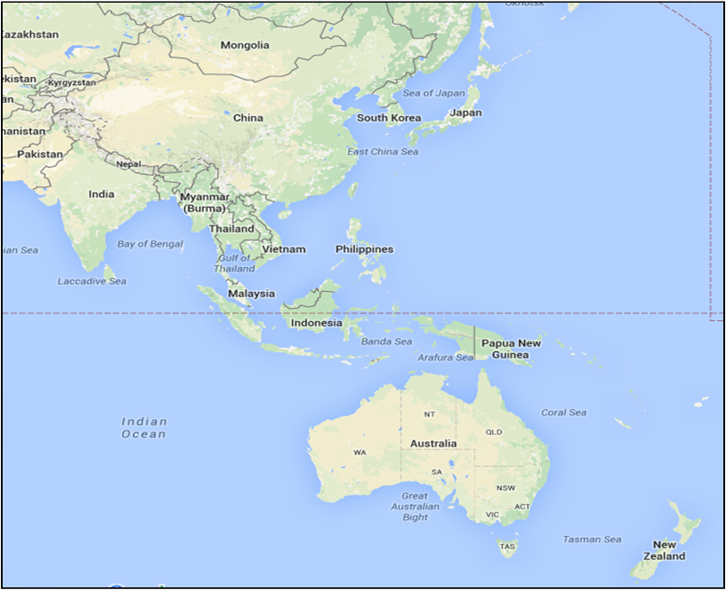
APCERT Operational Members
(28 Teams from 20 Economies)
Mongolia
MNCERT/CC, MonCIRT
Japan
★JPCERT/CC
China
★CNCERT/CC, CCERT
South Korea
★KrCERT/CC
Bangladesh
bdCERT
Taiwan
★TWNCERT, TWCERT/CC, EC-CERT
India
CERT-In
Hong Kong
HKCERT, GovCERT.HK
Myanmar
mmCERT
Macau
★MOCERT
Sri Lanka
Sri Lanka CERT|CC TechCERT
Vietnam
VNCERT
Brunei
BruCERT
Laos
LaoCERT
Indonesia
Id-SIRTII/CC, ID-CERT
Thailand
ThaiCERT
Australia
★CERT Australia(Chair), AusCERT
Malaysia
★MyCERT
New Zealand
National Cyber Security Centre
Singapore
SingCERT
Supporting Members (3)
Bkav (Vietnam), Microsoft, Secureworks
★Steering Committee

Slide 5
APCERT Working Groups
Malware Mitigation WG (Convener: MyCERT)
Information Sharing WG (Convener: CNCERT/CC)
Membership WG (Convener: KrCERT/CC)
Policy, Procedures and Governance WG (Convener: CERT Australia)
Training WG (Convener: TWNCERT)
TSUBAME WG (Convener: JPCERT/CC)

Slide 6
Current APCERT Priorities
Development of a Capacity Building Strategy for APCERT
Strengthening APCERT training activities
Expanding APCERT membership and (global) partnerships
Information classification and sharing mechanisms
Notes:
6

Slide 7
Thank you!
APCERT General Contact:
apcert-sec@apcert.org
APCERT Website:
https://www.apcert.org
Notes:
7

