Slide 1
APNIC Update
AP* Retreat, Melbourne
17 February 2020

Slide 2
Membership
Notes:
At the end of 2019, APNIC direct membership stood at 7,769, an increase of 7.8% on 2018. In addition there was 9,116 NIR sub accounts, after growth 6.5% in 2019. Total combined membership was 16,885.

Slide 3
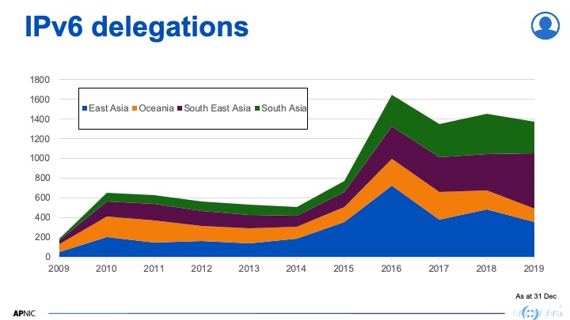
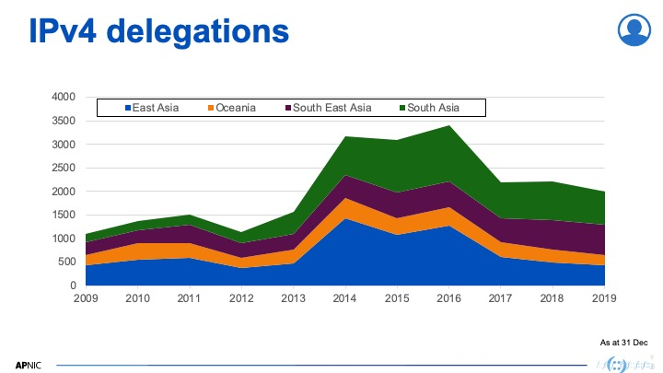
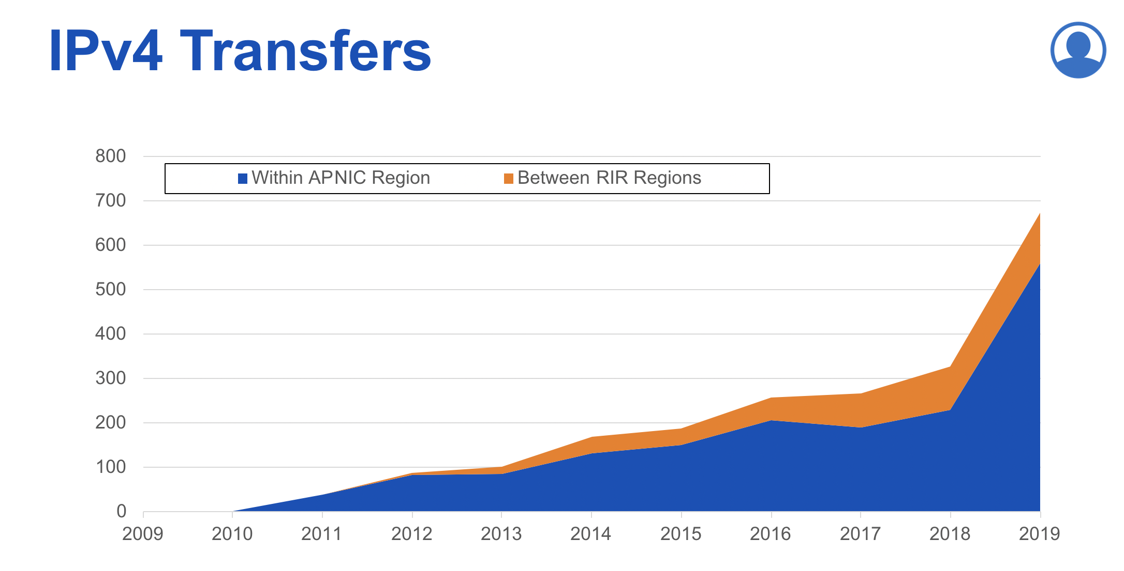
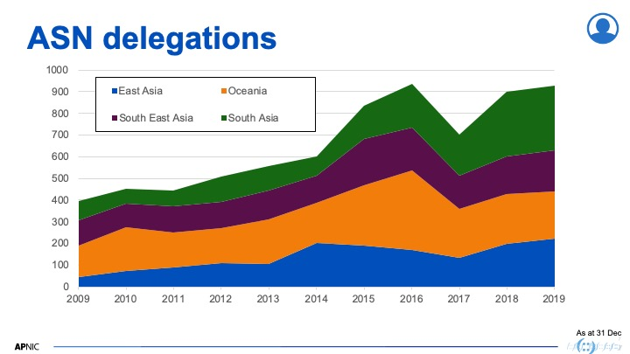

Slide 4
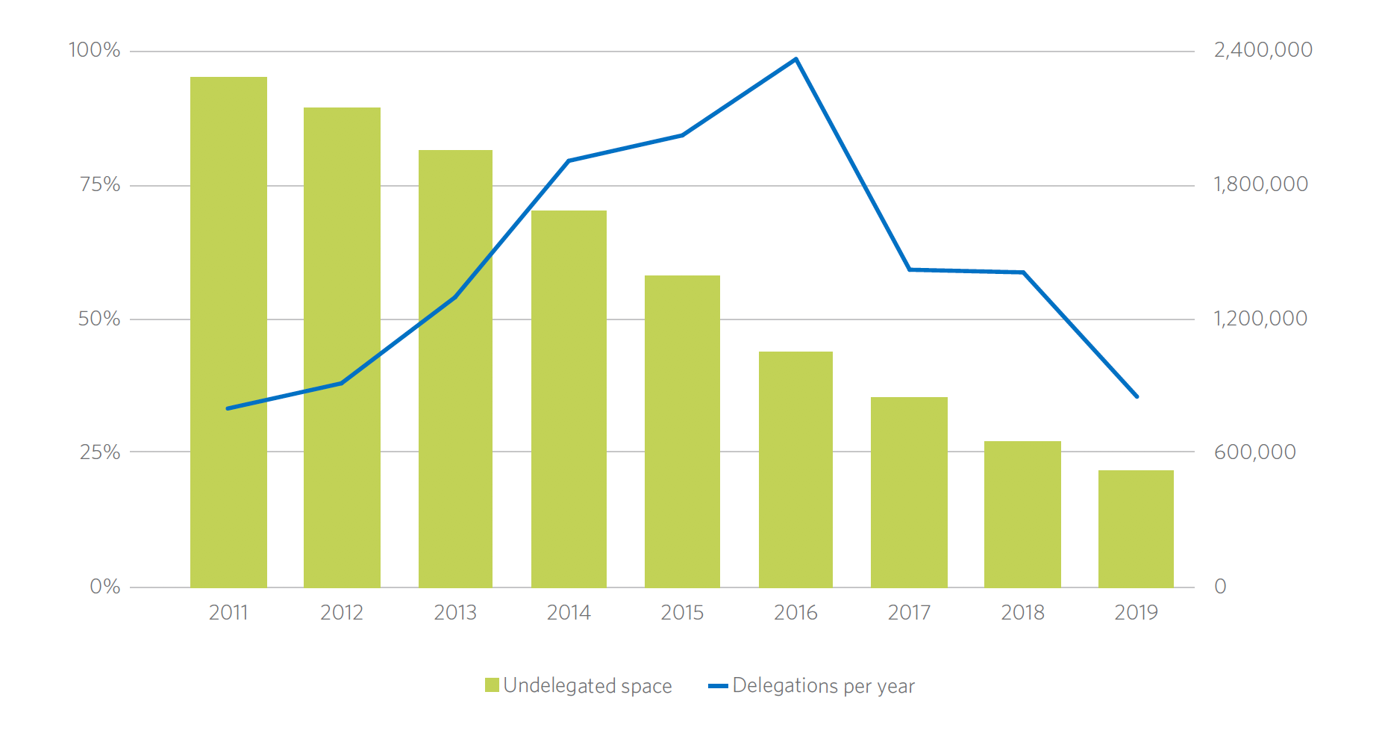
Last /8 address pool

Slide 5
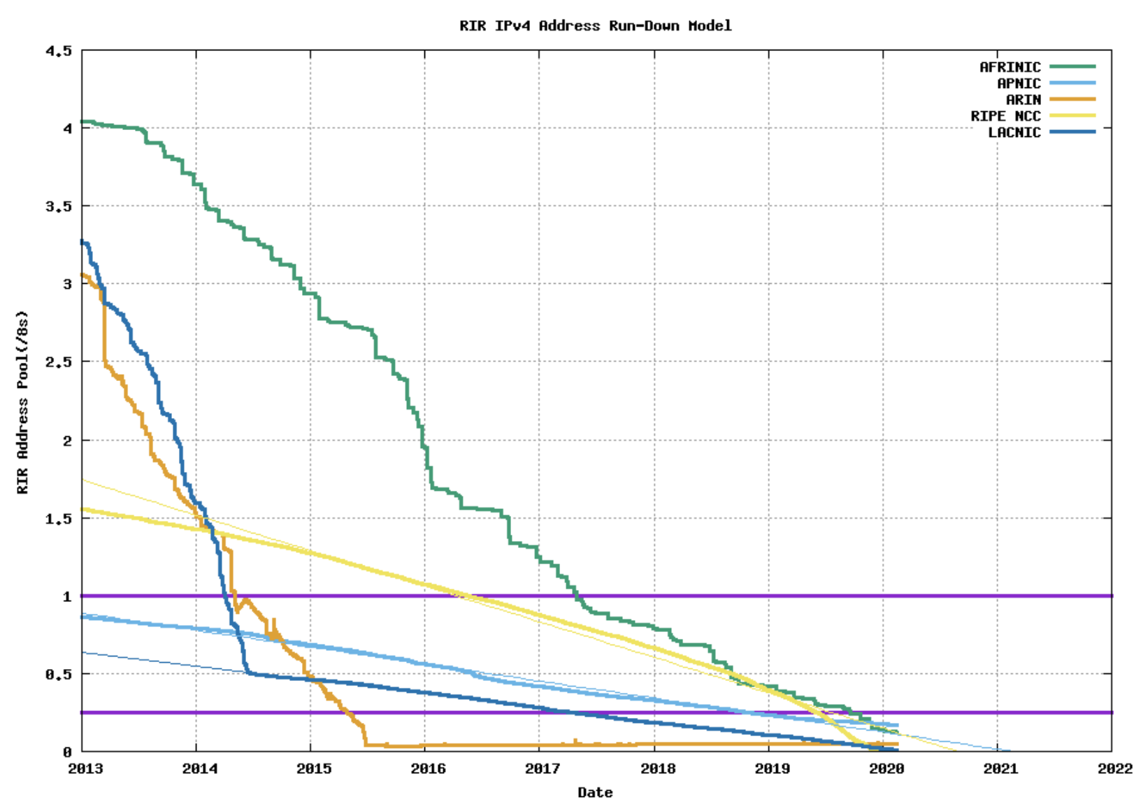
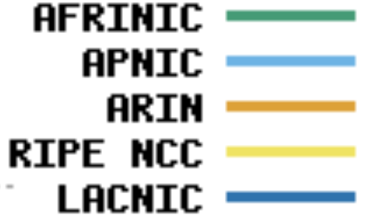

Slide 6

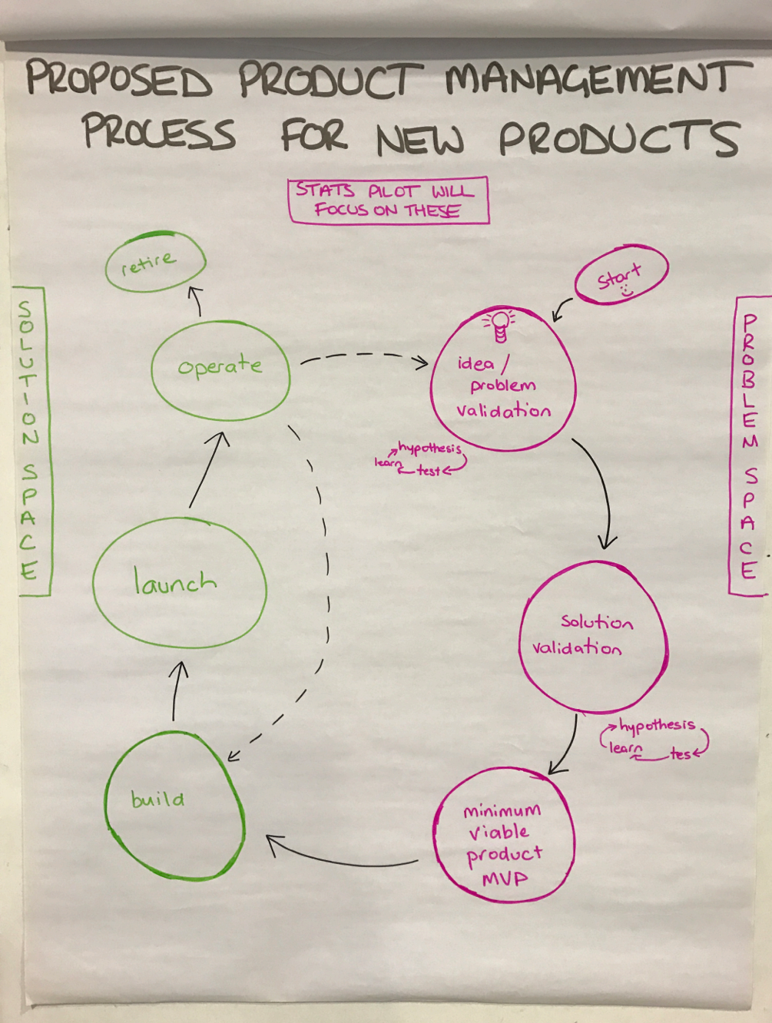
Product Management
Systematic approach to product development
  Lifecycle management
  User-centric
  Agile
Three cross-functional product teams
  Registry
  Membership
  Information Services
Three support teams
  Web development
  Platform
  DevOps
More in 2020

Slide 7

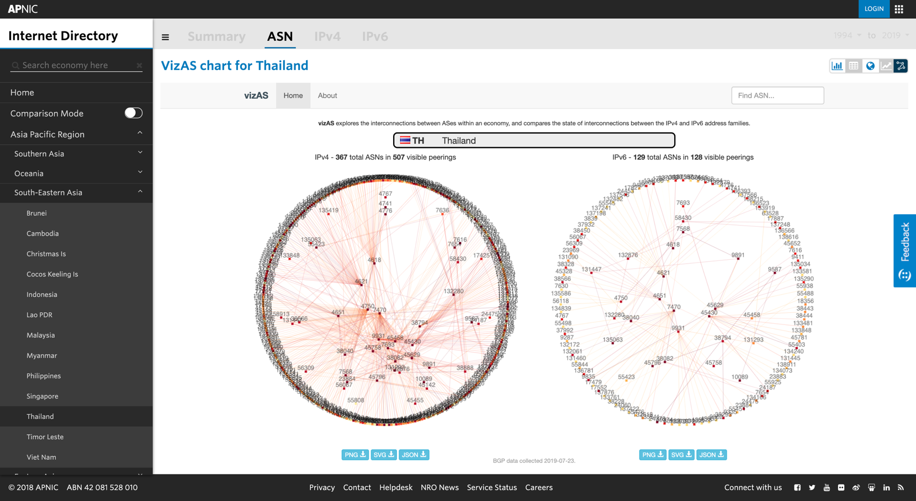
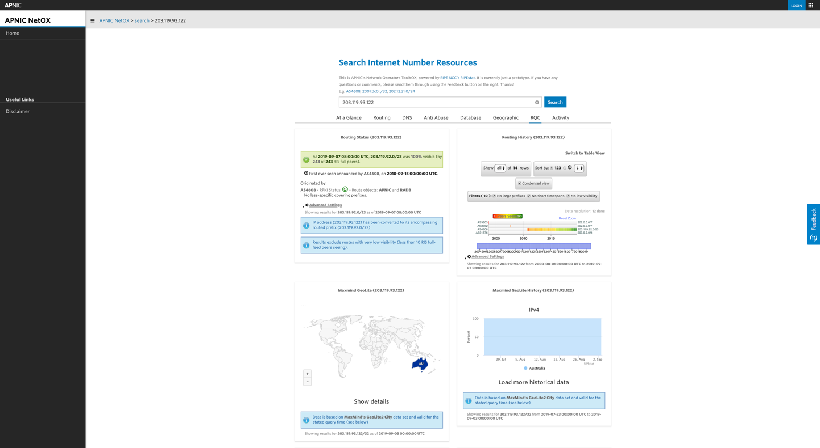
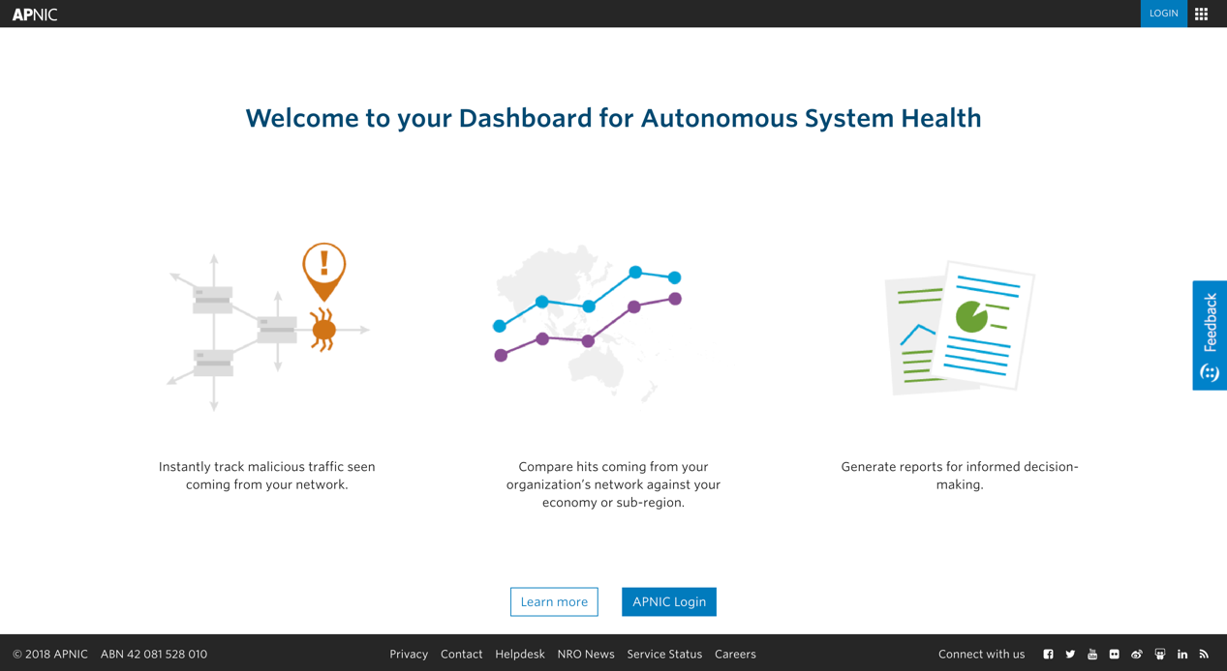
Information Products
DASH – Dashboard for AS Health
  Launched at APNIC 48
  Helps operators monitor suspicious traffic coming from their networks
  Uses data from APNIC Honeynet Project
NetOX – based on RIPEstat
  Includes RQC functions
  New widgets (AS relationships, PoC, IRR explorer, transfer history, abuse contacts)
Internet Directory v2.1
  Economy comparisons
  IPv6 capability
  VizAS
Notes:
Dashboard for Autonomous System Health

Slide 8

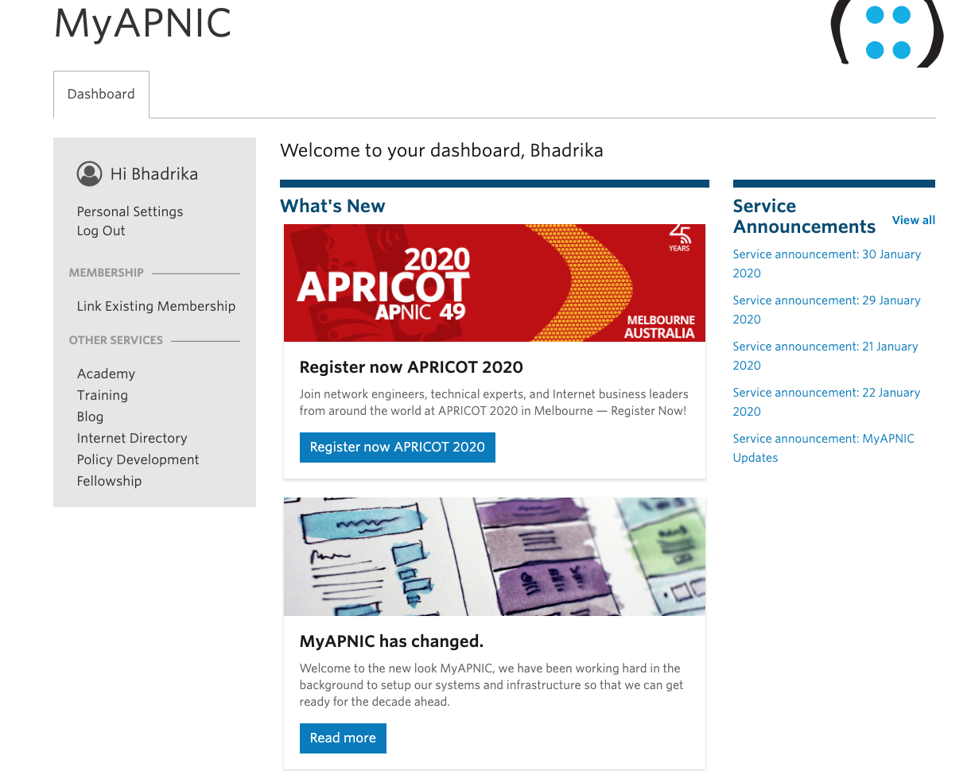
Membership Products
MyAPNIC+SSO integration:
  Event registration
  Academy
  Information products
IRT and contact validation
  1,000 emails, 62% confirmation
  Validation extended to IRT objects and ‘abuse-c’
Implemented independent election platform, BigPulse
  Online proxy and voting
  APNIC EC and NRO NC
apnic.net/myapnic

Slide 9
Registry Products
RDAP – Registry Data Access Protocol
  Google cloud-based APNIC RDAP service
  IETF draft for RDAP mirroring
RPKI
  Promotion in NOGs, training, ROA signing
  Conference content, New Routing Security/RPKI SIG
  IETF draft for Resource Tagged Attestation (RTA)
NIR Support
  Improved synchronization and consistency of NIR who data
  Support for whois, RDAP and RPKI
  API specifications to support APNIC-NIR automation
IP address management
  Resource Quality Check (RQC)
  Reclaiming unused IPv4

Slide 10
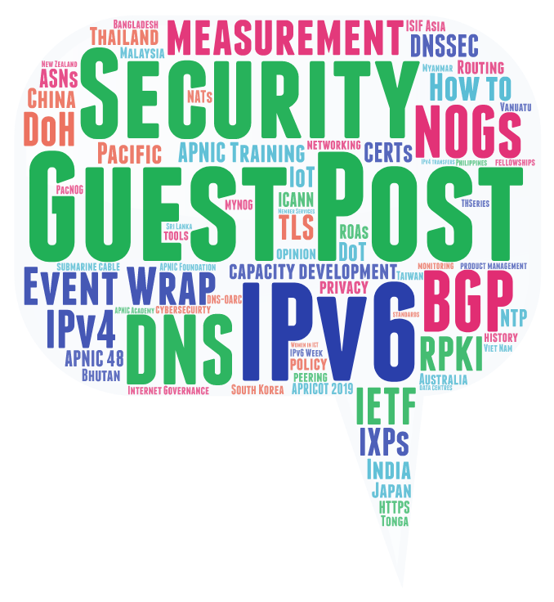
blog.apnic.net
Guest Blog Posts
Views
159
Average: 48,026 / month
Monthly Posts
Top 5: Guest Post, Security, DNS, IPv6, BGP
As at 31 Dec

Slide 11

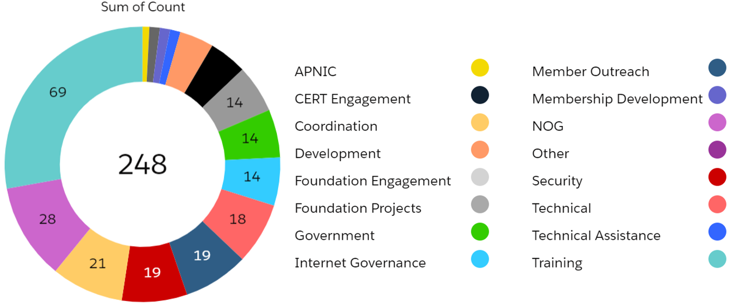
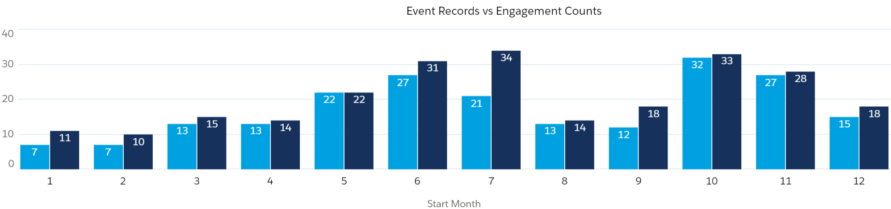
External Engagement Summary
* Includes Foundation engagements
Engagement summary by type
Engagement summary by month
Notes:
204 engagements in 2018 (6% more than 2017).

Slide 12
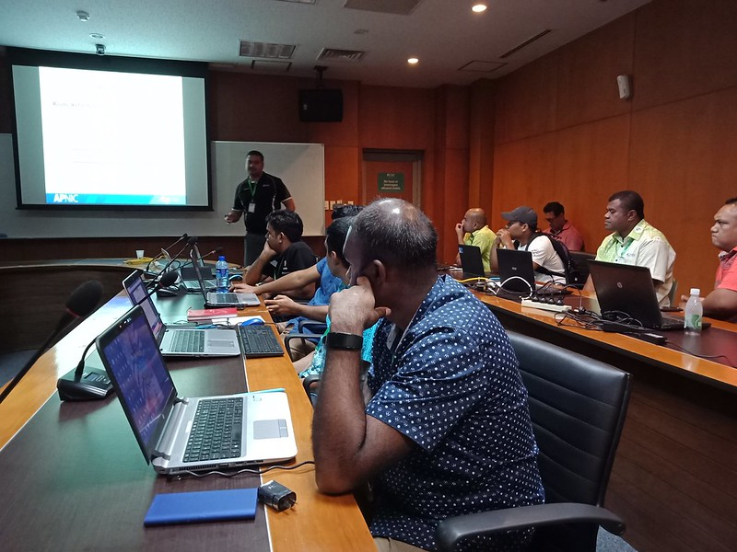
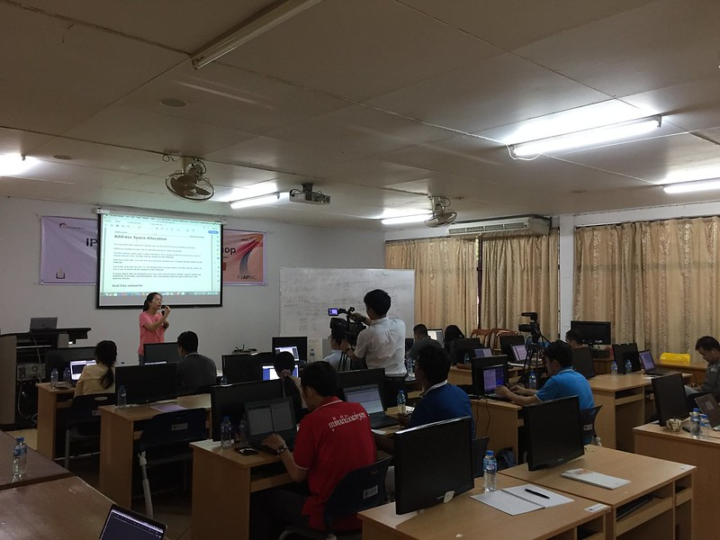
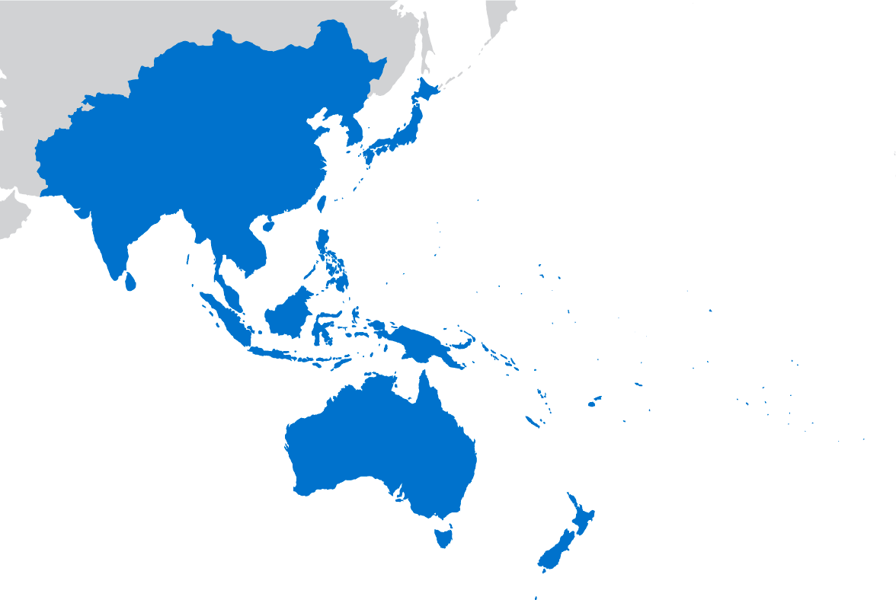
Training
IPv6 workshop, Lao PDR
PacNOG 25, Fiji
 | 2019
Face-to-face training Economies Trainees Trainee days | 69 30 1,971 5,757
Community Trainers | 22
APNIC Academy Users Economies Virtual Labs Course completions Trainee days | 5,060 42 1,723 870 525
YouTube training views | 37,729
TA- Indonesia

Slide 13
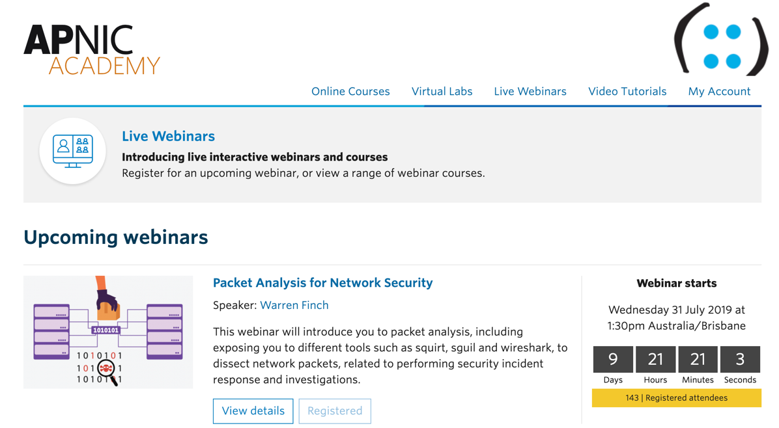
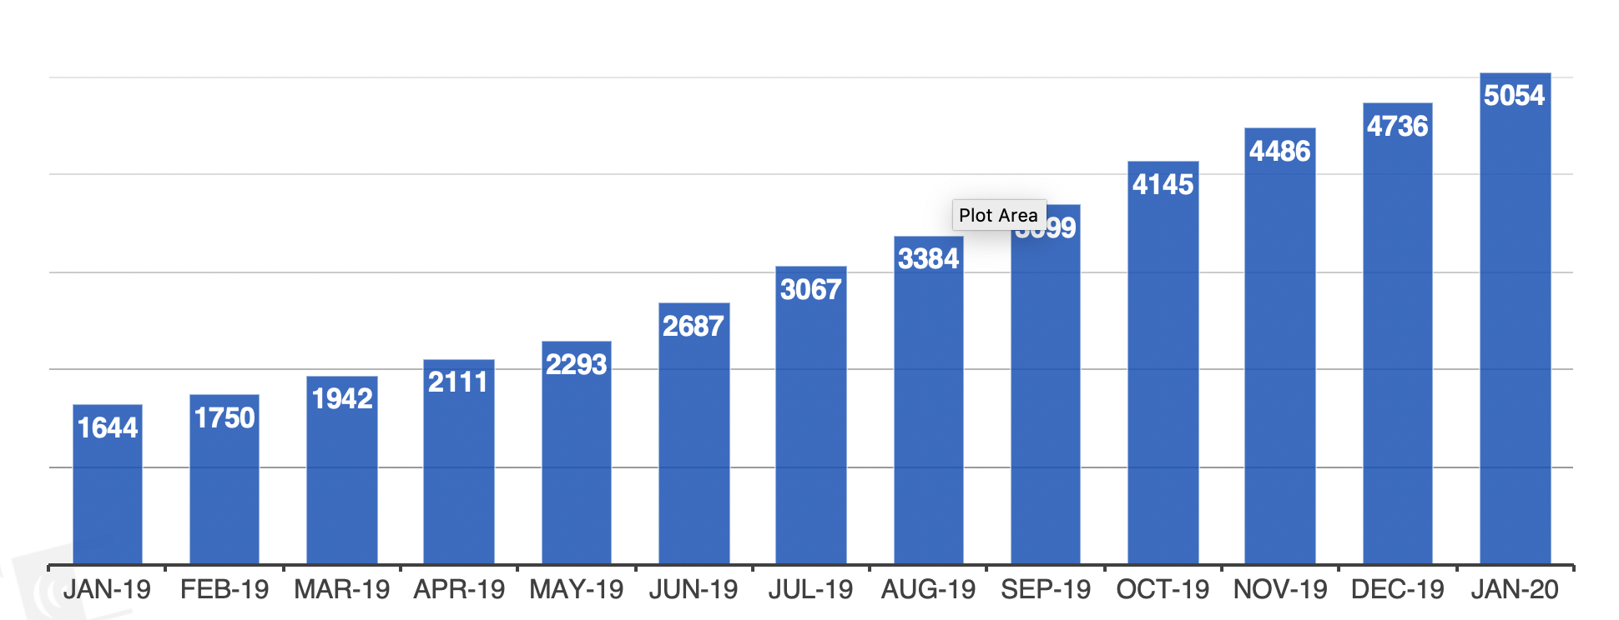
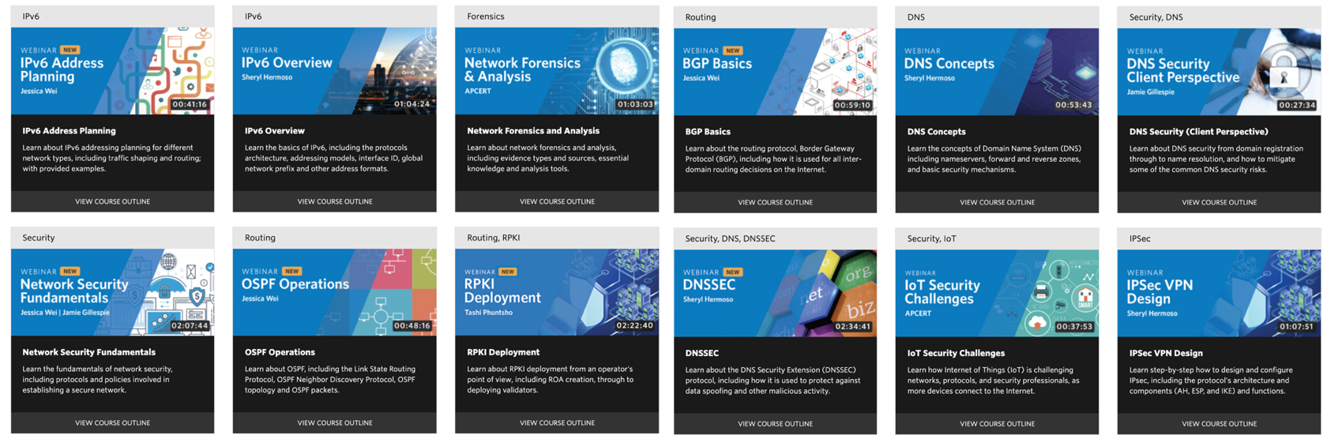
APNIC Academy
New webinar platform
  12 webinars
New courses
  IPv6 fundamentals
  (5 modules);
  IPv6 Address Planning
  (in development)
New Labs
  Cisco, Mikrotik etc etc
Access to ‘eduroam’
  APNIC Members only
Support for 8 languages
  EN, CNx2, JP, KR, TH, VN, ID
academy.apnic.net

Slide 14
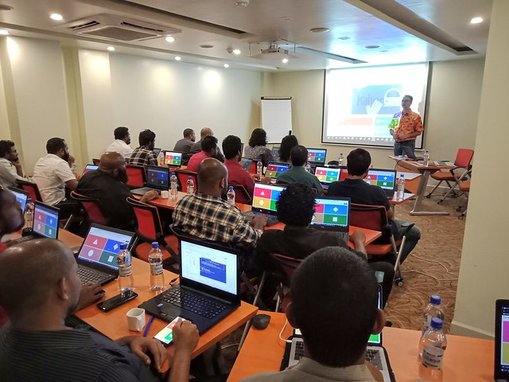
IPv6
IPv6 Training
  18 face-to-face, 539 trainees
  New 5-module Academy course
57 blog posts
  IPv6 Week promotion
  4 new success stories (30 total)
IPv6 deployment sessions at APNIC conferences; IPv6-only Wi-Fi
3 technical assistance engagements
Members holding IPv6: 64.07%
Regional IPv6 capability: 29.87% (APNIC Labs)
IPv6 Deployment workshop, Kolkata

Slide 15

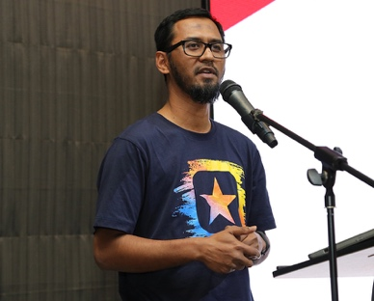
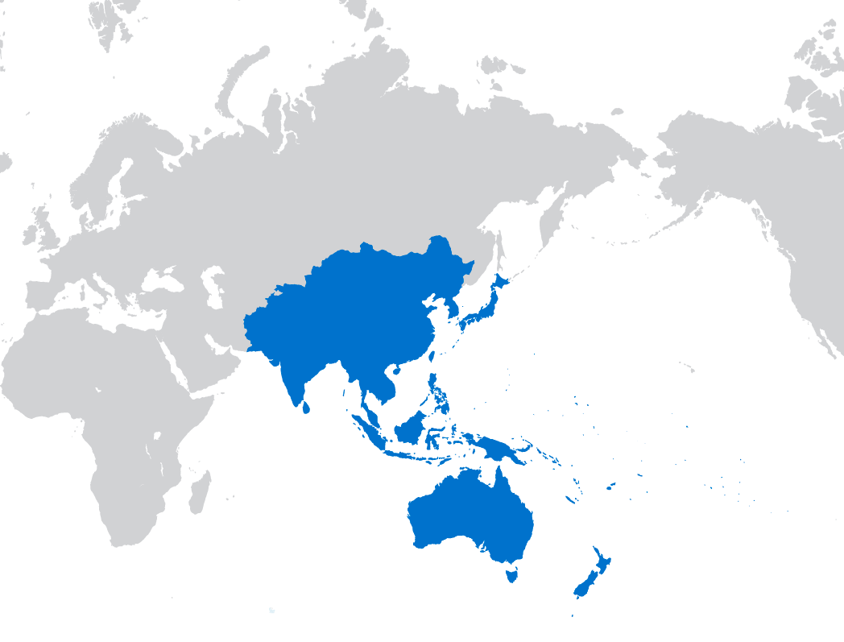
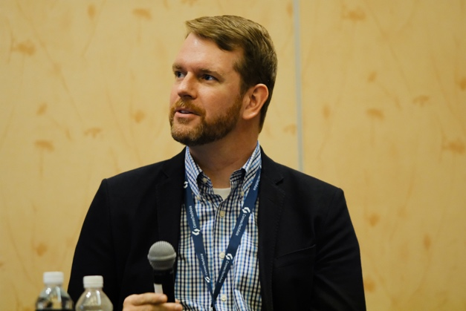
Security
19 security engagements including presentations and workshops
  31 face-to-face trainings
  11 CERT meetings
  8 LEA workshops
Webinars on DDoS mitigation, DNS security and cybersecurity awareness
FIRST tracks at APNIC 47 and 48
APNIC Community Honeynet expanded to BT, BD, MY, WS, TO and ID
93 security-related blog posts
Adli Wahid
Jamie Gillespie
apnic.net/security

Slide 16



Internet Governance
APrIGF 2019 (RU)
VanIGF - First local IGF event in VU
Sylvia Cadena reappointed to IGF MAG;
Rajesh Chharia appointed as a new member
APIGA 2019 – IG Academy (KR)
Nethui 2019 – APNIC sponsored fellows (NZ)
NetThing 2019 – revived auIGF (AU)
inSIG 2019 and Youth IGF (IN)
Global IGF: APNIC coordinated sessions on Safety and Security, cybernorms, data governance and safety; supported NRO CCG (DE)

Slide 17

APNIC Foundation
Six board members now appointed:
Edward Tian (CN), Sharad Sanghi (IN),
Sylvia Sumarlin (ID), Michael Malone (AU),
Danish Lakhani (PK), Jun Murai (JP)
Second board meeting held in May
Second annual report including audited financial statements published in September
Foundation now funding administrative and project support positions (AU, PG, FJ)
APNIC continues to provide other administrative support
‘To have a global, open, stable and secure Internet that is affordable and accessible to the entire Asia Pacific community’
apnic.foundation

Slide 18
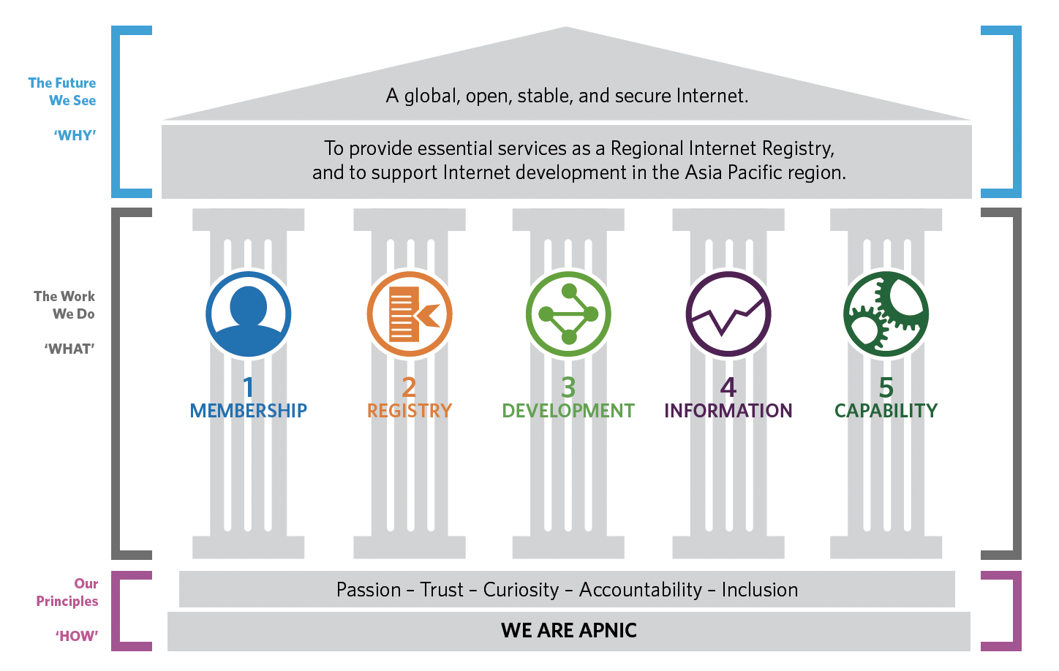
Strategic Plan 2020-2023

Slide 19

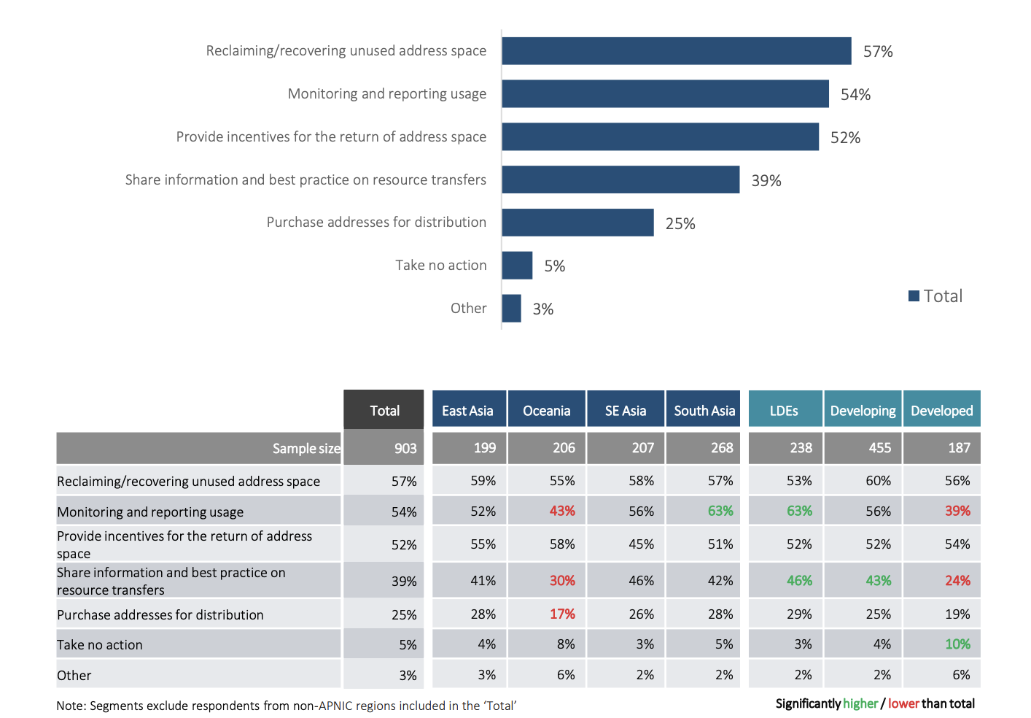
APNIC Survey 2020
apnic.net/survey

Slide 20

See you in Dhaka!
APNIC 50 will be held in Dhaka, Bangladesh
3 to 10 September 2020
Hosted by ISPAB

Slide 21
Thanks!

