Slide 2
APNIC Academy update
Che-Hoo Cheng

Slide 3



About APNIC Academy
APNIC Academy
supports the people
who build, operate and
maintain the Internet.​
Online
Courses
Virtual
Labs
Live
Webinars

Slide 4



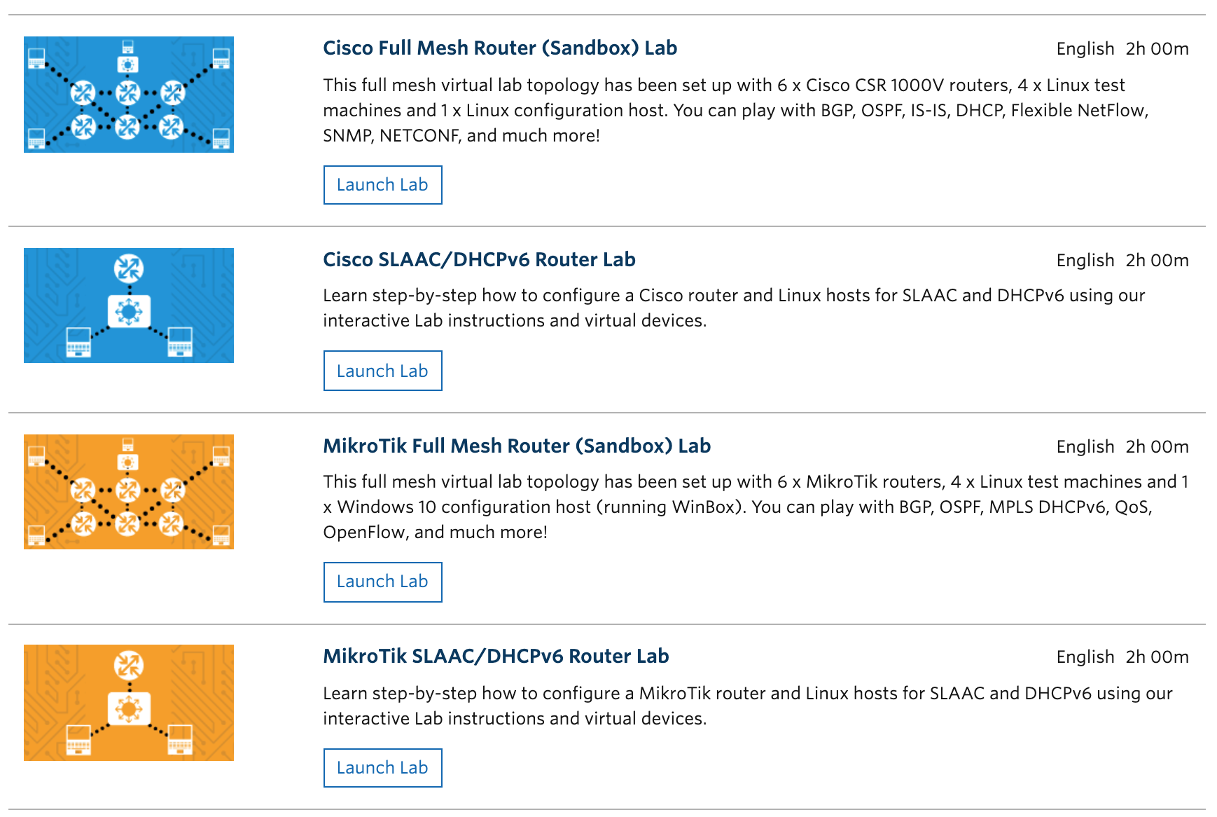
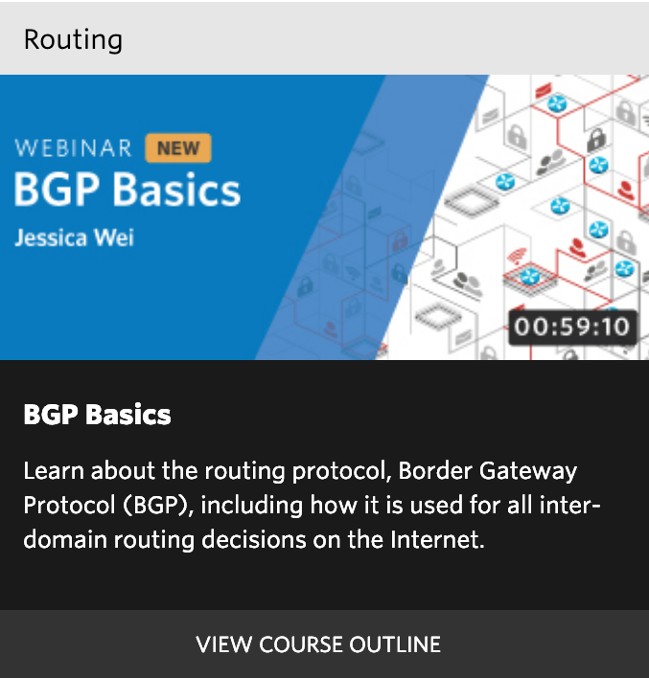
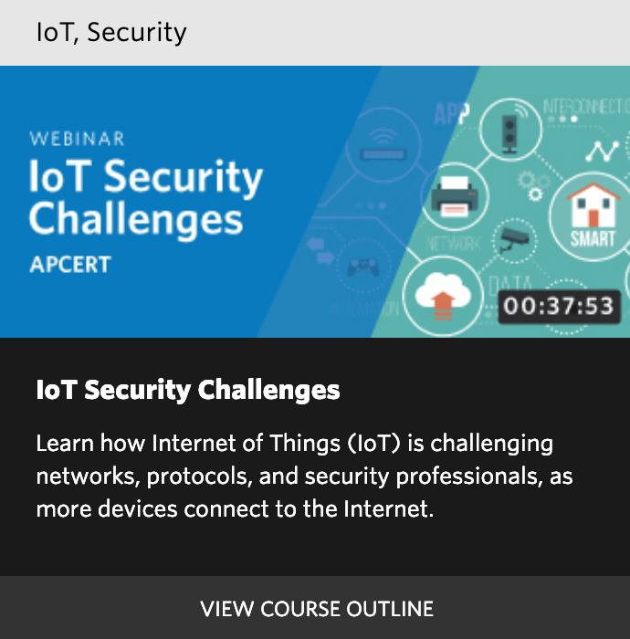
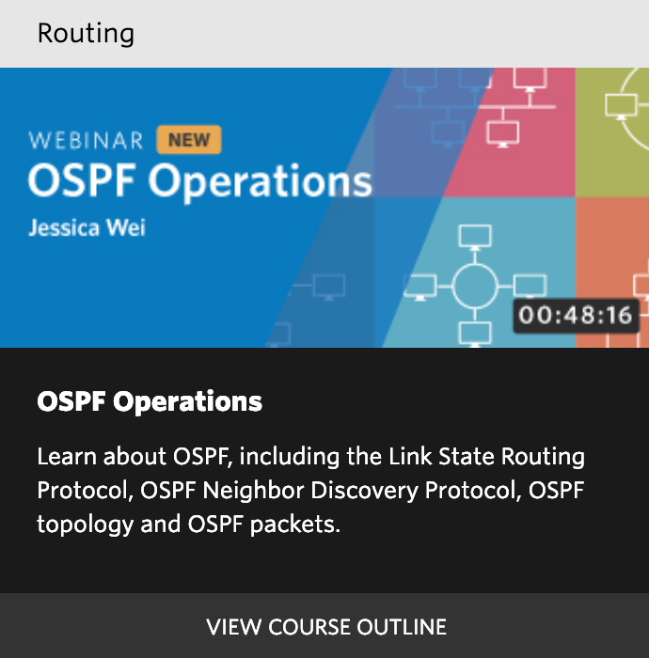
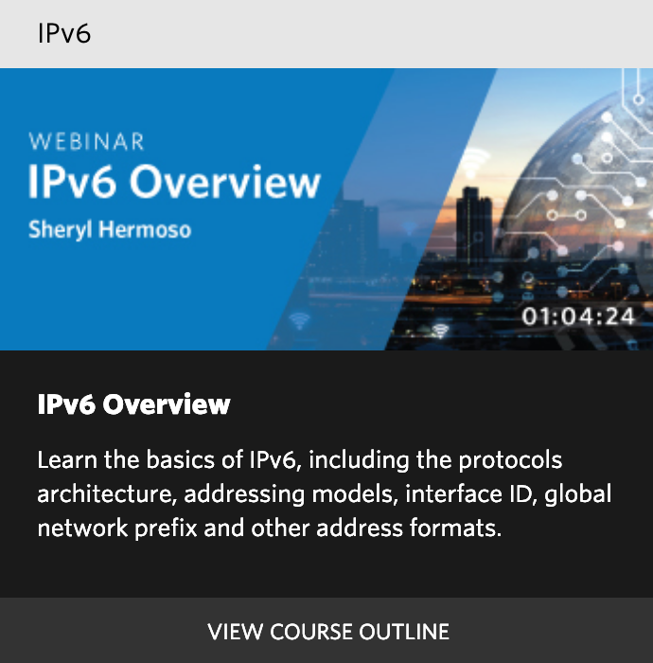
ONLINE COURSES
LIVE WEBINARS
VIRTUAL LABS

Slide 5
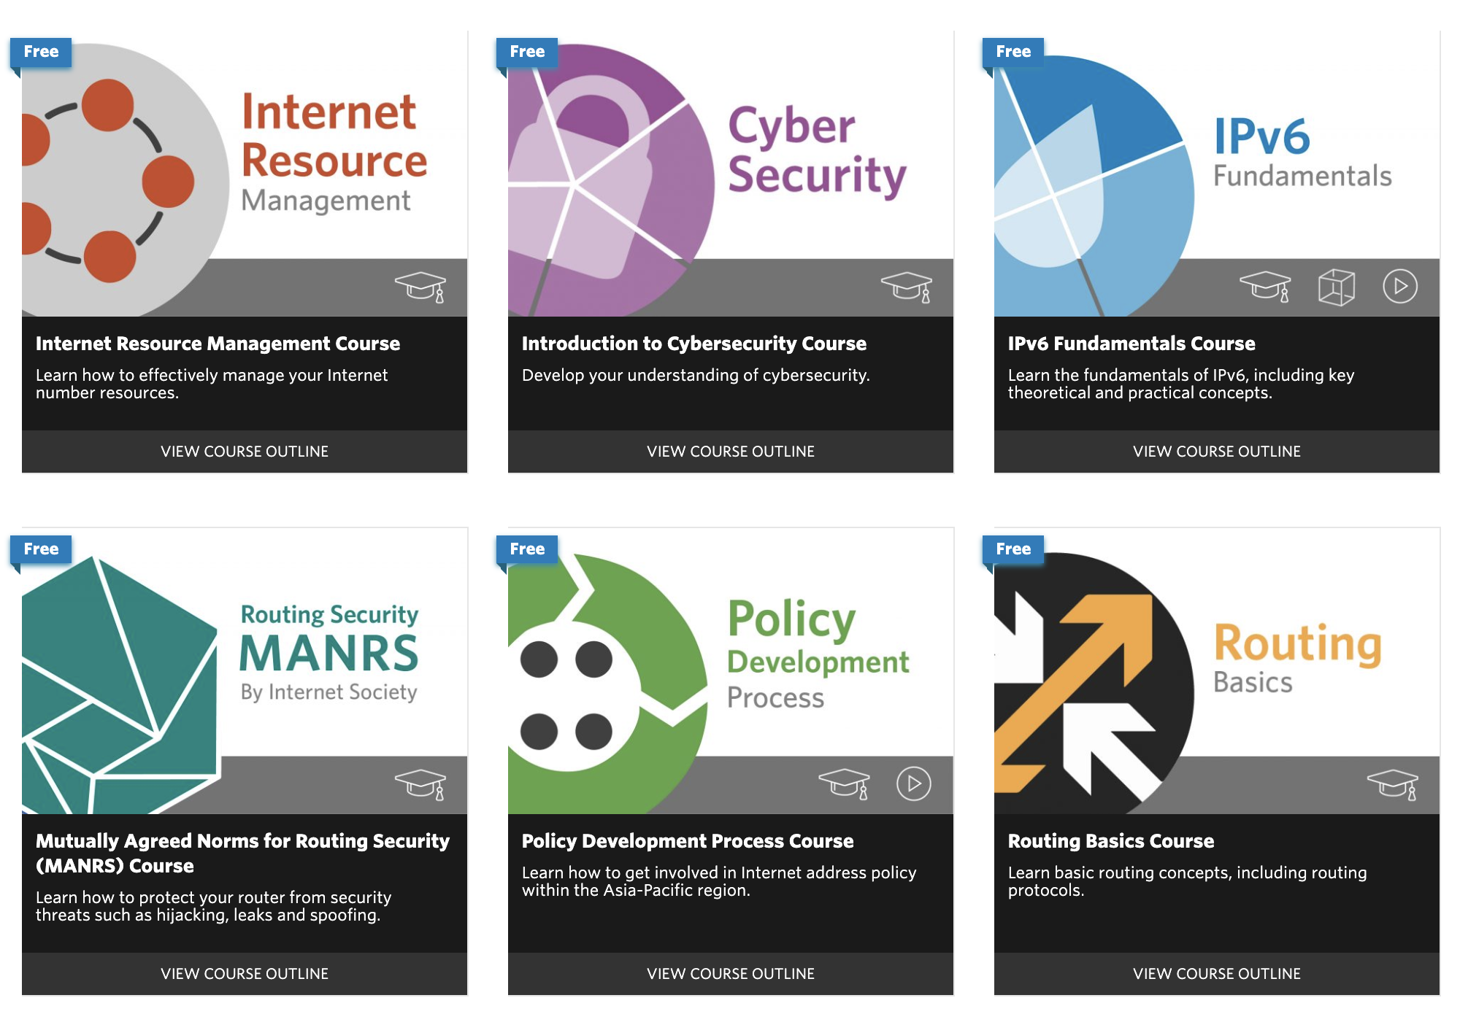
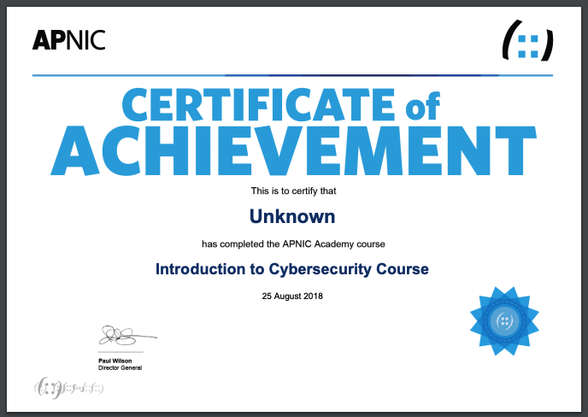
Online Courses

Slide 6
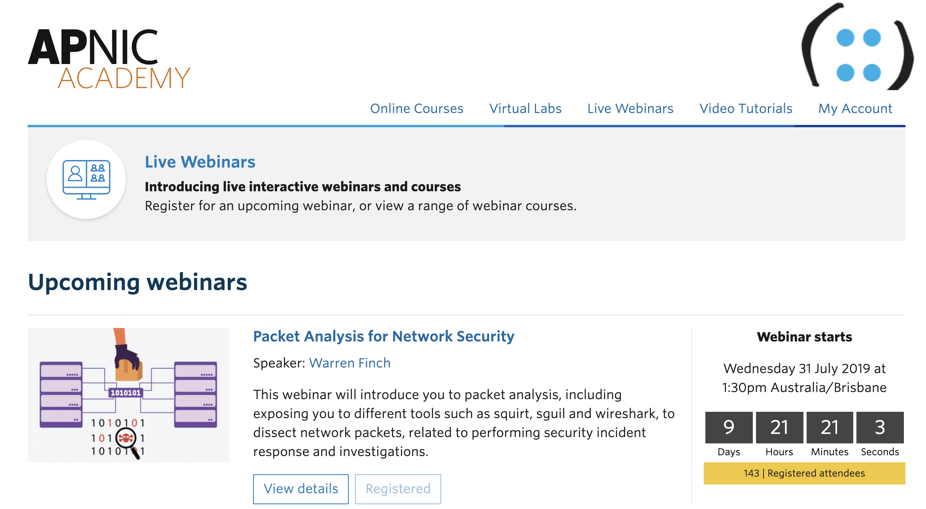
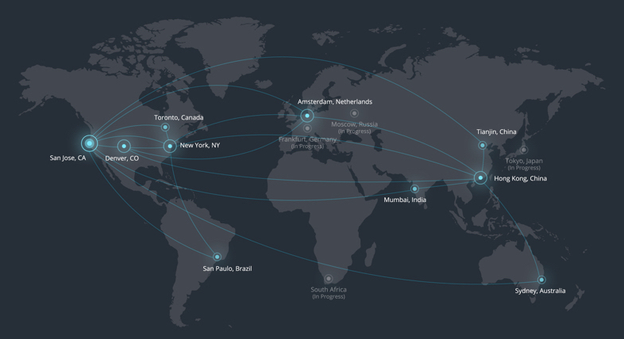
Live Webinars

Slide 7

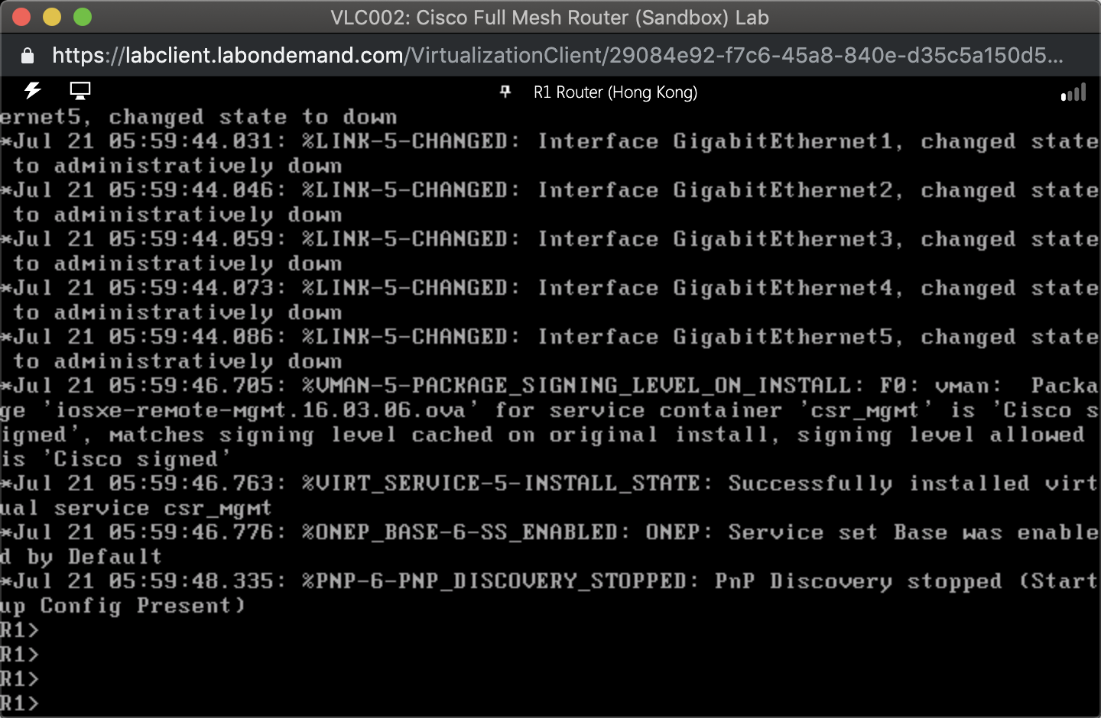
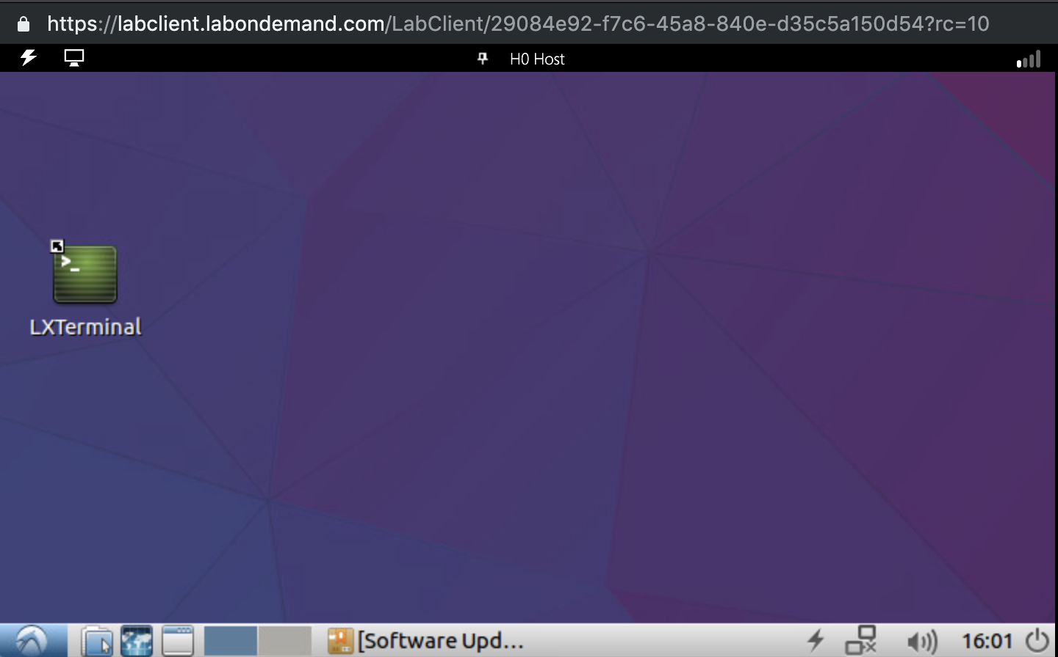
Virtual Labs

Slide 8
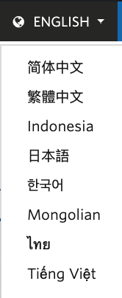
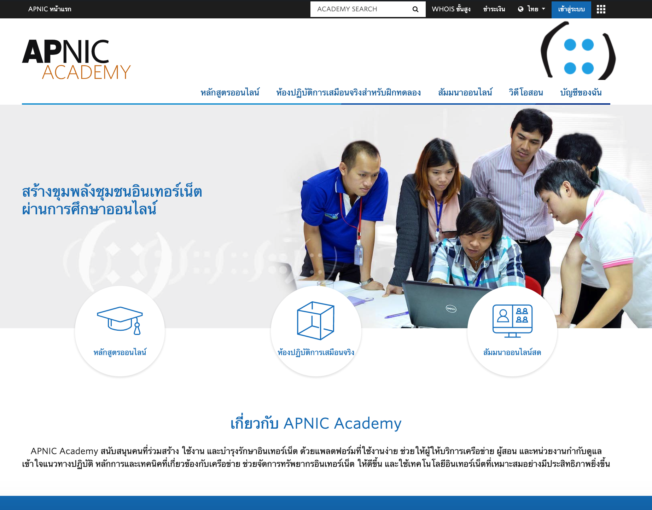
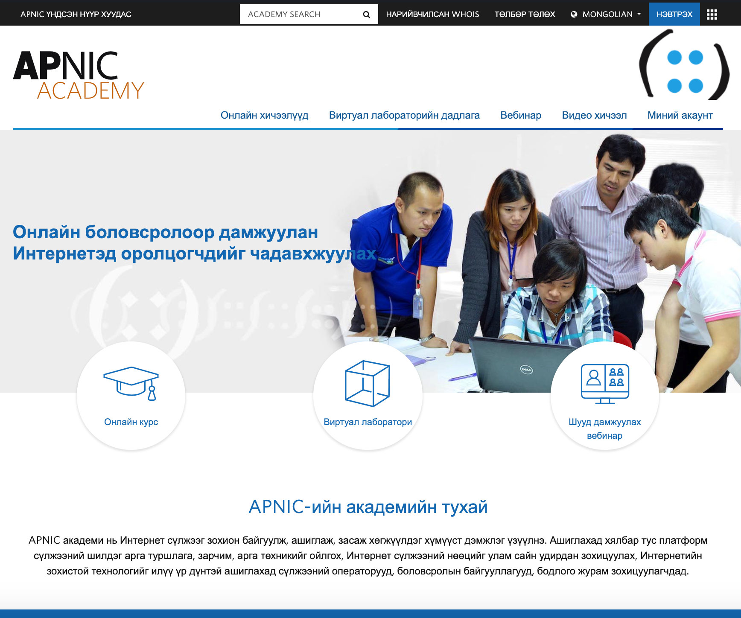
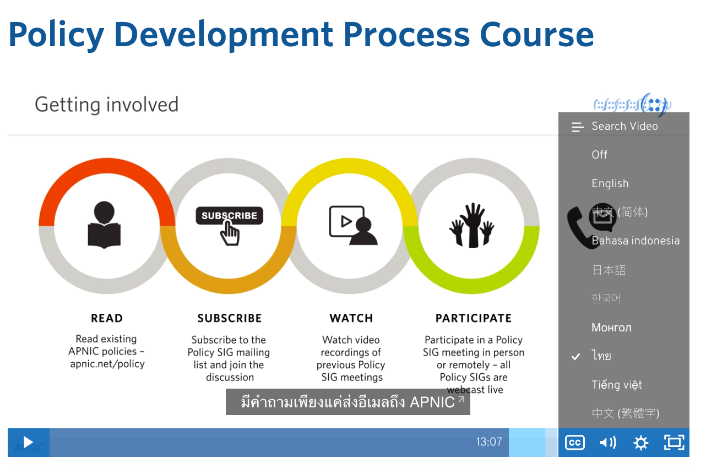
Multilingual Support Capability

Slide 9
eduroam Access for APNIC Members
eduroam (education roaming) is the secure, world-wide roaming access service developed for the international research and education community.
In over 106 territories
More than 12,000 locations
Lots of participating institutions

Slide 10
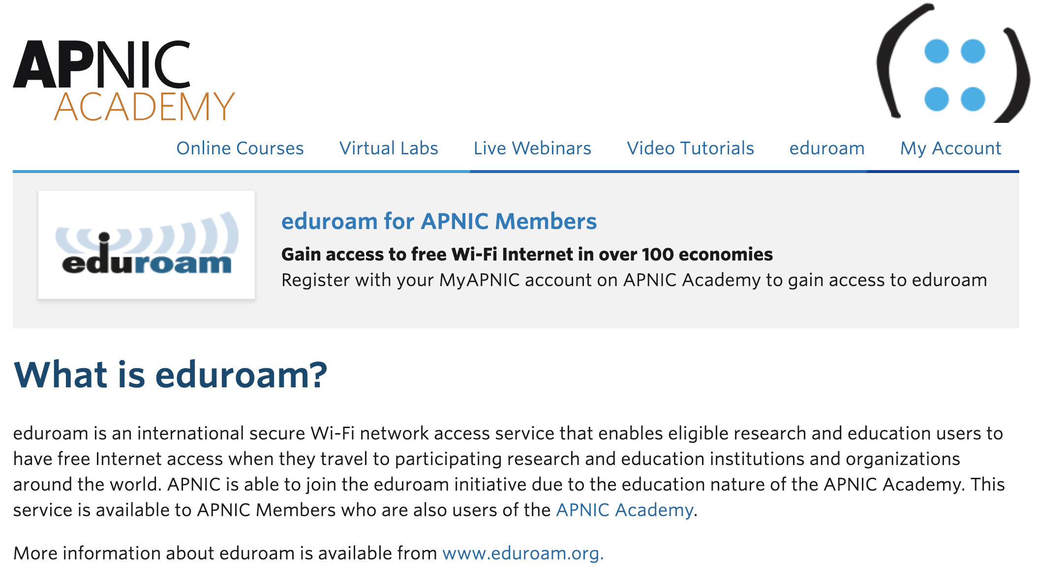
academy.apnic.net/eduroam

Slide 11
APNIC Academy Growth

Slide 12
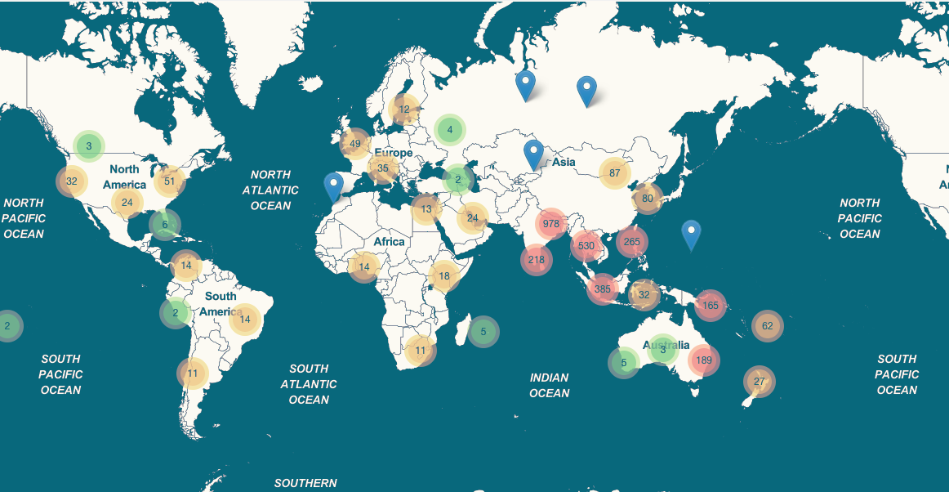



Concentrated Geographic Locations
Growth
Steady
Demand

Slide 13
APNIC Academy updates

Slide 14
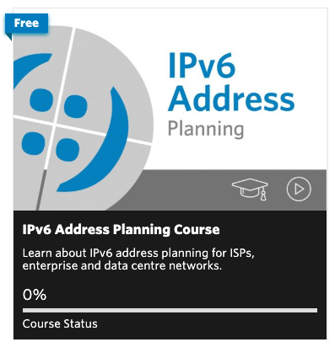
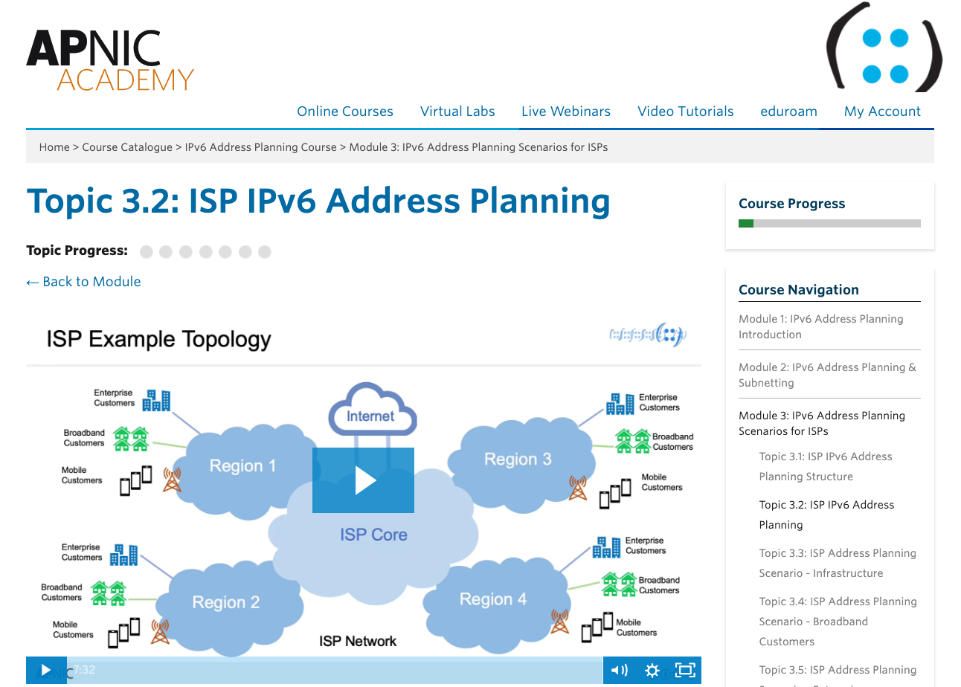
IPv6 Address Planning Course
Key features
1-2 hours of learning
Covers 19 topics:
  Planning considerations
  Subnetting
  Scenarios for ISP, Data Centre, Enterprise
All video-based (with audio)
Language subtitling to be added

Slide 15
Thank you!
academy@apnic.net

