Slide 1
Asia Pacific Next Generation
February 28, 2021
yangyang sunyoungyang@arizona.edu

Slide 2
Agenda
Progress of Rebuilding APNG
The APNG Leadership Team
What’s Next?: Getting Endorsements
What’s Next?: Composing the Advisory Committee

Slide 3

Rebuilding APNG: Why?
Continuing to foster the development of next-generation (Internet) leaders for Asia and the world
Positively influencing the career paths and worldviews of future generations
Inheriting the tradition of collaboration that Asian Internet pioneers have created
Paying forward what APNG Camp alumni received from APNG to younger generations

Slide 4
Rebuilding APNG: Mission
Fostering the development of future leaders of digital society
Building a human network
Learning from each other
Enhancing intergenerational mentorship and collaboration
Supporting UN SDGs through mutual cooperation, knowledge sharing, and promotion activities

Slide 5
Rebuilding APNG: Progress
Making the APNG leadership team into a Think Tank
Hosting APNG Webinars
Hosting APNG Seminars
Planning to host the APNG Camp in the near future

Slide 6
APNG Webinar Series for 2020
Sumith Gamage, “Post-COVID New Normal: Work from Anywhere” (July 4)
Benson Wu, “Cybersecurity Tips for Post-COVID New Normal” (August 15)
Kashif Adeel, “Digital Transformation and RPA Journey” (October 3)
Sam Goundar, “Application of Blockchain Technologies: Research and Practice” (November 14)
Anwarus Salam, “How to Build Your Own Chatbots” (December 19)

Slide 7
APNG Seminar at the 50th APNIC
(September 6, 2020)
New Normal Life with AI on the Internet
Talk 1: “AI and Connected Health – Now and Beyond the Pandemic” by Sam Goundar
Talk 2: “Future of Cybersecurity Through Autonomous Systems and Human-AI Collaboration” by Benson Wu
Talk 3: “Business Process Automation with RPA and CHATBOT” by Khan Md. Anwarus Salam

Slide 8
APNG Seminar at the 50th APNIC
(September 6, 2020)
New Normal Life with AI on the Internet
Talk 4: “Travel Safely around our World with ‘ThesafeCheck’ Novel AI Technology for Covid19 Travel Policy” by Joan Lai
Talk 5: “How AI Can Feed 5 Billion People In APAC” by Miller Rajendran
Talk 6: “Artificial Intelligence in Medical Diagnosis and Patient Care” by Dihan Morawaka

Slide 9
APNG Seminar at the 2021 APRICOT
(March 5, 2021)
Languages on the Internet
Talk 1: “Towards a Multilingual Internet” by Satish Babu
Talk 2: “Why Silicon Valley Is Worsening the North / South Digital Divide and How to Fix It” by Divon Lan
Talk 3: “The Recent work on Internationalized Domain Names (IDNs) in South and East Asian Scripts and Especially in Sinhala” by Harsha Wijayawardhana
Talk 4: “Preserving the Existence of Indonesian and Local/Traditional Languages through Speech Technology” by Amalia Zahra

Slide 10
APNG Seminar at the 2021 APRICOT
(March 5, 2021)
Languages on the Internet
Talk 5: “Thai Speech Recognition Technology and Linguistics of a Tonal Language” by Kwanchiva Thangthai
Talk 6: “Internet and Persian Language” by Fatemeh Saber
Talk 7: “Language, Language technologies and Internet: Context of Nepali Language” by Birodh Rijal
More information: https://apng.asia/?p=1437

Slide 11
APNG Action Plans for 2021
Hosting a seminar at the 2021 APRICOT/APNIC
Hosting a seminar at the 52nd APNIC
Hosting a webinar series for 2021
Planning to host the APNG Camp at the 2022 APRICOT/APNIC in Dhaka, Bangladesh

Slide 12
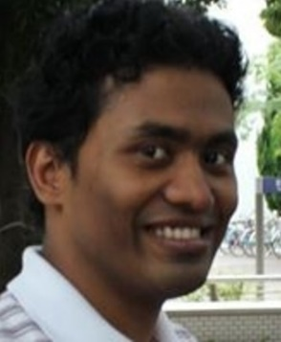
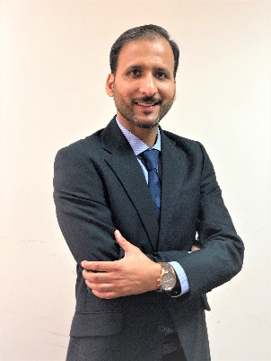
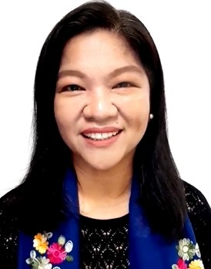
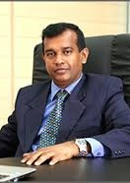
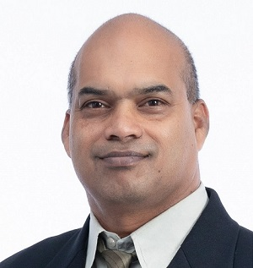
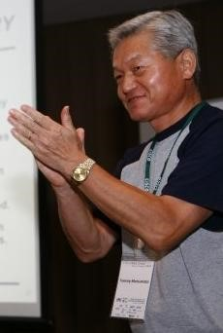
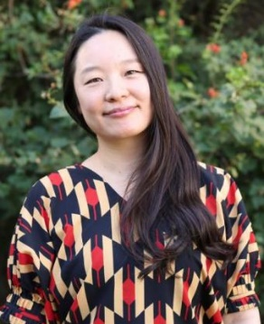
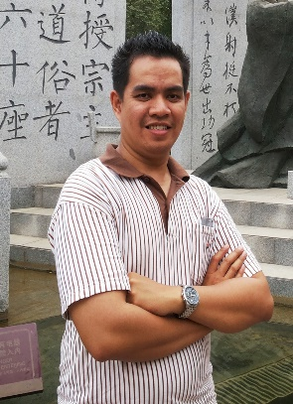
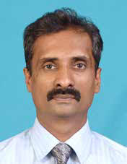
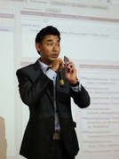

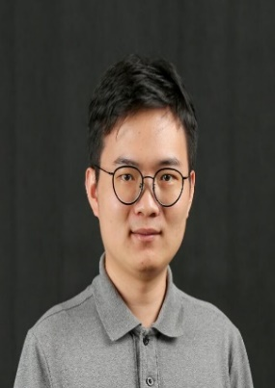
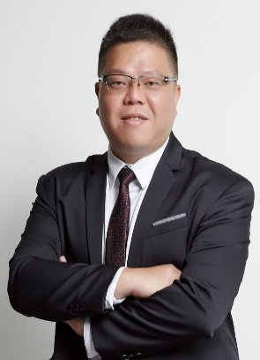
APNG: The Current Leadership Team
Co-chairs
Core Members
Advisor/Mentor
Tommy Matsumoto (Japan)
Khan Md. Mahfuzus Salam (Bangladesh, Japan)
Kashif Adeel (Pakistan, Oman)
Magie Antonio (Philippines)
Sumith Gamage (Sri Lanka)
Sam Goundar
(Fiji, New Zealand)
yangyang (South Korea, USA)
Emil Kaburuan (Indonesia)
Dihan Morawaka
(Sri Lanka, Malaysia)
Asik Rajbhandari (Nepal, Thailand)
Joan Vicente (Philippines)
Timothy Wu (Hong Kong)
Benson Wu (Taiwan)

Slide 13
How to Get Endorsements from the formal APNG
What is the correct process?
With whom do we need to discuss?

Slide 14
APNG: Organization (In progress)
Executive Committee
Advisory Committee
Secretariat
Webmaster
APNG Camp
Webinar /
Seminar Series
Funding Committee

