Slide 1
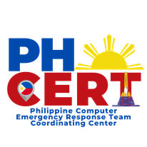
Challenges in Cybersecurity Implementation: A Philippine Perspective
A presentation to the AP* Retreat @ APNIC 56
Angel S. Averia, jr.
President, Philippine Computer Emergency Response Team

Slide 2



CHALLENGES IN CYBER SECURITY IMPLEMENTATION
A look into the PPT Framework
People
Process
Technology
Sources:
https://www.freepik.com/free-vector/portrait-young-employee-team_9650698.htm#query=people&position=6&from_view=keyword&track=sph
https://creazilla.com/nodes/7793046-engranatges-clipart
https://stock.adobe.com/id/images/id/81017431?clickref=1011lwWIsrbF&mv=affiliate&mv2=pz&as_camptype=&as_channel=affiliate&as_source=partnerize&as_campaign=pdvectors
Notes:
In assessing the country’s readiness to embrace cybersecurity, we are guided by the traditional framework of People-Process-Technology.
People includes everybody, from senior management all the way down the totem pole of workers who use an organization’s ICT, including third party.
Process encompasses cybersecurity policies and process including procedures, rules, and guidelines.
Technology are the technology solutions employed or to be employed in securing an organizations system (hardware and software) and data assets

Slide 3
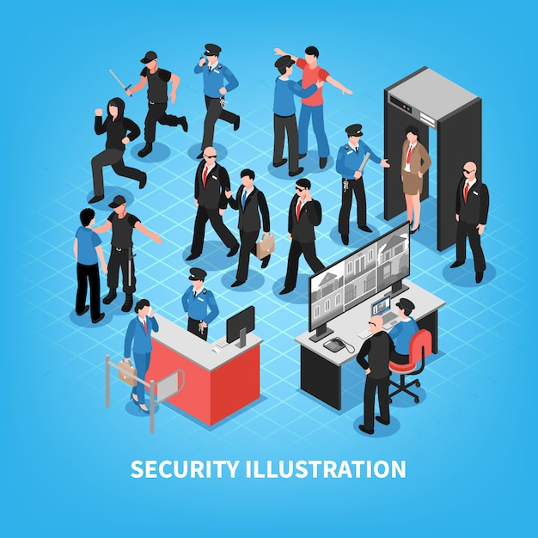
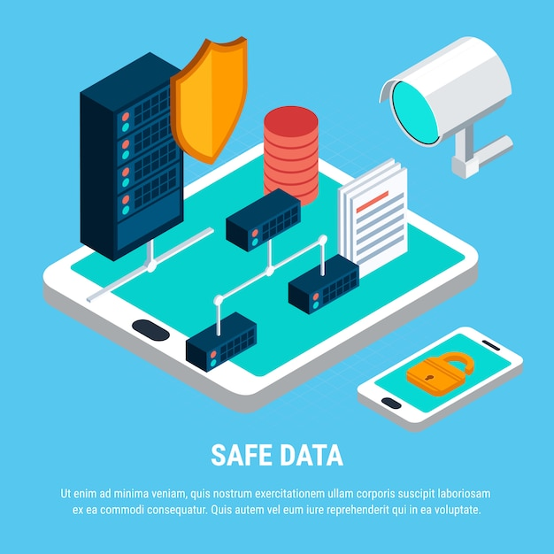

CHALLENGES IN CYBER SECURITY IMPLEMENTATION
Classes of Security Measures by Law: Philippines Data Privacy Act
Physical
Organizational
Technical
Sources:
https://www.freepik.com/free-vector/security-system-isometric_6089386.htm
https://www.alburolaw.com/organizational-security-measures-for-the-protection-of-personal-dat/
https://www.freepik.com/free-vector/safe-data-isometric_6371525.htm
Notes:
On the other hand, the Philippines’ Data Privacy Act of 2012 requires the implementation of physical, organizational, and technical security measures to protect and secure personal information and sensitive personal information.

Slide 4
Classes of Security Measures (Data Privacy Act)
Organizational
Physical
Technical
Roles and responsibilities are assigned.
Everyone is aware, trained, knows, and understand their roles and responsibilities.
Everyone has the relevant skills.
Those responsible for physical security measures are trained and equipped to use/operate the physical security measures.
Those responsible for technical security measures are trained and equipped to use/operate the technical security measures.
People
Policies, rules, procedures, and guidelines on organizational readiness and practice are in place.
Cybersecurity & privacy framework adopted. Capacity building programs in place
Policies, rules, procedures, and guidelines on physical protection measures are in place.
Policies, rules, procedures, and guidelines on technical protection measures are in place.
Process
ICT Pillars (Best Practice)
Access control
Time lock, alarm, CCTV
Data vault, Fire proof storage.
UPS, genset, fire suppression, and environmental controls
Redundancy, Hot/cold backup
Data anonymization, segmentation, encryption
Access control and VPN
Virus control
Firewall, IDS/IPS, Network Monitor
SIEM or UTM or Threat Intel
Technology
Online learning courses on cybersecurity and data privacy
Notes:
People-Process-Technology aligned with Organizational-Physical-Technical Security Measures

Slide 5
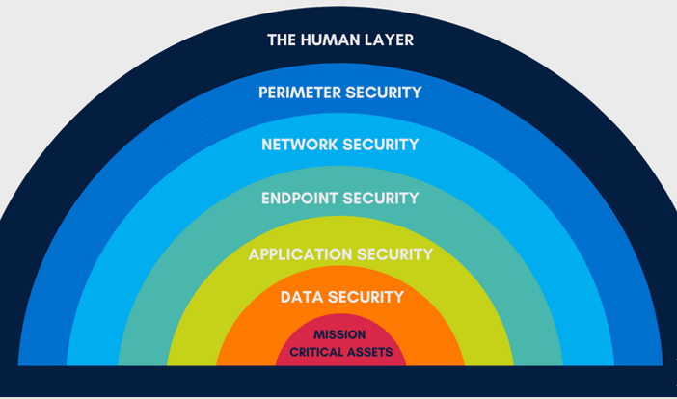
CHALLENGES IN CYBER SECURITY IMPLEMENTATION
Source: https://www.diamondit.pro/7-layers-of-cybersecurity/
Notes:
Then, we look at the cybersecurity layers

Slide 6
CHALLENGES IN CYBER SECURITY IMPLEMENTATION
End Users, including 3rd Party users: cybersecurity awareness and hygiene
Information Technology Workers: Network and Data Base Administrators; Developers including analysts, designers, and programmers; and others
Web and Application Development Practices: Are Security by Design and Privacy by Design Embedded?
Cybersecurity Work Force: Knowledge and Skills; Certification; Technology specific skills
Senior Management
People
Notes:
We consider the full spectrum of workers in an organization who use ICT

Slide 7
CHALLENGES IN CYBER SECURITY IMPLEMENTATION
Cybersecurity governance framework
policies, standards, and processes
Roles and responsibilities
risk assessment and management
awareness and capacity development
3rd party assurance
Process

Slide 8
CHALLENGES IN CYBER SECURITY IMPLEMENTATION
Defining and implementing the appropriate technology
Technology

Slide 9
Survey says….
CHALLENGES IN CYBER SECURITY IMPLEMENTATION
The 2021 Survey was jointly conducted by the DICT and Secure Connections. Secure Connections is a coalition of cybersecurity policy researchers and cybersecurity professionals advocating for a safe and secure Philippine cyberspace environment.

Slide 10
How does the PH gov’t fare?
PH Govt Infosec Survey 2021
Government agencies have good awareness of cybersecurity posture, believe agency has good ability to recover from information security incident, BUT…
Low awareness of national policies, international standards
Low organizational capacity, lack of necessary cybersecurity skills and expertise
More than half of agencies do not have a Computer Emergency Response Team (CERT)
Major gaps: policy awareness, organizational capacity, cybersecurity skills, financial resources, leadership support
People

Slide 11
Cybersecurity Posture
Personnel
65% have in-house infosecurity team/personnel
33% have dedicated team/personnel
24% have a single person handling information security
3 out of 10 said their infosec unit “significantly understaffed”
41% think they are somewhat understaffed
People
Notes:
There is a lack of knowledge of national information security policies and international standards. About 60% of the respondents are not aware of the DICT policies on information security. Only 1/3 of the respondents said their agencies have information security certifications. Half do not have a bring-your-own-device (BYOD) policy at a time when remote work was necessary.
The organizational capacity of government agencies is low. About 65% said they do not have an organized Computer Emergency Response Team (CERT), while only a handful of the government’s technical personnel have an information security certification.
The government lacks the necessary cybersecurity skills and expertise. Less than half of the respondents said their agency’s information security team are familiar with cloud security, mobile security, and BYOD security at a time when the government itself is pushing for a shift to the cloud and the pandemic requires government employees to work remotely. Even fewer have actual experience in dealing with these information security issues. According to 1/3 of the respondents, it takes 3 to 6 months to fill up an information security position.

Slide 12
Cybersecurity Posture
Computer Emergency Response Team (CERT)
6 out of 10 don’t have a CERT
lack IT personnel; outdated procurement regulations
2/3 of agencies with CERT are part of a Sectoral CERT.
35% of agency CERTs had responded to an information security incident, in past 12 months; almost half did not
2 in 10 of agencies “did not know” if their CERT ever responded to an informations security incident
People
Notes:
This could indicate the need to upgrade and upskill even the IT personnel on cybersecurity issues and expertise.

Slide 13
What are the current policies?
  Office of the President MO No. 37 s. 2001
  DoE Department Order No. 2004-02-002
  RA 10175 Cybercrime Prevention Act of 2012 Sec 2(j)
  National Cyber Security Plan 2004; 2022 (released 2017)
  DICT MC No. 005 (Aug 2017)
  RA 11479 The Anti-Terrorism Act of 2020 Sec 3(a)
  RA 11659 Public Service Act Amendment of 2022 Sec 2(e)
Process
Some government agencies have their own information security policies, standards for their respective sectors.
Not clear how agencies are implementing security measures or adopting any standards, if at all.

Slide 14
What are the gaps?
PH lacks a national policy directive mandating government agencies with jurisdiction over critical infrastructure (CI) to promote information security
No clarity in institutional arrangements on cybersecurity–enforcement, monitoring, and assessment; response to and reporting of cyber incidents; and mitigation of cyber risks
Process
Poor awareness and adoption of minimum information security standards that will protect CII institutions across the board

Slide 15
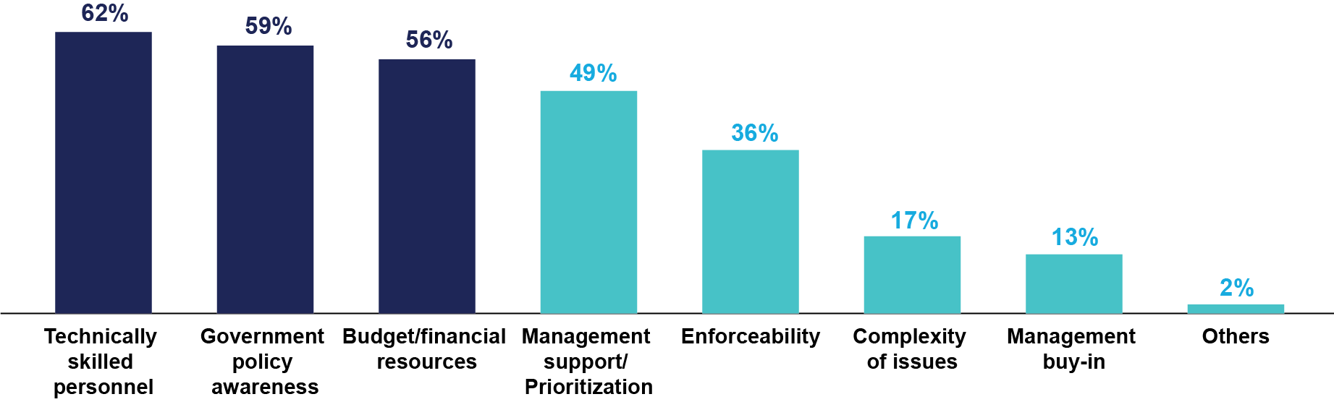
Implementation challenges (3Ps)
Top factors affecting compliance to NCSP and DICT's policies
Process
People: availability of technically skilled personnel (62%)
Policy: government policy awareness (59%)
Pera (Funds): budget/financial resources (56%)
Notes:
Both leaders and technical personnel identified the same factors that affect implementation challenges to information security.

Slide 16
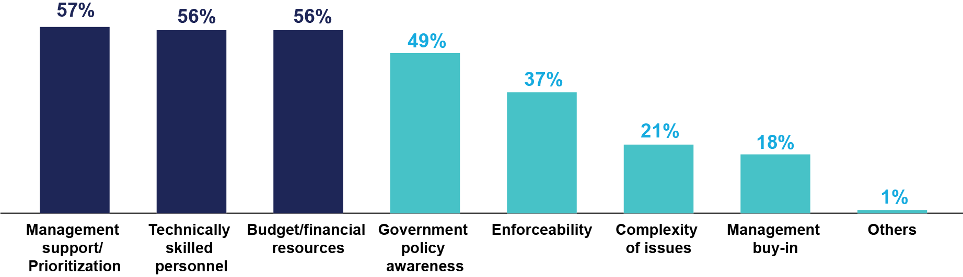
Implementation challenges (3Ps)
Top factors influencing implementation of Infosec Standards
Process
Prioritization: management support/prioritization (57%)
People: technically skilled personnel (56%)
Pera: budget/ financial resources (56%)

Slide 17
CHALLENGES IN CYBER SECURITY IMPLEMENTATION
The Emerging Danger
Artificial Intelligence
Impact on Cybersecurity
People-Process-Technology

Slide 18
CHALLENGES IN CYBER SECURITY IMPLEMENTATION
Thank you very much!
Maraming salamat!

