Slide 1
Internet Landscape of Japan
-- from IXP perspective --
Katsuyasu Toyama
Chairperson, the APIX association
COO, JPNAP by Internet Multifeed Co.

Slide 2

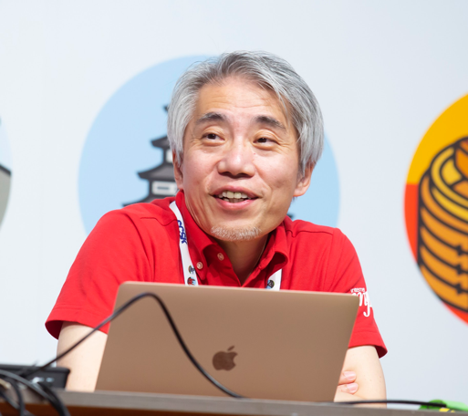


Self-introduction: Katsuyasu Toyama
JPNAP (2001, 2007-2012, 2015-)
  COO, Representative Director, and EVP
Asia Pacific Internet Exchange (APIX) association
  Chairperson (2010-2017, 2019-)
Peering Asia
  Peering Asia WG member (2017- )
NTT Communications
  SVP of Internet and Mobile Services (2012-2015)
  AS2914(GIN), AS4713(OCN)
from JANOG52 official photos

Slide 3
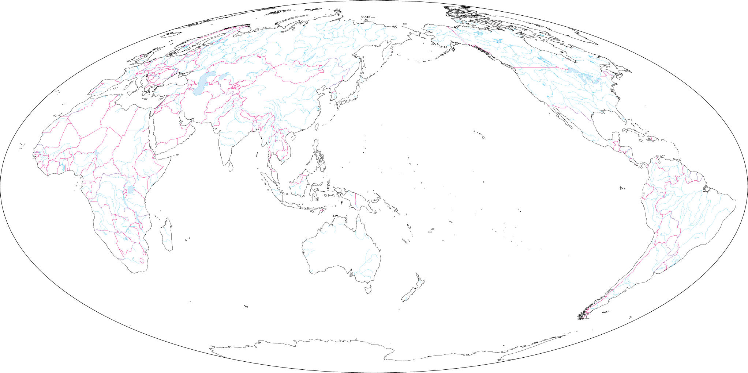
Japan: the location
North America
Europe
JAPAN
JAPAN
Asia-Pacific
Pacific Ocean
Africa
South America
Indian Ocean
Maps and Flags of the World
Mollwide projection: Asia-centric
https://www.abysse.co.jp/world-e/map/mollwide_asi_on.html

Slide 4
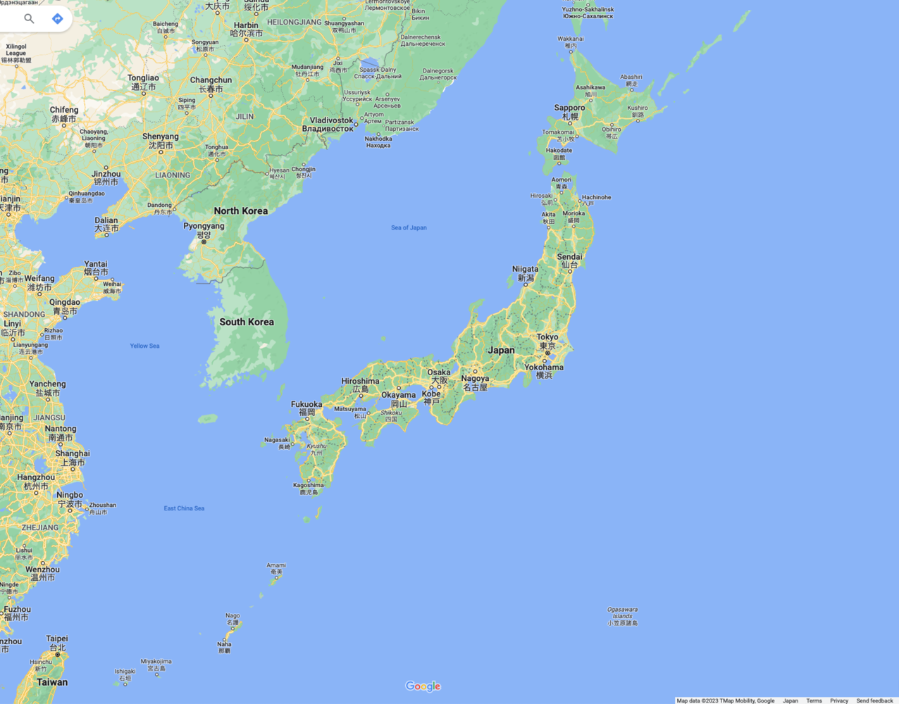
Population: 125 million [in 2023]
  The 12th in the world
Area: 378,000 km2 (146,000 mi2) [in 2020]
  The 62nd in the world
Sapporo
3,000km
Sendai
Kyoto
Tokyo
Fukuoka
(Capital)
Osaka
500km
JAPAN
Naha
Google Map

Slide 5
The Internet in Japan
History
  1984 Started in academia (UUCP-based)
    Keio University, Tokyo Institute of Technology, and Tokyo University
  1988 Connected via Internet Protocol (IP)
  1993 Commercial business started
    AT&T Jens and Internet Initiative (IIJ)
In 2023
  A few hundreds of Internet Service Providers (ISPs)
  4 mobile network operators (MNOs)
  4 (commercial) internet exchanges (IXPs)

Slide 6
 | Company | Service name
1 | Softbank | Softbank Hikari
2 | NTT resonant | OCN
3 | NTT docomo | Docomo Hikari
4 | Sony Network Communications | So-net
5 | Biglobe | Biglobe
6 | Optage | eo Hikari
7 | KDDI | au Hikari
8 | Nifty | @Nifty
 | Company | Service name
1 | NTT Docomo | docomo
2 | KDDI | au
3 | Softbank | Softbank Mobile
4 | Rakuten Mobile | Rakuten Mobile
Mobile Network Operators (MNOs)
 | Company | Year to start
1 | JPIX | 1997
2 | JPNAP | 2001
3 | BBIX | 2002
4 | Equinix | 2007
Top 8 Internet Service Providers (ISPs) on FTTH
Internet Exchanges (IXPs)
Multi-Media Research Institute: https://www.m2ri.jp/e/
Press Release: https://www.m2ri.jp/release/detail.html?id=579 on 8 Jun 2023 (in Japanese)

Slide 7
Internet Penetration
Internet usage rate (Individuals): 82.9% [1]
Nation-wide development rate of optical fibers: 99.3% [1]
Number of broadband subscribers: 43.8 million [2]
  ISP (FTTH): 36.6 million
  CATV (HFC+FTTH): 6.5 million
Mobile broadband subscribers (4G/5G): 184 million [2]
[1] White paper 2022, Information and Communications in Japan by MIC
[2] Press release by MIC:
  https://www.soumu.go.jp/menu_news/s-news/01kiban04_02000220.html

Slide 8
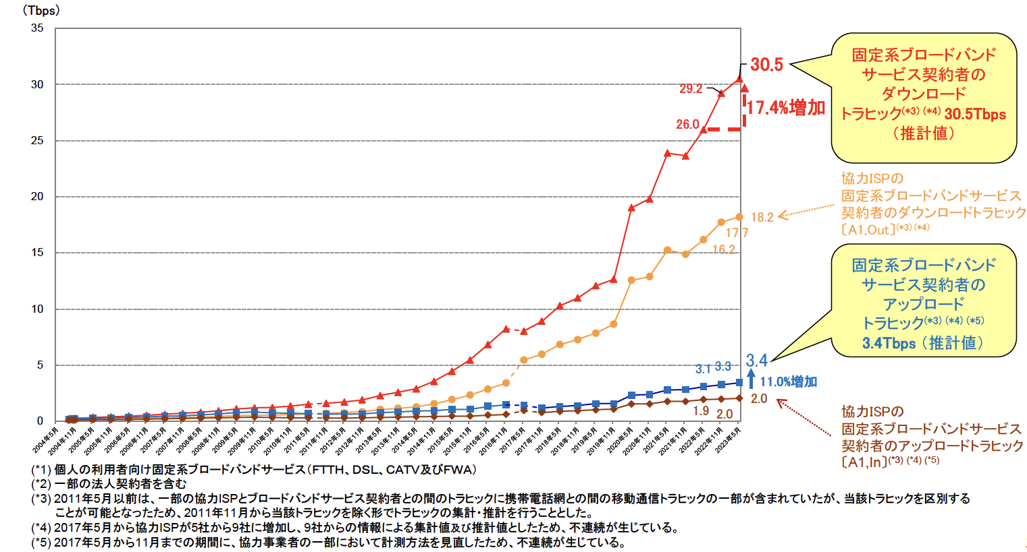
Estimated broadband Internet traffic in May 2023
  Download: 30.5Tbps, 17.4% increase (YoY)
  Upload: 3.4Tbps, 11.0% increase (YoY)
Download:
30.5Tbps
(+17.4%)
Upload:
3.4Tbps
(+11.0%)
https://www.soumu.go.jp/menu_news/s-news/01kiban04_02000226.html (in Japanese, the latest)
https://www.soumu.go.jp/main_sosiki/joho_tsusin/eng/pressrelease/2023/2/15_01.html (in English)

Slide 9
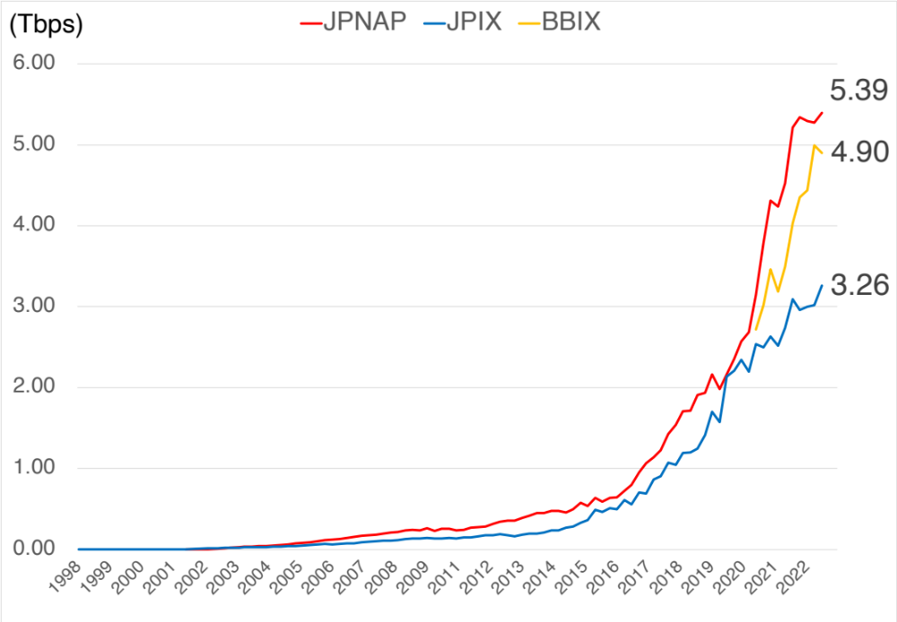
Traffic trend of 3 major IXPs in Japan
Traffic data is collected by INTERNET MULTIFEED CO. from the web sites of each IXP
  Traffic data of JPIX has been published since 1997, and JPNAP since 2001
  BBIX started to publish traffic data since 2021 (Equinix does not publish so far)

Slide 10

IPv6/IPv4 ratio at JPNAP
Comparing average bit/s

Slide 11

Internet topologies
Sapporo
Sendai
Fukuoka
Tokyo
(Capital)
Osaka
Naha
Google Map

Slide 12
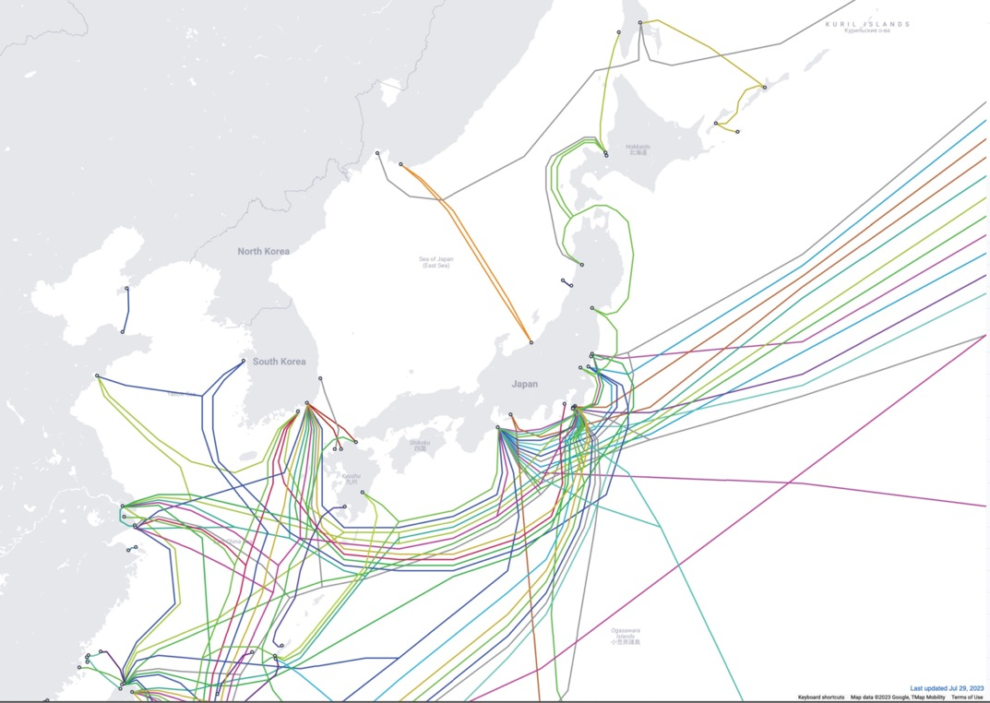
Submarine cable systems and their landing areas
Tokyo
Osaka
To US
To Asia
To Australia
https://www.submarinecablemap.com

Slide 13
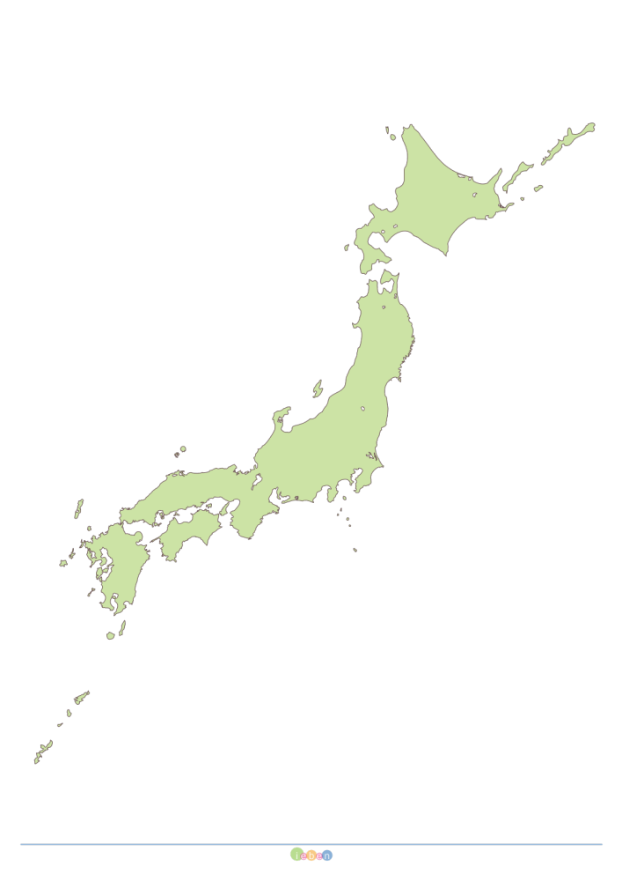
Internet topology
ISP
Tokyo & Osaka
  Interconnection points
  Gateways to other regions
  Redundancy
Concern
  ISPs in east rely heavily on Tokyo, while
  ISPs in west/middle connect to both
ISP
ISP
Content
North America
Content
IX
Tokyo
IX
Osaka
ISP
ISP
Asia Pacific
https://ieben.net/hakutizu-japan/A3-print/hakutizu/

Slide 14
ASN ratio: domestic vs international
510 unique ASNs are connected to BBIX/Equinix-JP/JPIX/JPNAP
  referred to PeeringDB (29 Aug 2023)
International
Domestic

Slide 15
Peering policy
Big ISPs are selective, some are very restrictive
Small/Medium ISPs (eyeballs) are open
Content, Cloud, and CDN are open
  sometimes they behave like selective so that they could control traffic

Slide 16
Recent topics in Japan
The rise of the live streaming traffic
The third hub of Japan is growing

Slide 17
Recent topics in Japan
The rise of the live streaming traffic
The third hub of Japan is growing

Slide 18
The rise of the live streaming
Until recently, big live events were broadcast only on TV
Some events began to stream via Internet
A turning point was World Cup soccer game 2022

Slide 19
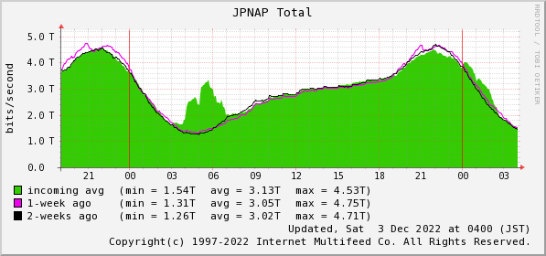
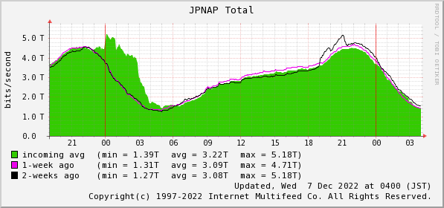
The rise of the live streaming
World cup soccer games 2022
Dec 3, 2022
  World cup soccer game
    Japan vs Spain
Dec 6, 2022
  World cup soccer game
    Japan vs Croatia

Slide 20
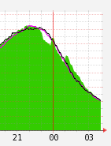
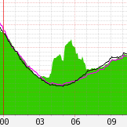
The rise of the live streaming
Before
After
Jun 28, 2018
  World cup soccer game
    Japan vs Poland
  Live was broadcasted on TV
    Traffic decreased by 0.5Tbps
Dec 3, 2022
  World cup soccer game
    Japan vs Spain
  Live streaming on the internet
    Traffic increased by 1.7Tbps

Slide 21
The rise of the live streaming
Unique approach of Japan
  “CONECT” council
    ISPs and Content providers/CDNs are regularly sharing the information
Should special care about an event stream, which
  is very popular
  is free
  doesn’t require registration

Slide 22
Recent topics
The rise of the live streaming traffic
The third hub of Japan is growing

Slide 23
The third hub of Japan is growing
Usually, it is very difficult to make another hub city other than Tokyo and Osaka

Slide 24
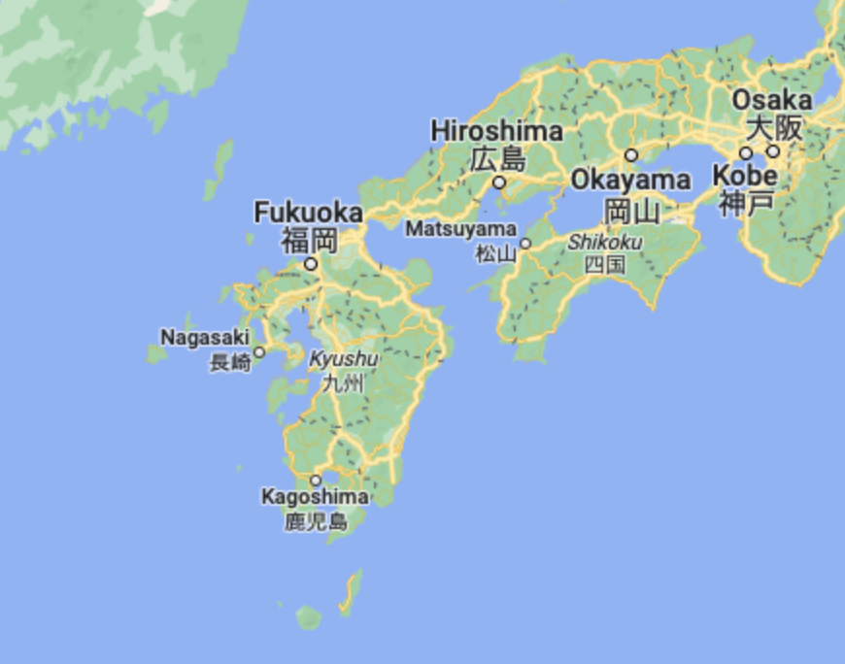



The third hub of Japan is growing
Fukuoka
  A major city of Kyushu Island
  Three commercial Internet exchanges were built there around 2021
Google Map

Slide 25
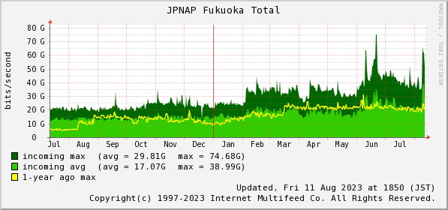
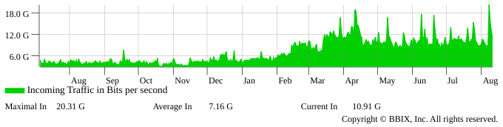
The third hub of Japan is growing
JPNAP Fukuoka
https://www.jpnap.net/en/ix/traffic.html#jpnap-fukuoka-traffic
BBIX Fukuoka
https://www.bbix.net/en/service/ix/traffic-graph/ (Fukuka-zone)

Slide 26
The key success factors
There are substantial number of eyeballs (ISP or CATV) in Kyushu Island
CDN providers or their cache servers could be invited
The access lines to Fukuoka become cheaper than before

Slide 27
One last comment
Japanese people involved in Internet operations and business collaborate and self-regulate well.
These characteristics, along with high aspirations, are working well to make the Internet better for all users.
My hope is that these values will remain within our community and be extended to economies across the Asia Pacific region, and ultimately, the world.

Slide 28
Thank you very much!
ありがとうございます
(Arigato gozaimasu)
Any questions and comments?

