Slide 1



M-Root DNS Deployment with APNIC Foundation's support
Hiro Hotta, JPRS
Kazuhiro Kitamura, JPRS
February, 2023

Slide 2
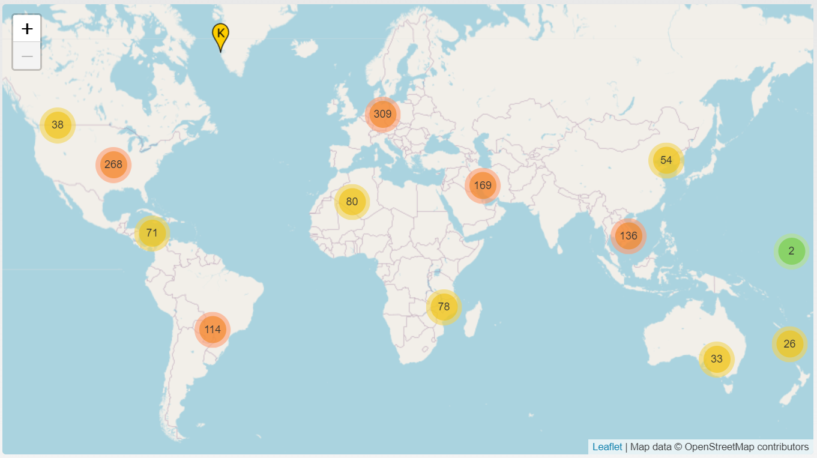
Number of Root DNS Server Instances
The root DNS server system consists of 1,600+ instances.
AP region has about 20% of root server instances
（as of January, 2023）
https://root-servers.org/
About 60% of the world population live in AP region
February, 2023

Slide 3
Operators of Root DNS Servers
name |  | Operator | Organizational type
A-Root |  | Verisign, Inc. | Company (domain name registry)
B-Root |  | Univ. of Sothern California, Information Sciences Inst. | University（laboratory）
C-Root |  | Cogent Communications | Company（ISP）
D-Root |  | Univ. of Maryland | University
E-Root |  | NASA Ames Research Renter | Government (laboratory）
F-Root |  | Internet Systems Consortium （ISC） | Nonprofit organization（DNS soft. developer）
G-Root |  | U.S. DoD Network Information Center | Government
H-Root |  | U.S. Army Research laboratory | Army（laboratory）
I-Root |  | Netnod | Nonprofit organization（operator of IX）
J-Root |  | Verisign, Inc. | Company (domain name registry)
K-Root |  | RIPE NCC | European Regional Internet Registry
L-Root |  | ICANN | Nonprofit organization
M-Root |  | WIDE project & JPRS | Research project & Company (domain name registry)
M-Root Operator is the only one based in AP region
February, 2023

Slide 4
M-Root DNS Server deployment
In 2004, M-Root started anycast services
In 2020, MoU among WIDE Project, JPRS, and APNIC concluded for global deployment of M-Root instances with focus on AP region
Deployment of more anycast instances under way with funding support from APNIC Foundation/APIDT
Kazuhiro Kitamura <kitamura@jprs.co.jp> is appointed as M-Root Deployment Manager
February, 2023

Slide 5
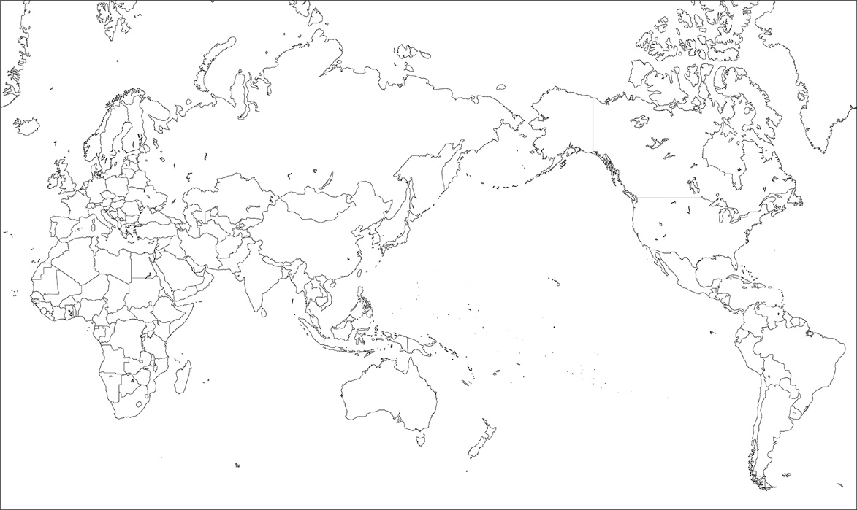



















M-Root deployment status
Expand the overage in APAC (2) RTT improvement from the region
★ until 2019
★ 2020 - 2022
★ Coming Soon
★
★
★
★
★
★
★
★
★
★
★
★
★
★
★
★
★
★
★
★
★
February, 2023

Slide 6
interested in hosting an instance?
contact :
m-root-eoi@jprs.co.jp
or
Kazuhiro Kitamura
(M-Root Deployment Manager)
kitamura@jprs.co.jp
February, 2023

