Slide 1
APNIC Academy
Che-Hoo Cheng
Infrastructure & Development Director
APNIC
2023-02-26

Slide 2
APNIC’s Vision & Mission
Vision:
  “A global, open, stable, and secure Internet”
Mission:
  To provide essential services as a Regional Internet Registry, and to support Internet development in the Asia Pacific region

Slide 3
Internet Development Work
Human Resource Development / Capacity Building
  Training & Technical Assistance on Internet infrastructure topics
Technical/Security Community Support
  NOGs, Peering Forums, NRENs/RENs & CERTs/CSIRTs
Internet Infrastructure Support
  IXPs, Root Servers, Honeynet & RIPE Atlas

Slide 4
Positioning of Training
Internet infrastructure focused
  Targeting current and future Internet engineers
  Covering deployment and operations
  Emphasising best practices – RFCs and other industry best practices
  Vendor neutral
Standardized, well-structured training content and curriculum as solid foundation
  CC BY-NC-SA 4.0 used for training content for maximum benefit to community
Inputs & feedbacks received guiding the development
Notes:
Open-source preferred, if available and of quality

Slide 5

Training Curriculum
APNIC Policies and IRM
Internet Routing, IXPs and Peering
IPv6
Network/Routing Security (including RPKI)
DNS/DNSSEC
NMM
SDN and Network Automation
MPLS
CERT/CSIRT
Information/Cyber Security
System Admin (Linux)

Slide 6
APNIC Academy
APNIC Academy as the branding to use for all APNIC training and technical assistance (TA) activities gradually starting 2020
Blending Learning / Flipped Classroom / HyFlex
  Face-to-Face + Online / Instructor-Led + Self-Paced
    As complement, with good balance
  Theories and practical exercises
  Basic to advanced level
  Depth and breadth

Slide 7
APNIC Academy Platform
One single online platform for all users to go to for all training and TA activities
  Less ambiguity after merging and integration with training website
  Course catalogue and information
  Training calendar and registration
  Training content (current and past)
  Training attendance and progress records
  TA platform support
  Support APNIC Login (SSO)
Notes:
Merging the training website into Academy platform

Slide 8
APNIC Academy Platform
Integrated Virtual Labs
Multilingual support
Mobile friendliness
Also a platform for internal to manage the relevant activities
  With good integration and automation

Slide 9
Serving Other Projects and Needs
APNIC Academy platform also be used to serve other projects and needs
  No need to reinvent the wheel and have duplicated effort
Examples include:
  MANRS & APCERT courses
  APie (Asia Pacific Internet Engineer) Program of AI3/SOI Asia
  Training for non-technical audiences

Slide 10
Long-Term Goal
Full certification with full curriculum
  Leveraging APNIC Academy platform
“Certified APNIC Internet Engineer” (?)
  Certification issued after obtaining enough credits on enough topics (?)
  Level 1-3 (?)
Notes:
Will gather inputs from various stakeholders

Slide 11
High Growth Starting 2021
Demand for more training is clear from surveys and feedback
APIDT/APNIC Foundation funding starting 2021 enables higher growth in training capacity
  Scale up all training and TA activities
  Do more and do better with good foundation and structure, leveraging APNIC Academy platform, content and curriculum
Also more focused in-person support to community
  Sub-regionalization for training delivery, TA and community/infrastructure support, with more staff trainers and Community Trainers dedicated for sub-regions
Notes:
So as to meet the ever-increasing demand
High scalability
Will invest more in both in-person and online training

Slide 12
Possible Partnership
NRENs/RENs, universities and VET
  Content freely available for use by all teachers/professors
    To raise the standard for graduates
  Courses formally incorporated into diploma/degree programs
  Partnering to deliver more training for scaling up
  Federated access to APNIC Academy platform – eduGAIN support
RIRs & I* organizations
  Content sharing, if licensing terms are compatible
  Content hosting

Slide 13
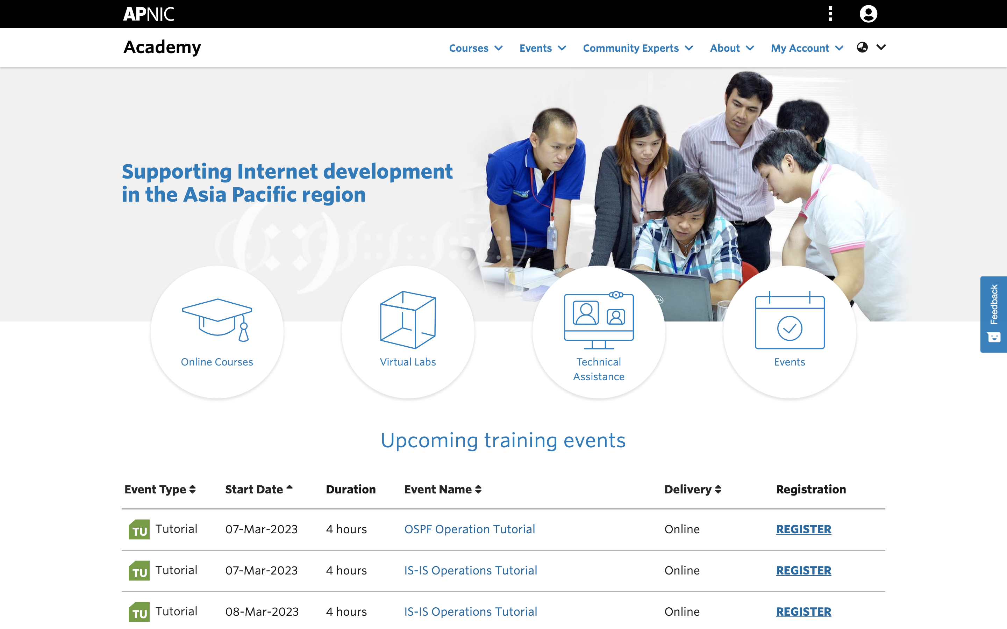
Academy Product –
Platform, Content and Curriculum

Slide 14
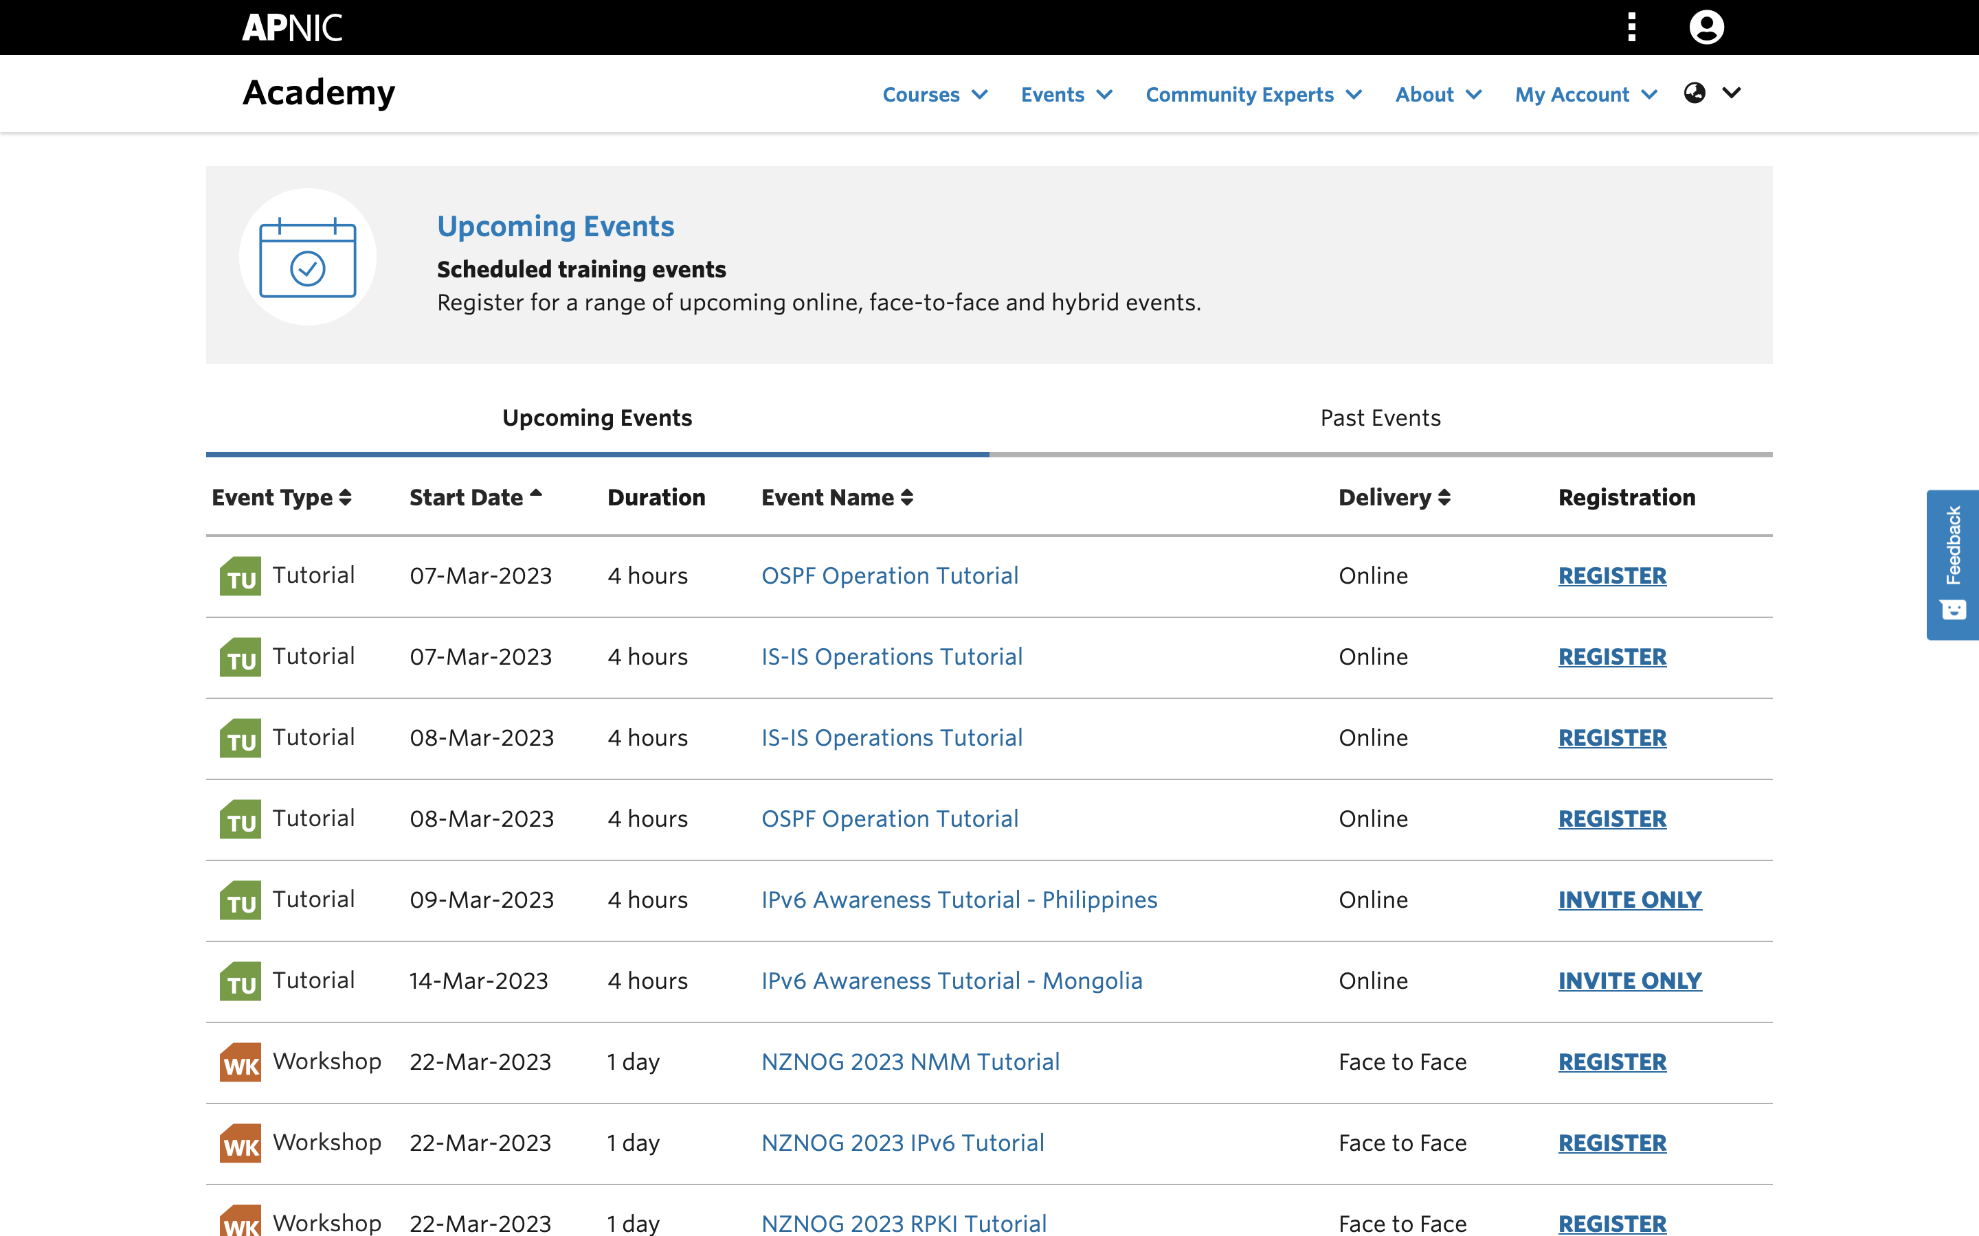
Academy Product –
Platform, Content and Curriculum

Slide 15
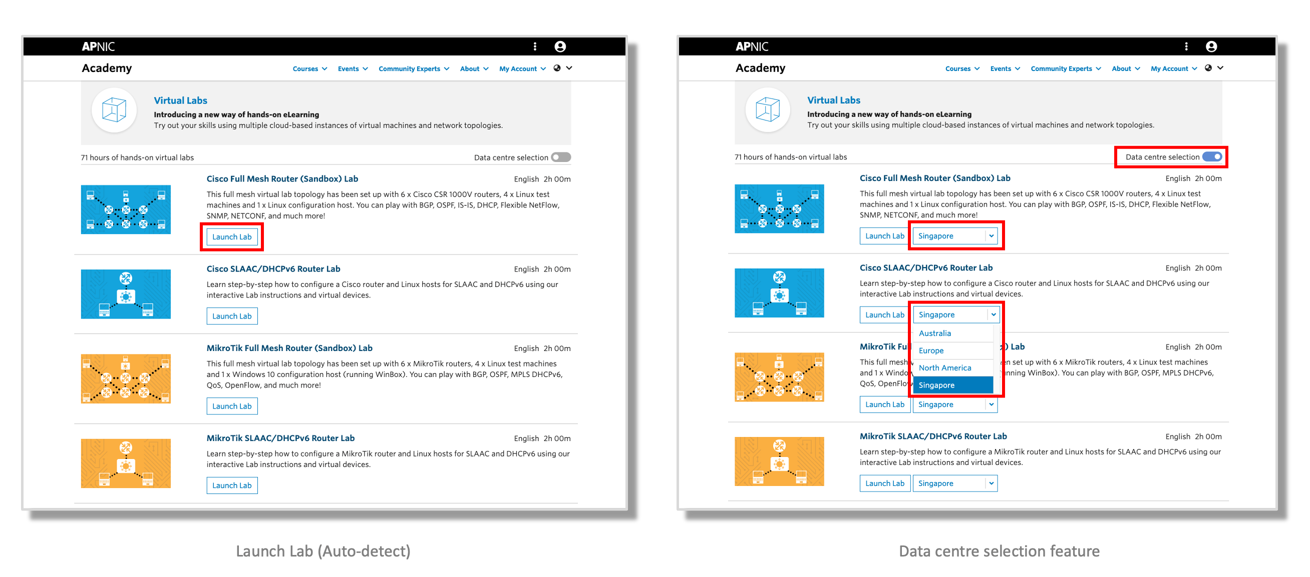
Academy Product –
Platform, Content and Curriculum

Slide 16
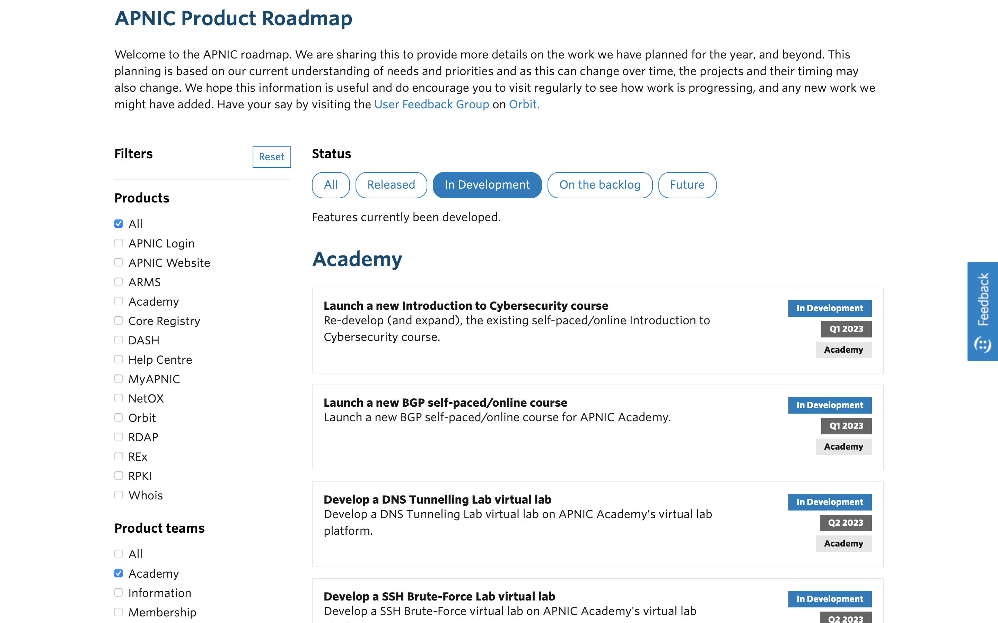
Academy Product –
Platform, Content and Curriculum

Slide 17
Instructor-led Training
Returning to Face-to-Face training gradually
Hybrid training is also an option to consider
  No international travel is involved
Nominal fee is charged for in-person/hybrid training
  Members receive discount
Online training (free of charge) will still be maintained
Can do customised training based on need, e.g. IPv6 for specific industry type
Sub-regionalisation (SA/O and SEA/EA)
  To provide more focused support for higher impacts
  To do much more training & TA, with staff trainers and Community Trainers
Notes:
Registration all on APNIC Academy platform

Slide 18
Community Trainers
Voluntary CTs have been providing a lot of help to training
  Will maintain 30+ Voluntary CTs
Adding Retained CTs for even more focused on-the-ground local support to targeted economies
  13+ economies identified as trial
    1 Retained CT for each
  To work half-time
  To do even more training & TA
    Preferably in local languages
If you are interested or have referrals:
  https://www.apnic.net/about-apnic/employment/

Slide 19

Relaunch of eduroam service
eduroam Wi-Fi Internet access service is available in more than 100 economies at participating universities, libraries, hospitals, airports and so on
It’s now available to all eligible APNIC Academy users who have completed one online self-paced course with successful quizzes
  Will add instructor-led courses when course completion can be properly recorded
For registration, please visit: https://academy.apnic.net/en/eduroam

Slide 20


Launch of two new self-paced courses
To publish 2 new courses “Introduction to BGP” and “Cybersecurity Fundamentals”:

Slide 21
References
APNIC Training Services - Strategies & Directions of APNIC Academy at APNIC 52: https://conference.apnic.net/52/assets/files/APBS588/apnic-training-services-strategies-and-directions-of-apnic-academy.pdf
Training & Development Updates at APNIC 53: https://2022.apricot.net/assets/files/APNT374/training-and-development-updates.pdf
Training & Development Updates at APNIC 54: https://conference.apnic.net/54/assets/files/APSG129/apnic54trainingdevel_1663116194.pdf

Slide 22
Questions?

