Slide 1
How Monitoring and Evaluation is supporting development outcomes for the Internet
The APNIC Foundation experience
February 2023
Notes:
Knowing what we are doing
Having stats allows us improve what we are doing
Communicating it to others what works and what doesn’t allows for greater engagement

Slide 2
What is Monitoring and Evaluation?
Monitoring and Evaluation (M&E) is used by organisations to assess and improve the performance of projects, programs and organisations.
  Monitoring is the regular collection and analysis of information to provide indicators of progress towards objectives. It includes monitoring inputs, activities, outputs and progress towards outcomes. Monitoring answers the question: ‘What is going on?’
  Evaluation is assessment of a planned, ongoing or completed activity to assess the achievement of objectives as well as testing underlying theory of change assumptions. Evaluation answers the question: ‘What happened?’

Slide 3
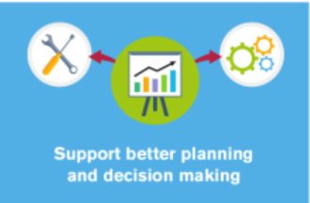


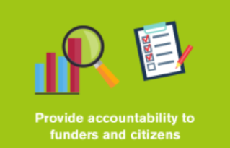
Why do we need it?
Notes:
Monitoring is the regular collection and analysis of information to provide indicators of progress towards objectives. It includes monitoring inputs, activities, outputs and progress towards outcomes. Monitoring answers the question: ‘What is going on?’
Evaluation is assessment of a planned, ongoing or completed activity to assess the achievement of objectives as well as testing underlying theory of change assumptions. Evaluation answers the question: ‘What happened?’
M&E needs to be considered and defined before the start of any activity so that it can provide the evidence required to make assessments of program performance.

Slide 4
What do I do?
The purpose of my role is to ensure the APNIC Foundation has a robust monitoring and evaluation (M&E) framework to measure and assess a variety of projects and activities.
The development, management and implementation of the M&E framework ensures that project outcomes and outputs have performance measures that are captured, analysed and reported against.

Slide 5
How is the Foundation using M&E?
1
Co-designing project-level M&E frameworks using theory of change
2
Strengthening project reporting – internal/external stakeholders
3
Measuring and communicating the impact and evidence base of our work
4
Increasing the reliability of data to inform learning and decision making
5
Delivering portfolio-level impact measurement and reporting – aggregated program data
6
Developing project level risk registers

Slide 6
The future….making the Internet better?
1
Measuring the impact of Internet best practices such as RPKI, IPv6, MPLS
2
Monitoring and evaluation resources for the technical community
3
Improving data visualisation and reporting
4
Mainstreaming evaluation as BAU
5
Measuring and communicating our social impact (i.e. SDGs) – increase access to values-based investors

