Slide 1
AP* Retreat
Presented by Sylvia Cadena, Head of Programs and Partnerships
27 February 2024 – Bangkok, Thailand

Slide 2
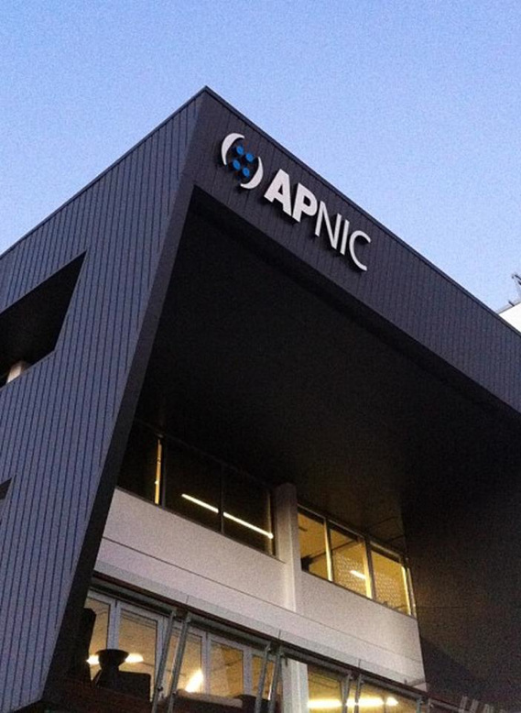
Asia Pacific Network Information Center - APNIC
A neutral, independent, not-for-profit, membership-based organization established in 1993
Managing Internet number resources IPv4, IPv6 and ASNs
Serving APAC region
APNIC helps build essential technical skills across the region
Supports Internet infrastructure development
Produces insightful research
Active participant in the multistakeholder model of Internet cooperation and governance.
APNIC performs these activities as part of its commitment to a global, open, stable and secure Internet that serves the entire Asia Pacific region

Slide 3
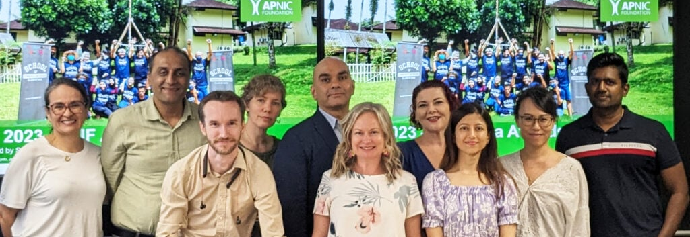
Foundation team
Left to right: Sylvia, Omar, Dave, Helen, Raj, Ellisha, Cathlene, Swati, Ann and Indika

Slide 4
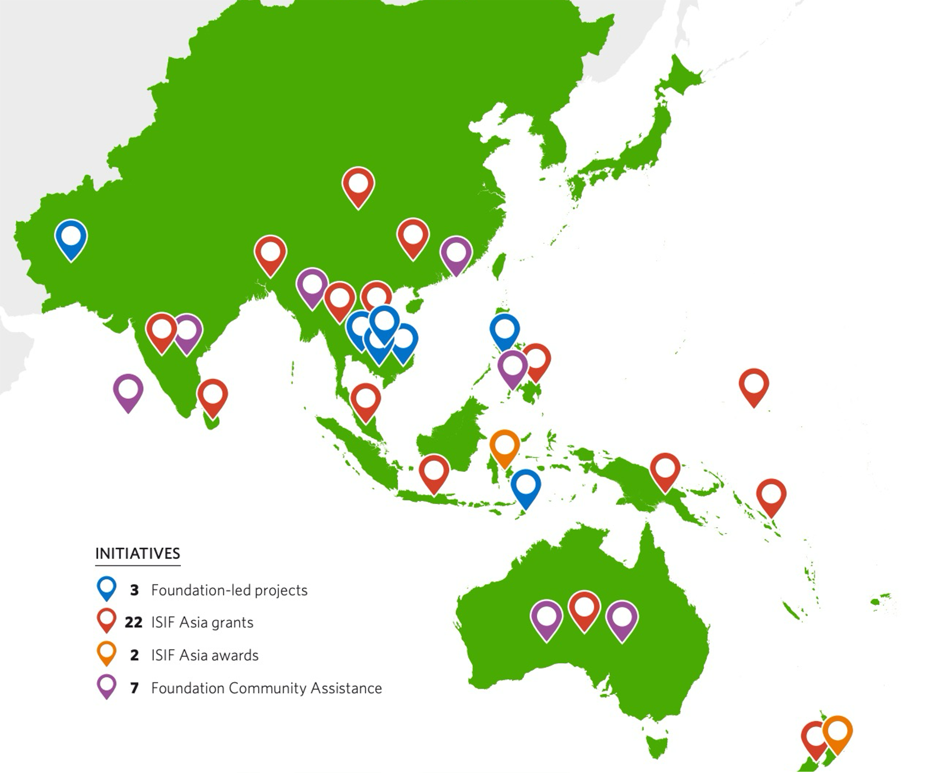

The APNIC Foundation
        VISION
To have a global, open, stable and secure Internet that is affordable and accessible to the entire Asia Pacific community
MISSION
To increase investment in Internet development in the Asia Pacific region, through education and training, human capacity building, community development, research, and related projects and activities
2022 Annual Report
Notes:
Founded in 2017 by APNIC the regional Internet address registry (RiR) for the Asia-Pacific. One of the world's five RIRs

Slide 5
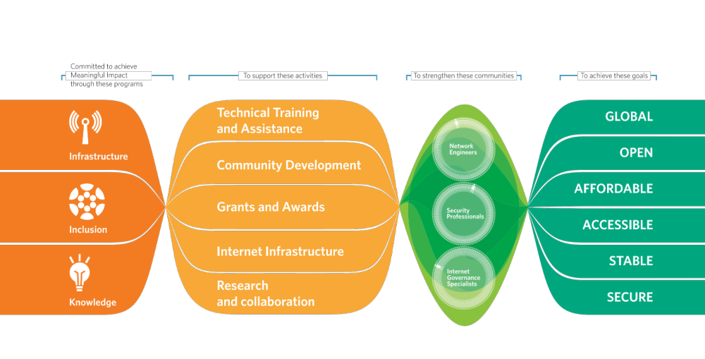
How we work

Slide 6



Foundation Programs
INFRASTRUCTURE
Network deployment and operations
Network monitoring and management
Security and privacy
IPv6 Deployment
INCLUSION
Availability of connectivity
Internet access affordability
Accessibility
Diversity
Environment
KNOWLEDGE
Research
Professional development
New Information and training resources
APAC languages

Slide 7
Impact and projects updates
Infrastructure development and capacity building

Slide 8
Foundation community assistance
Organization | Project Title
Ministry of Communication and Aviation | Developing SolCERT
EngageMedia | Asia-Pacific Digital Rights Festival
IGF Secretariat - UN DESA | APAC Remote Hubs and Fellowships from the Global South to attend IGF 2023
APIA and SANOG chairs | SANOG Fellowships support
Dot Asia | APrIGF Fellowships and logistics support
FIRST | Regional Symposium for the Pacific
KISA (Korea Internet & Security Agency) | Fellowship and Conference Support for APIGA 2023
Digital Empowerment Foundation | Community Network Xchange 2023
BKNIX Co. Ltd | BKNIX Infrastructure Development
Association for Progressive Communications | APC Comparative economic and social study of networks
World Summit Awards | WSA Grand Jury Meeting (APAC invitees)
IEEE | Connecting the Unconnected (CTU) Challenge
MISPA-IXP | IXP Support

Slide 9
Technical training and mentoring support for
Internet professionals in Afghanistan
32 Afghan participants, 29 active
178 courses and learning activities approved
71% reported as completed (84 training and professional certifications achieved)
91% of the participants reported progress on monthly basis
Afghanistan Internet Governance Forum (A-IGF), Afghanistan Youth IGF (AyIGF), and Afghanistan School on Internet Governance (AFSIG) resumed operations
In addition, the project supported the establishment of a brand-new initiative, the Afghanistan Network Operator Groups (AFNOG)

Slide 10
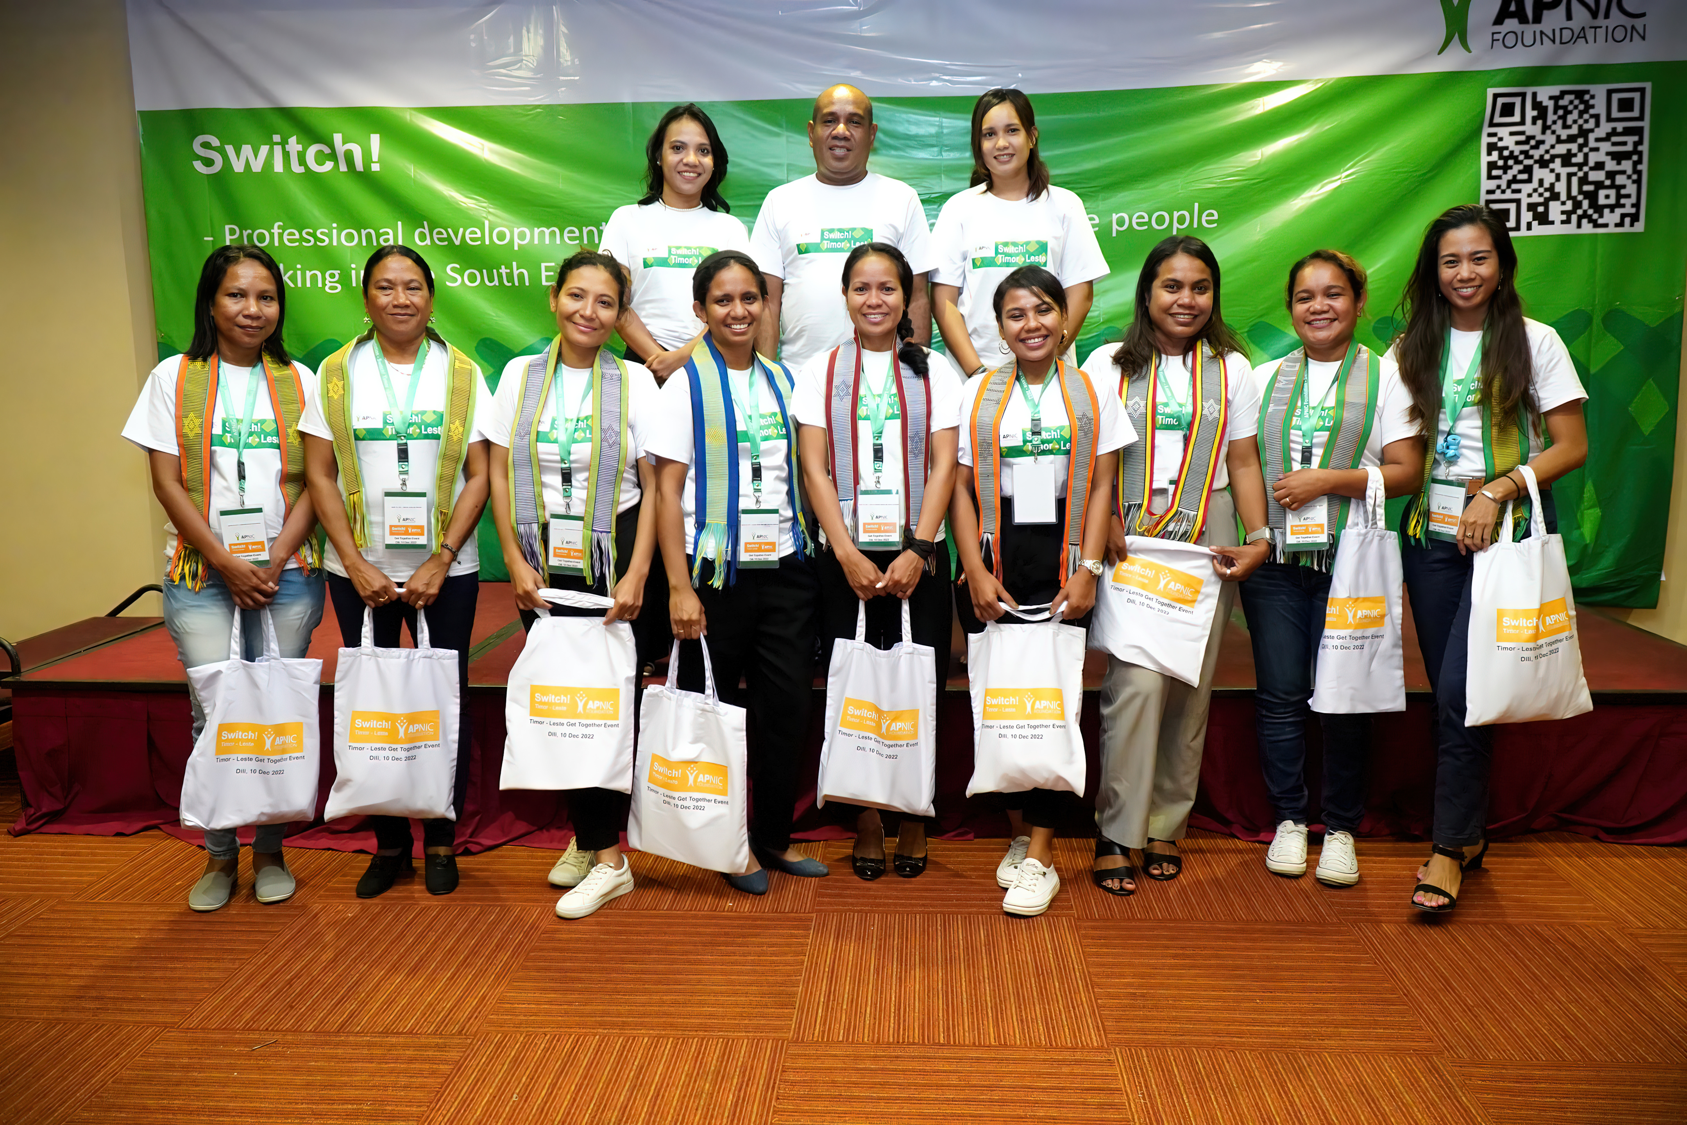
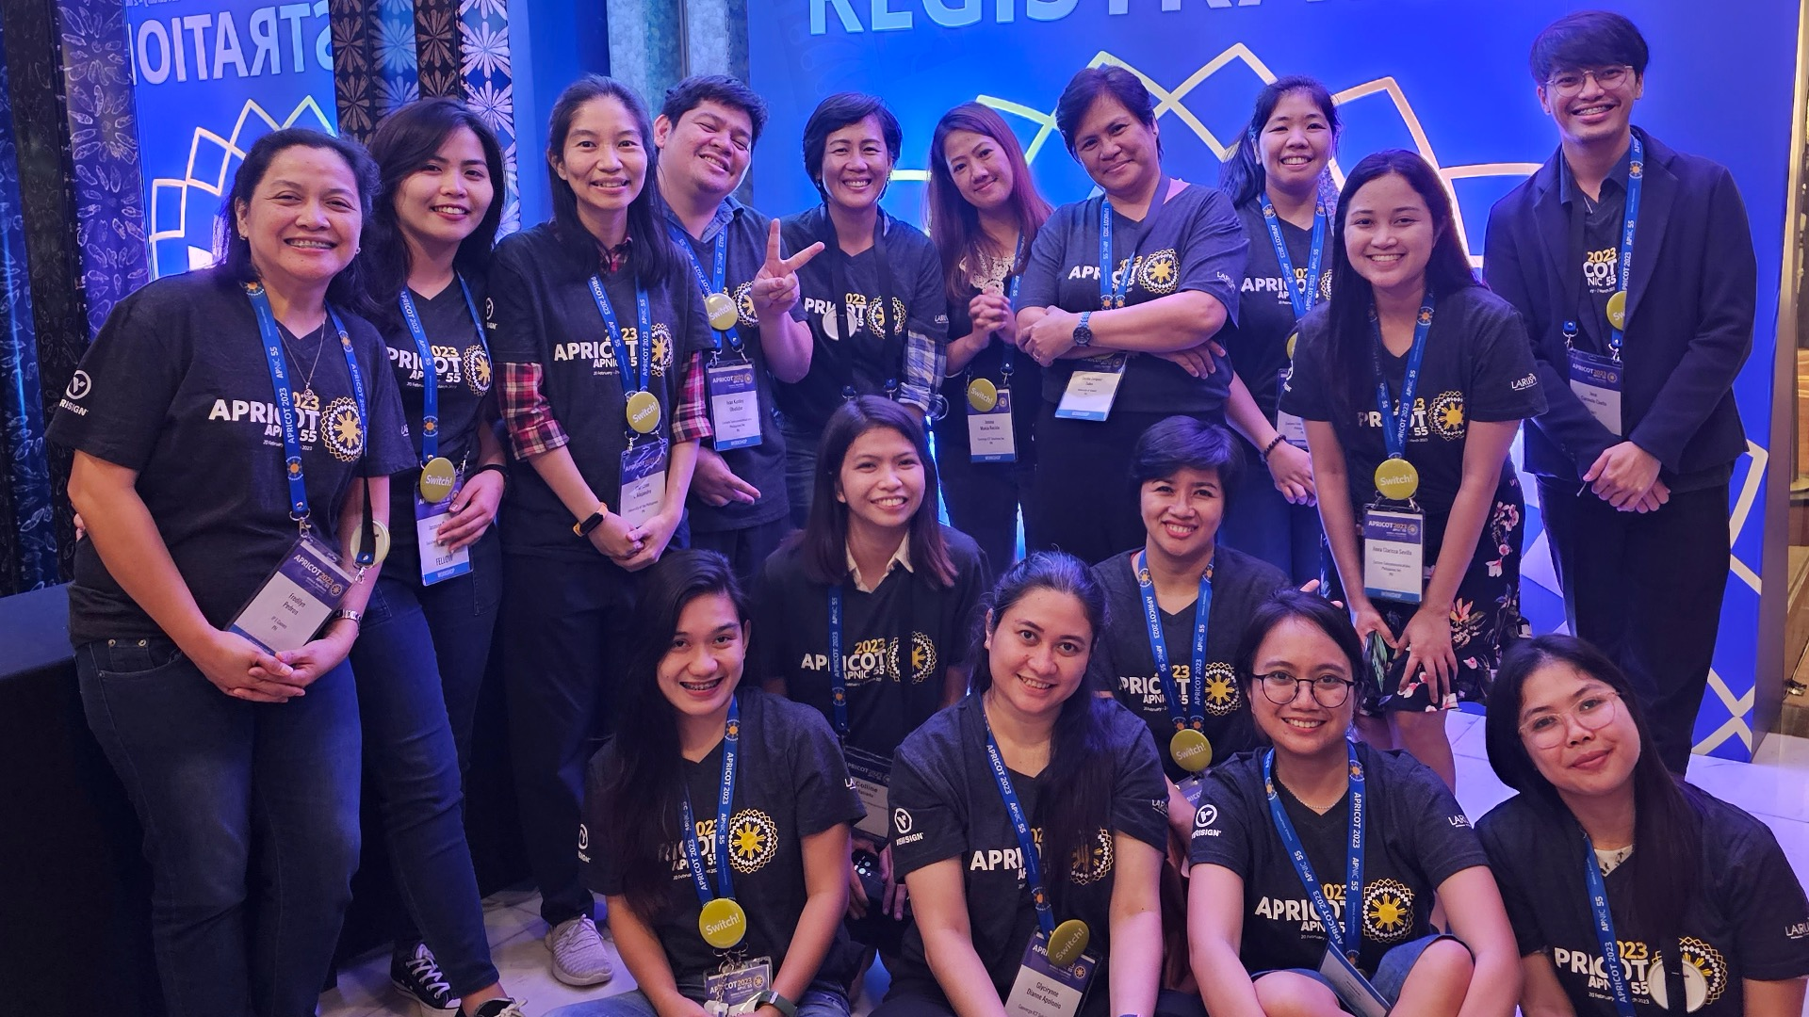
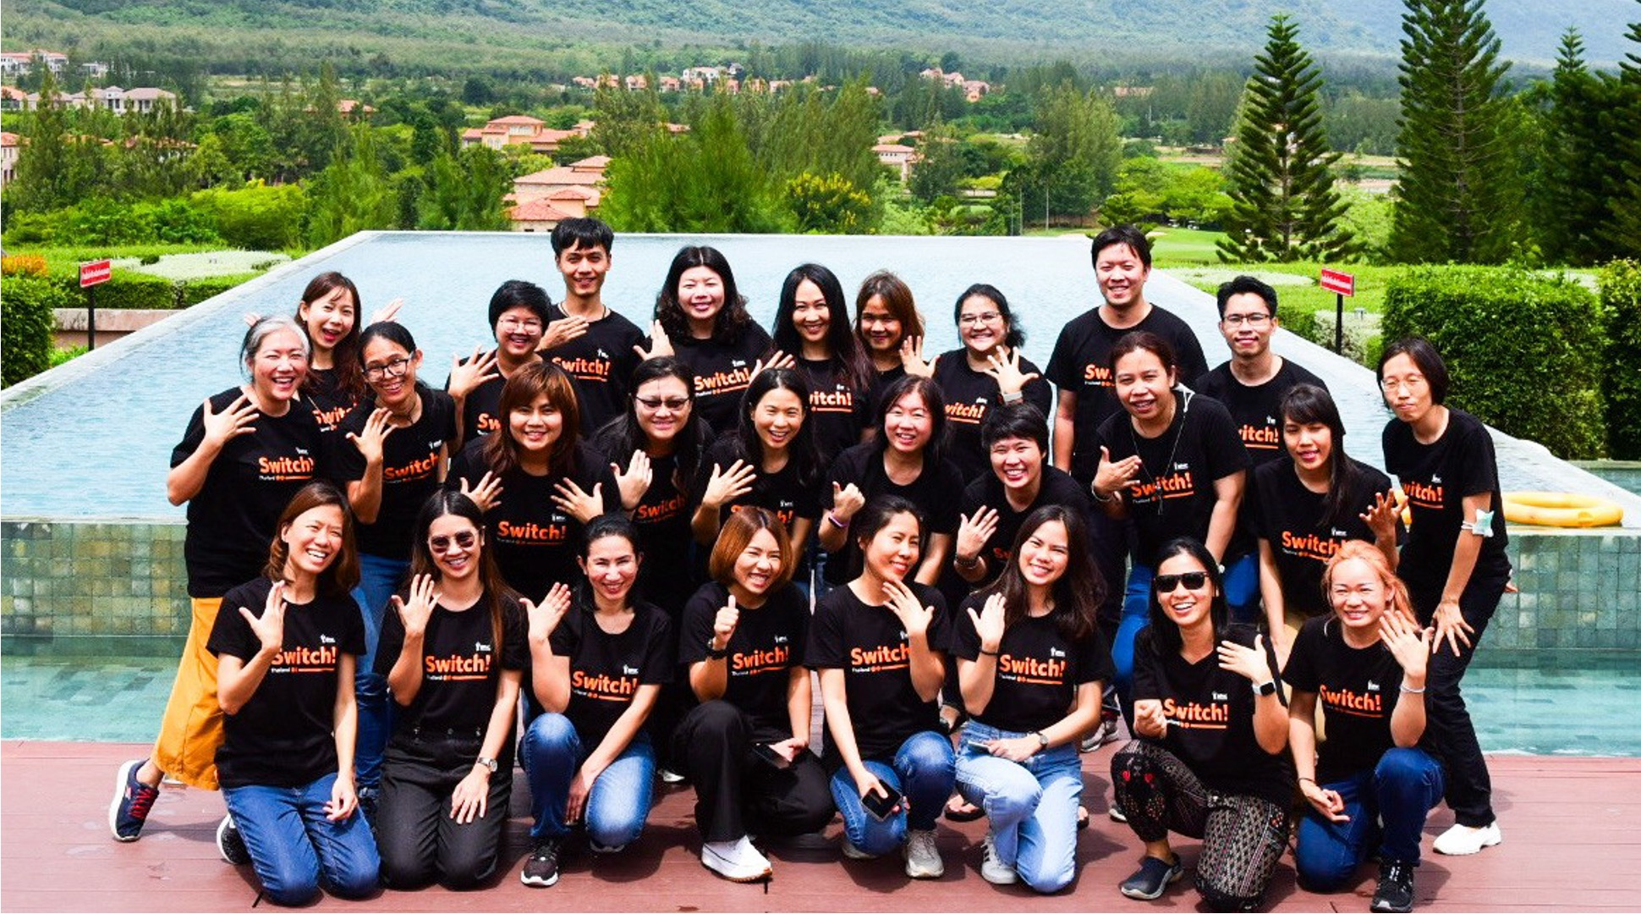







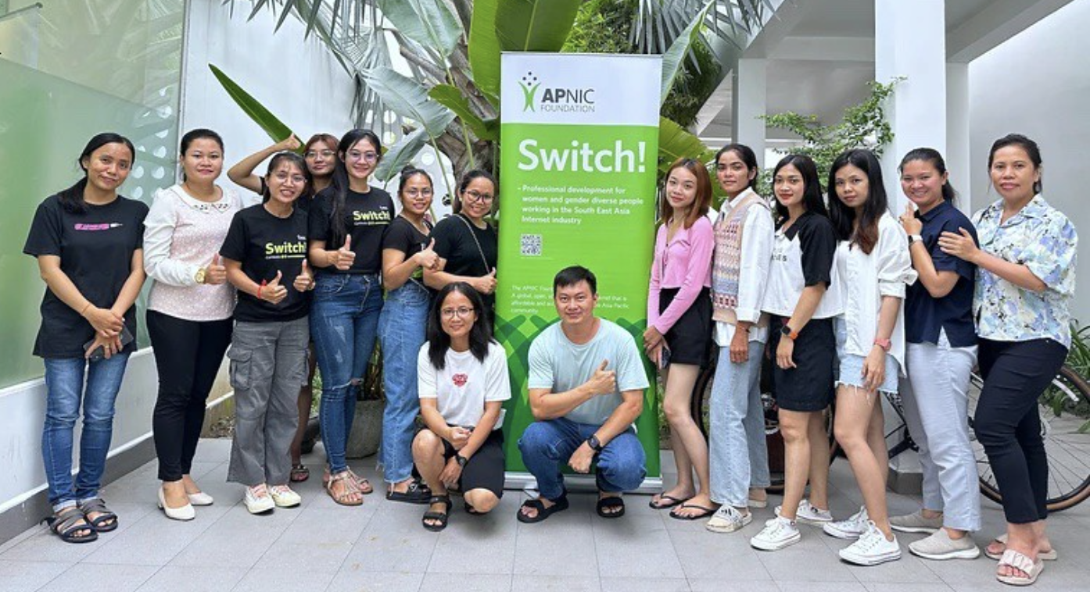
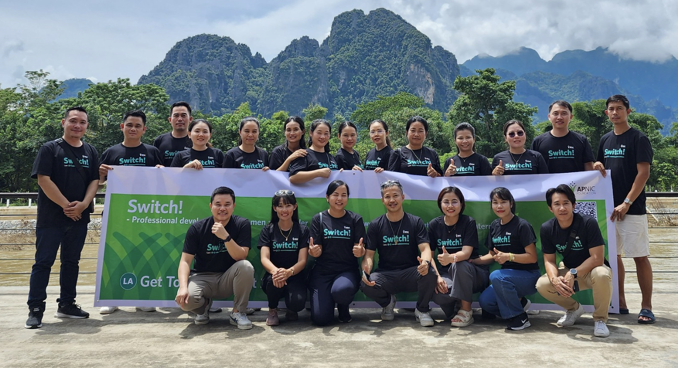

Slide 11
Switch! gender and diversity
176 participants from KH, LA, TL, TH, PH, VN - 162 women, 14 gender diverse
2075 training activities approved, 85% reported as completed and 87% monthly report
Average of 12 training requests completed per active participant
90% of participants received a Certificate of Achievement (meaning they completed at least 65% of their originally approved PD Plan) and achieved 934 certifications (average 5 per active participant)
52% shared research outcomes for a total of 11 publications
93% reported engagement across 738 networking activities, an average of 4 engagements per participant during the year at local, national, regional and/or global levels
Out of the 131 participants that joined the coaching program, 71% completed the program

Slide 12
Trust discretionary fund
Organization | Project Name
Internet Society | Internet Protocol Journal
 | MANRS Ambassador & Fellowships
Asian Institute of Technology | AINTEC conference 2023
 | AP* Secretariat Support
APAN | APAN56
auDA | APrIGF 2023
Web Consortium Asia Pacific General Incorporated Foundation | W3C APAC
PeeringDB | PeeringDB
CyberGreen Institute | CyberGreen Institute

Slide 13
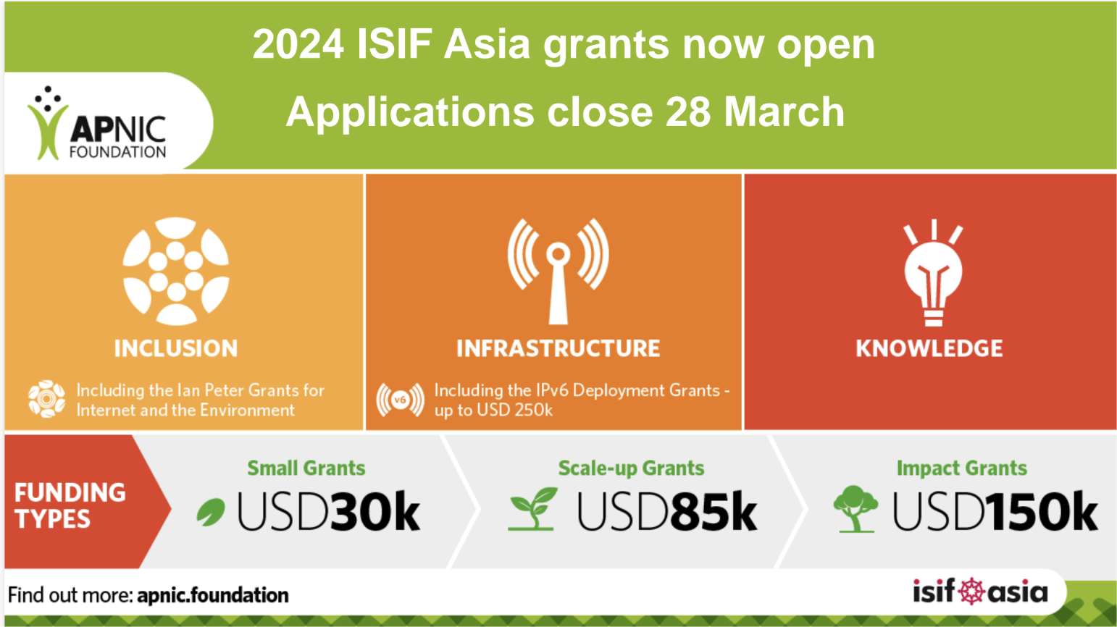

Slide 14

ISIF Asia at a glance
Tracking 68 projects (2021, 2022 and 2023 funding cycles): 59 under development, 23 progress reports and 9 final reports approved
Awards for IXP development

Slide 15


Slide 16
Questions, comments and feedback are always welcome!

