Slide 1
One Global Internet, Opportunity for All
February 2023
AP* Retreat 2024

Slide 2
What we h
Collaborating with our Asia Pacific partners
Share your feedback

Slide 3
2024 Action Plan

Slide 4
2024 Overview
In 2024, the Internet Society will:
Advocate to defend the Internet
Build the Internet and improve its resilience
Scale impact through mobilization and capacity building
Sustain the health of our organization and programs

Slide 5
We Will Advocate to Defend the Internet

Slide 6
We Will Advocate to Defend the Internet by
Countering Internet Threats
Defending the Internet in the United Nations
Extending Encryption
Guiding Constructive Internet Policy
Helping Shape Internet Legal Precedent
Sharing Cutting Edge Knowledge
Securing Global Routing
Notes:
We will proactively advocate in at least five countries where we observe major threats to the Internet. We will also work to predict, flag, and respond to at least five unanticipated threats to the Internet. Across all these efforts, we will mobilize members, partners, and other supporters so that together we can advocate for an open, globally connected, trustworthy, and secure Internet.
In 2024 and in years to come, several UN processes and negotiations can potentially shape the international policy environment. The Internet Society will be well-positioned to inform these processes at the regional and global levels. We’ll leverage our suite of tools and resources—like IIAT and the ITU proposal matrix—to inform the positions of at least five delegations.To fight attempts to harm the Internet, we will urge country delegations to adopt pro-Internet language in at least 10 public documents. Additionally, we will mitigate 75 percent of critical Internet fragmentation threats at key UN processes and negotiations.
We will mitigate 75 percent of encryption threats in countries where Internet Society staff and/or community intervened.
We will deliver a policy framework for protecting Internet intermediaries that will preserve the open, globally connected, trustworthy, and secure Internet. To do this, we’ll draw from real-world policies and best practices to develop approaches that do not harm the Internet nor the ability of people around the world to use the Internet fully and securely. The framework will be developed in consultation with our community as well as national and legal experts.
We will lend our valuable subject matter and technical expertise to courts and to influence judicial decision-making by filing at least two briefs at appropriate U.S. courts of law. For each brief we file, we will drive awareness of our position and why it matters among tech policy community, impacted industry stakeholders, and academic/legal thought leaders.
Continue to organize and host NDSS which is happening across the Pacific this week.
We will collaborate with Global Cyber Alliance to ensure a smooth transition of the MANRS secretariat function. We will remain active in the MANRS community and continue to advocate for increased routing security.

Slide 7
We Build the Internet and Improve Its Resilience

Slide 8
We Will Continue to Build the Internet and Improve Its Resilience by
Connecting the Unconnected
Fostering Sustainable Peering Infrastructure
Measuring the Internet
Notes:
We will continue our work in helping to close the global digital divide with plans to build or improve six community networks. We will emphasize scaling this work in 2024 so that any community with Internet access challenges can independently create and sustain local connectivity solutions. To this end, we will promote the resources we’ve developed, such as Community Networks Readiness Assessment and the Do-It-Yourself (DIY) toolkit. We will also expand our portfolio of resources by publishing a policy and advocacy toolkit which communities can use to effectively advocate for policies and regulations that support community networks.
In 2024, we will continue to support IXPs by establishing one and enhancing five. We will monitor traffic in select countries to determine if whether Internet traffic in those countries is mostly local. We’ll continue to support peering events because they are an important opportunity for people to establish and nurture peering relationships. Attendance of Autonomous System Number representatives at these events will help verify whether the peering community does in fact find value in these events. And last, we will take steps to transition our role as organizer of annual AFPIF to the African IXP Association by 2025. A key milestone in 2024 will be a signed “Transition Agreement” with AF-IX.
We want to see more and more people use Pulse data. That’s why we’ll monitor media, advocacy, and research for at least 120 mentions or references about Pulse. Using Pulse data, two research fellows will publish research on the platform. We will improve the interface and user experience of the Pulse website so visitors can fully take advantage of all that Pulse has to offer.

Slide 9
We Will Scale Impact through Mobilization and Capacity Building

Slide 10
We Will Scale Impact through Mobilization and Capacity Building by
Mobilizing a Strong Community to Protect the Internet
Recognizing Internet Pioneers
Developing Internet Leaders to Protect the Internet
Equipping Policymakers with Internet Technology Insight
Notes:
We will continue to empower our chapters, special interest groups, and organization members to take concerted action, focus on opportunities that support sustainable growth, and work together to amplify greater impact.
We’ll support stronger connection between award winners and inductees and alumni, ambassadors, and fellows. In 2024, five former awardees and inductees will mentor future Internet leaders.
We’ll equip future Internet leaders with the experience, skills, knowledge, and connections to make the biggest possible impact for the Internet through Learning@ISOC and fellowship opportunities
We will deliver our Policymakers Program three times in conjunction with IETF with a total of 21 influential policy makers participating in the program. The first of these is happening in Brisbane next month.

Slide 11
Looking further ahead
Notes:
The Board is working on finalizing the 2030 strategy with an aim to publish it in Q2.
They announced late last year the two global challenges and the strategic goals that ISOC will be responding to in the next five years.

Slide 12
Challenges and Goals
Global inequality
Lack of trust in the Internet
Reduce barriers to Internet access and make it faster, cheaper
Empower communities to build and defend the Internet
Vigorously defend the Internet against decisions that weaken online security
Advocate for policy, technology, and commercial decisions that protect people’s safety, security and privacy
Empower people to make safe choices to protect themselves online

Slide 13
Collaborating with our Asia Pacific
partners

Slide 14
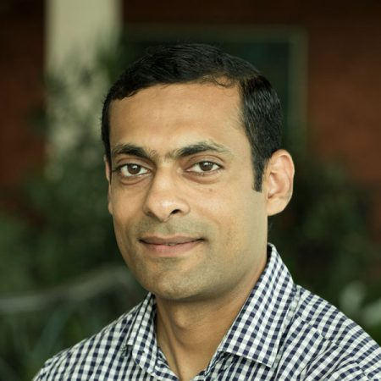


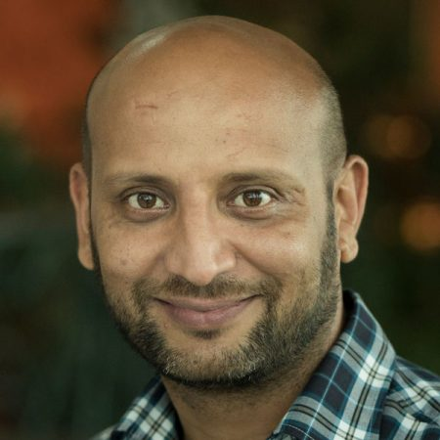
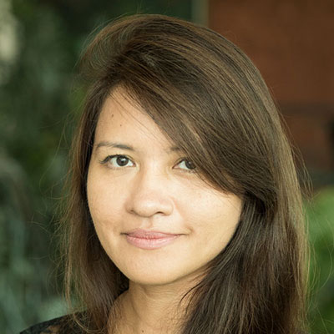



The Team
Notes:
We are taking a new collaborative approach towards how we develop and maintain our relationships with APAC partners.
We hope this will break down silos and further our reach and enrichen our engagement with the community.
Importantly we're here to listen and share the concerns and opportunities from the APAC region with our colleagues and wider ISOC community.
We also have representation across all projects and initiatives in 2024 and have already planned for APAC specific activities.

Slide 15
APAC Activities in 2024
Connecting the Unconnected | Map Community Networks in the APAC region Providing CTU grants Organizing a connecting the unconnected policy roundtable, ideally in collaboration with a regional policy / regulatory event.
Fostering Peering Infrastructure | Implementing 50/50 vision Providing SPI grants Supporting regional IXPs
Measuring the Internet | Enhance the value and use of Pulse, especially to inform public policy development Advocating for organizations and countries to measure the resilience of the Internet at local/regional levels

Slide 16
APAC Activities in 2024
Countering Internet Threats | Counter major Internet fragmentation threats in the region. Participating in the Christchurch Call as one of a few technical community representatives
Guiding Constructive Internet Policy | Understand policy/legal approaches to intermediary liability in the APAC region and identify good policy approaches to contribute to a modern policy framework that governments and other stakeholders can use.
Extending Encryption | Prevent policies/laws in APAC region that would weaken encryption or the security of encrypted communications Prevent the introduction of mandatory client-side scanning for end-to-end encrypted communications.
Defending the Internet Way of Networking in the United Nations | Preserve the multistakeholder approach and reinforce the technical community as a trusted and expert partner through active engagement in IG processes in the APAC region.

Slide 17
APAC Activities in 2024
Policymaker Program | Bring the ISOC Policymaker Program @IETF to the APAC region to equip regional policymakers with technical insight
Empowering Internet Champions | Develop and empower skilled Internet champions in the APAC region to advocate for an open, globally connected, secure and trustworthy Internet. Attract Youth Ambassadors, Early Career Fellows, Mid Career Fellows from the APAC region Build and enhance our Alumni Network in the APAC region
Mobilizing a Strong Community to Protect the Internet | Members of the Internet Society's APAC community have access to resources, training, and engagement opportunities to adequately develop them as advocates within their communities to protect the Internet.
Recognizing Internet Pioneers | Identify APAC region Internet Pioneers and the human impact of their efforts

Slide 18
We look forward to continue working with, supporting and empowering you all in 2024 and beyond.

Slide 19
Thank you.

