Slide 1
The Effort to Combat Against
Manga Piracy
February 26, 2024,
AP* Retreat
MAEMURA Akinori (前村 昌紀)
JPNIC – Japan Network Information Center

Slide 2

Stop the piracy! https://www.abj.or.jp/stopkaizokuban

Slide 3
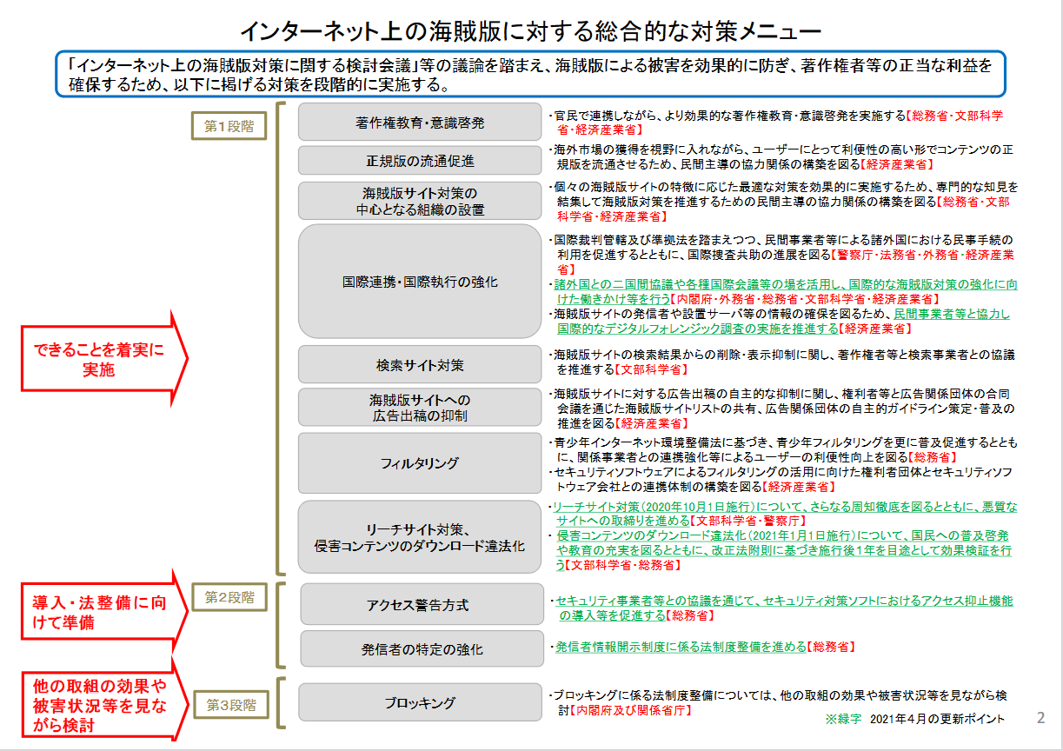
Comprehensive countermeasure lineup
against the piracies on the Internet (whole shape)
In 2020, by Cabinet Secretary’s Intellectual Property Strategy Division - 内閣府知的財産権戦略本部
https://www.kantei.go.jp/jp/singi/titeki2/chitekizaisan2020/pdf/kaizoku_taisaku.pdf

Slide 4
Comprehensive countermeasure lineup
against the piracies on the Internet (1/2)
Education＆Enlightenment about Copyright
To seek more effective education and enlightenment about the copyright (MIC, MEXA, METI)
Private sector led institutionalization of the distribution of authorized copies, exploring overseas market, with good usability (METI)
To maintain high expertise on addressing the piracies to take the best effective countermeasure for individual piracy sites (MIC, MEXA, METI)
To mobilize civil procedures in other countries and international cooperative investigation on the basis of international court jurisdiction and legislation(NPA, MOJ, MOFA, METI),
to mobilize bilateral coordination and international conferences to reinforce the international countermeasures for addressing the piracy (CO, MOFA, MIC, MEXA, METI),
to promote international digital forensic investigation cooperating with private operators (METII)
To promote the cooperation between copyright holders and search engines on the deletion and suppression of search result of the piracy sites
To promote sharing the piracy site list and establishing guideline of advertisement bodies on suppressing the advertisement on the piracy sites
Promoting the distribution of authorized copies
Central Institution of addressing the piracies
International Cooperations including law enforcement
Search Engines
Suppression of advertisement revenue of the piracy sites

Slide 5
Comprehensive countermeasure lineup
against the piracies on the Internet (2/2)
Filtering
To promote the filtering for the junevile based on the act for Internet Environment for the junevile (MIC) and to institutionalize the cooperative actions between security software venders and copyright holder association (METI)
To thoroughly deploy addressing leech site and enforce the mal-intended sites (MEXA, NPA) and to promote, enlighten and educate the citizens on the illegalization of the downloading of pirated contents (enacted in October 2020, in effect in January 2021) (MEXA, MIC)
To promote the access suppression by security software in cooperation with the security operators and venders (MIC)
To promote the legislation of disclosure of sender information (MIC)
Legislation of content blocking is to be considered with careful observation of the effect by the other countermeasures and the trend of loss
Addressing leech sites & illegalizing the downloading of pirated contents
Access alert
Reinforcement of identification of senders
Content Blocking

Slide 6
Endeavors by multistakeholder “fight against piracy” team
Publishers’ Alliance “Fight Against Piracy” Conference
  Government, Publishers, ISPs, Engineers, JPNIC
  Monthly regular meetings
Multi-directional endeavor to address the manga piracy
  Law Enforcement - especially in the other countries,
  CDNs, Search Engines, Domain Name Registrars
  Maintains “Top 20 piracy sites” and keep track of the situation

Slide 7
Call for Cooperation to address the piracy
Publishers are now in cooperation with Government, JPNIC, ISPs, Law Enforcement Agencies, Diplomatic Channel, … 360 degree approach to effectively suppress the piracy
The piracy operator may be not in Japan but in another countries

Slide 8
Thank you very much!
The Effort to Combat Against Manga Piracy
February 26, 2024
AP* Retreat
MAEMURA Akinori (前村 昌紀)
JPNIC – Japan Network Information Center

